Slide 1







SUSPECTED CANCER: RECOGNITION AND REFERRAL
Neil Smith 2015

Slide 2


Slide 3


Slide 4


Slide 5


Slide 6


Slide 7
PROGRAMME SUSPECTED CANCER: RECOGNITION AND REFERRAL
12-1.00 | Lunch | NS
1-1.20 | Introduction to NICE guidance for cancer | NS
1:20-1:30 | Challenges and plans | JB/LS
1:30-1:50 | Improving the process | NS
1:50-2:20 | Updates on referral forms | NS
2:20-2:40 | Participant feedback | G.P.s
2:40-2:50 | Blood test | NS
2:50-3:00 | Future plans | NS

Slide 8
QUESTIONS TO ANSWER
NEIL- How can I help to make this work?
COMMISSIONERS- How can we afford and plan?
HOSPITAL- How can we survive the demand?
G.P.s
When should we think cancer?
What should we do?

Slide 9

CANCER FACTS
>300,000 new cancers per year UK
>200 different cancer types
>1/3 people will develop cancer
Considerable variation in referral and investigation for possible cancer
Identification usually happens in primary care
UK poor cancer outcomes due to late diagnosis

Slide 10

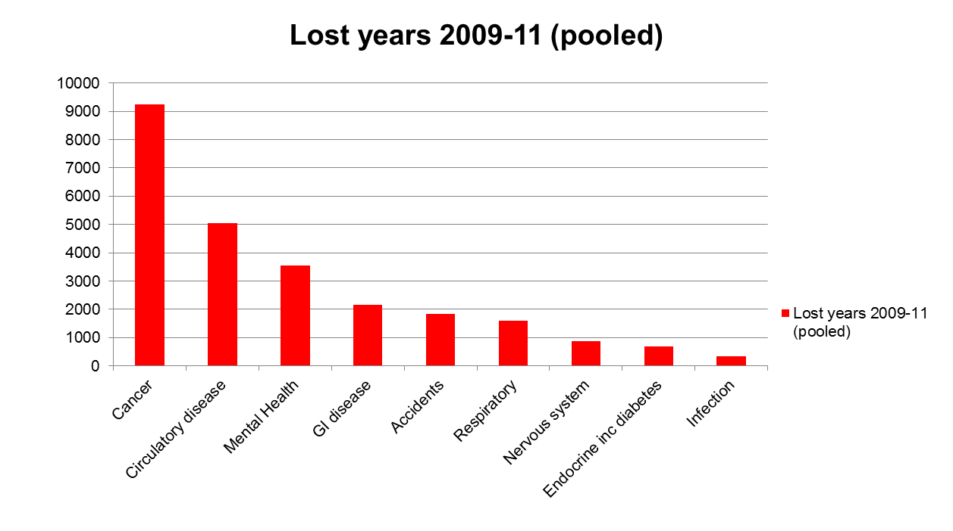
Cancer – where are we?

Slide 11




Notes:
NICE not Nice.

Slide 12

Referral Guidance for Suspected Cancer
Department of Health (2000) guidelines
NICE guidance 2005
11 tumour sites & Cancer in Children and Young Adults
Ovarian Cancer 2011
NICE Updated 2015
http://www.nice.org.uk/guidance/NG12/chapter/1-recommendations
Notes:
Background, history of cancer referral guidance

Slide 13


TELEGRAPH 23/06/15
GP delays referring cancer patients are costing 10,000 lives a year, NICE warns
Family doctors to be issued with checklist of symptoms to help them spot cancer quicker in a bid to prevent at least half of needless deaths.
Notes:
Media storm puts pressure on G.P.s

Slide 14






2WR and the realities of G.P.

Slide 15




Riding the wave of cancer or getting wiped out by it?
Notes:
Riding the wave of cancer or getting wiped out by it?

Slide 16

OPPORTUNITIES
Earlier diagnosis, earlier stage, earlier treatment
Saves lives, increased survival
Saves money (NHS & society)
Supports G.P.s thinking cancer and acting consistently
Reduce emergency admissions
Evidence based (including primary care)
Direct access to diagnostic test for G.P.s
Standardised 2WR
Redesign pathways
Patient information, support & safety netting

Slide 17

>4000 pages (summary 94) “an unintelligible bowl of spaghetti”

Slide 18
THREATS
Workload & responsibility
Risk litigation
Patient expectation
Swamp the system (matched resources)
Increase inequalities (worried well and younger)
Over-investigation (Ulysses effect)
Vague symptoms
No links to risk assessment tools
Potential delay diagnosis & targets not met
Potential delay access for other conditions

Slide 19
RISK FACTORS FOR NICE
Only includes risk factors that significantly influence the chance of symptoms being predictive of cancer
SMOKING (lung)
AGE (most cancers)
ASBESTOS EXPOSURE (mesothelioma)

Slide 20
CONSIDERATION & EXPECTATIONS
“While guidelines assist the practice of health care professional, they do not replace their clinical knowledge and skills.”
Appropriate history and examination.
Simple investigations (FBC, ESR, urinalysis)
"Unexplained"-
as at end of basic history, examination, investigations.

Slide 21
OVERVIEW of CHANGES
Threshold level of risk reduced from PPV 5% to 3%
Layout by site of possible cancer & symptom
Direct access investigations (OGD, US, CT, FOB)
Strength of recommendation- (offer v consider)
Timings very urgent e.g. 48 hours for children
Patient information, support and safety netting

Slide 22


If you received a safety recall notice explaining that there was a fault with your car that had over a 1/33 chance of breaking down and potentially killing you, would you take your car to be checked?

Slide 23
PATIENT SUPPORT- INFORMED DECISION
Discuss potential risk and benefit
Explain they are being referred to a cancer service (most people referred do not have cancer)
Information on possible diagnosis (benign & malignant)
Where, when, what, who

Slide 24
SAFETY NETTING
Responsibility for reviewing and acting on results of investigation.
Awareness false negatives (CXR and FOB)
Review for risks lower than meet criteria to investigate or refer.
Explicit symptoms & time frame.
"Concerned, recurs, persists or worsens."

Slide 25
CANCER LIS 2016/17 PROPOSAL
Support practices in making changes.
Use resources and “best practice guidance”
Ensure safety netting process in place e.g. acting on abnormal test results
Update referral forms to reflect new NICE guidance & get rid of old ones
Encourage patient engagement
Audit 2WR referrals and offer prevention messages to those without cancer

Slide 26


Slide 27

Challenges for deliver of new NICE guidance
Capacity
Workforce & equipment planning
Achieving current cancer targets
Other cancer demands
Developing new services and pathways
7 day working
Implications to other services

Slide 28
Challenges for commissioning new NICE guidance
Estimating impact and enhanced demand
Financial modelling
Finding increased capacity
Change management
Patient expectation
Education
Support to primary care

Slide 29



Pennine Lancashire Plan
Working collaboratively for over 1 year
Clinical and managerial engagement
G.P. and Consultant feedback
New referral forms – aiming to complete by 31/3/16
Cancer LIS supporting referrals and safety netting 1/4/16
Develop improved access to urgent investigations 2016
Regularly update primary care

Slide 30


Slide 31
DIAGNOSTIC PROCESS- NICE RECOMMENDS:
Use proforma
Include appropriate information
Refer within 1 working day
Discuss with a specialist if uncertain (interpretation finding, not classical)
Policy on DNA and cancellations
Consider impact on none urgent appointments
Continuing education, peer review
Skills: communication; clinical consulting; reasoning and diagnostics.
Notes:
Not changed – same as guidelines from 2005

Slide 32
RESOURCES
RCGP- courses E learning module- under development
NICEhttp://www.nice.org.uk/guidance/NG12/chapter/1-recommendations
NICE resources http://www.nice.org.uk/guidance/ng12/resources
CRUK- summary http://www.cancerresearchuk.org/health-professional/learning-and-development-tools/nice-cancer-referral-guidelines
Macmillan- Rapid referral guidelines http://www.macmillan.org.uk/Documents/AboutUs/Health_professionals/PCCL/Rapidreferralguidelines.pdf
GP update http://www.gp-update.co.uk/The-GP-Cancer-Update-Course
NB Medical Education –Hot Topics http://www.nbmedical.com/hot-topics
BMJ http://www.bmj.com/content/351/bmj.h3640

Slide 33
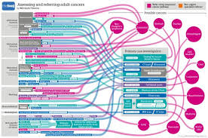
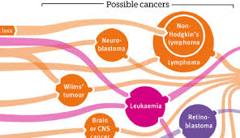
Notes:
BMJ flow charts- more spaghetti.

Slide 34


Slide 35
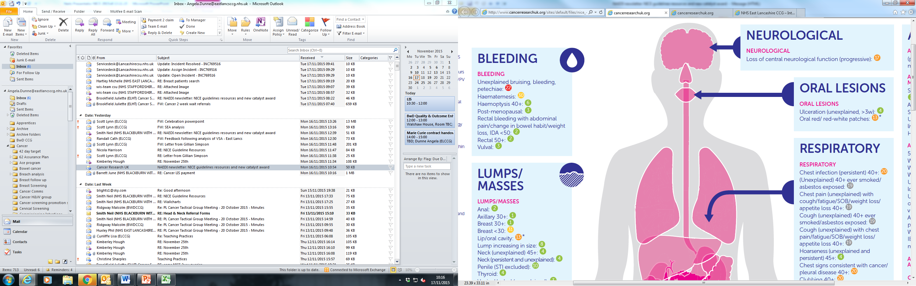

Slide 36
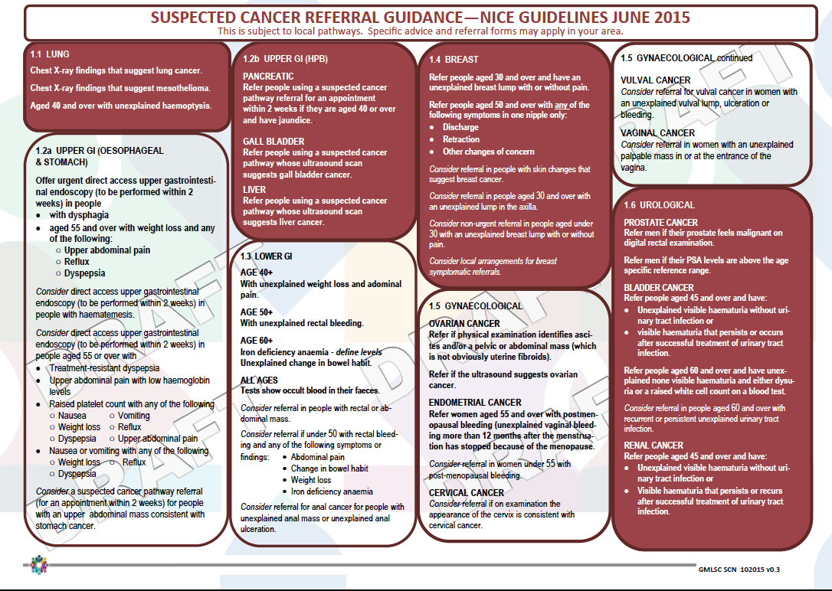

Slide 37

IMPROVEMENT TO 2WR REFERRAL FORMS FOR PENNINE LANCASHIRE
NICE wording and criteria
2WR 2016 incorporating 2015 NICE guidance
Links to Map of Medicine and NICE guidance

Slide 38
CAPTURING DATA
Templates embedded in EMIS web
Input referrer’s name and date of referral
Demographics automatically included
Please E mail rather than fax
Would any one object to moving away from having faxed referrals?

Slide 39
IMPROVED PATIENT ENGAGEMENT
Please check that the patient’s address and daytime contact number are up to date. If any of the details have changed please add here:
Has the patient been informed that this is an urgent referral and they need to attend an appointment within 2 weeks and this may be at BGH, RBH or Rossendale PCC?
Has the patient been given a 2 week referral information leaflet explaining the risk of cancer?

Slide 40
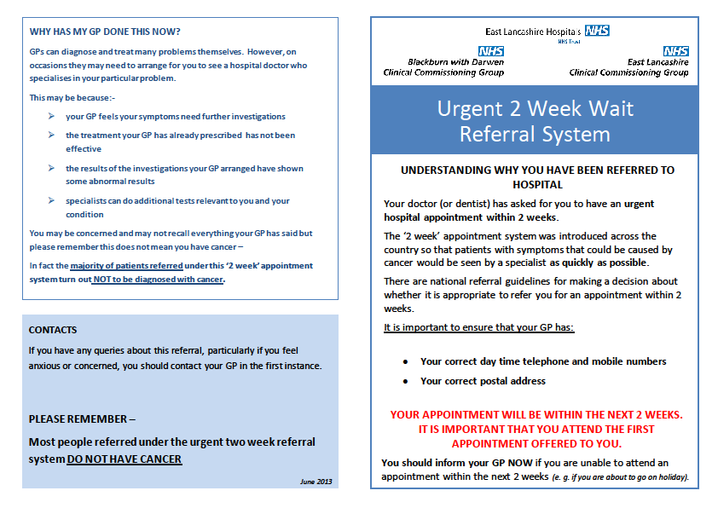

Slide 41
CAPTURING CLINICAL INFORMATION
Please ensure you have closed the last consultation
before completing this form. This will enable the
clinical information you have written to populate the
space below
Consultations
Problems
Medication
Allergies

Slide 42
IMPROVING SAFETY
Is the patient currently taking anti-platelets or anticoagulants (warfarin or new oral anti coagulants)
If ‘Yes’ please ensure the name and dose is captured on this form in the medication section or write this in the box below:
___________________

Slide 43
IMPROVING INFORMATION
COMMENTS BOX
Narrative
ICE –patient and G.P.
Results, family history
Risk assessments
Why you want the patient to be seen

Slide 44
SPECIFIC LOCAL GUIDANCE AND PATHWAYS
Lung pleural clinic
Jaundice and IDA
Direct to flexible sigmoidoscopy
Urgent USS in ovary and endometrial
MSSU and PSA in urology
BCC in skin
Soft tissue sarcomas to Preston
Children seen within 48 hours

Slide 45
RELATED REFERRALS THAT ARE NOT 2WR FORMS
Routine Endoscopy
Macmillan Move more
Familial Risk Breast cancer
Breast symptomatic

Slide 46
12 TUMOUR TYPES 16 REFERRAL FORMS
Lung
Upper GI (2a OeS, 2b HPB, 2c IDA)
Lower GI (3a Lower GI, 3b Rectal Bleeding)
Breast
Gynaecology
Urology
Skin
Head and Neck
Brain/CNS
Haematology
Sarcoma (11a bone, 11b soft tissue)
Childrens

Slide 47


Slide 48
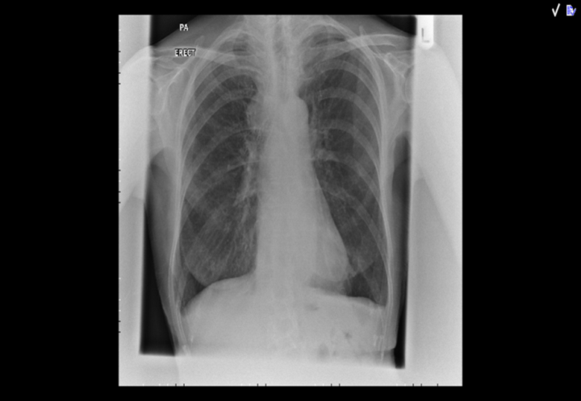
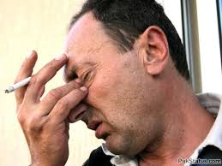
1. Lung
Highlights asbestos exposure as risk factor
Still do CXR first and refer if findings that suggest lung cancer or mesothelioma
Has CT been arranged by radiologist (subsequent to the abnormal CXR)
Directly refer if >40 unexplained haemoptysis
Pathway where pleural effusions go straight to
specialised clinic.

Slide 49

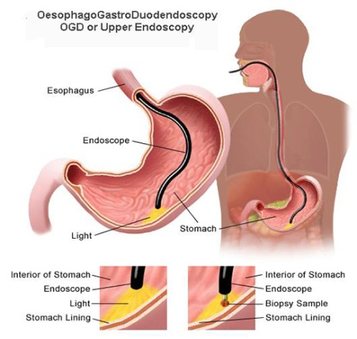
2a. Upper GI (Oesophagus & Stomach)
UDUGIE - Urgent Direct access Upper
Gastrointestinal Endoscopy
If results are normal or reveal minor changes, the patient will be discharged to GP for further primary care management.
If serious pathology is identified, appropriate follow-up will be arranged automatically by the hospital.
Upper abdominal mass consistent with stomach cancer endoscopy seen in a consultant clinic
Refer all dysphagia
Over 55 years of age and symptomatic

Slide 50

2b. Jaundice & Unexplained Upper Abdominal Mass (HPB)
Refer all jaundice (clinical & raised bilirubin)
LFTs, alcohol from EMIS system
Form leads to urgent USS in consultant clinic
Suspicious urgent CT and MDT
Direct link to HPB team
Not suspected cancer (gall stones) back to G.P.

Slide 51

2c. Iron Deficiency Anaemia
The patient should have a NEW UNEXPLAINED Iron Deficiency Anaemia
Definition :- Anaemia (Hb<120g/l male: <100 g/l female) and iron deficiency (MCV<79 or low ferritin or low iron saturation)
Please refer all - men and non-menstruating females
menstruating females if they have: GI symptoms, Age 50 or over or strong family history of GI cancer
Pathway where patients undergo CNS triage and have both upper and lower GI investigations

Slide 52

3a. Lower GI
Likely to have biggest impact on demand and capacity
FOBs not available at present
Generally lowering threshold for referral
If you are significantly concerned, yet the patient DOES NOT meet the criteria, still refer under 2WR, but state your reasons.

Slide 53
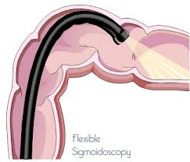
3b. Rectal bleeding
Unexplained rectal bleeding WITHOUT anal pain
These patients will be referred directly for a sigmoidoscopy. Please issue a prescription of 2 sachets of Moviprep with the information leaflet embedded at the end of this form.
Does anyone disagree to prescribing bowel prep for these patients?

Slide 54
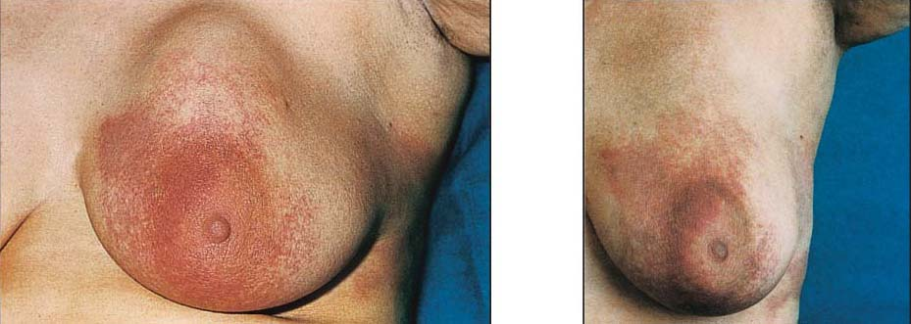
4.Breast
Separate forms not 2WR
Other breast symptoms
Familial risk
Refer 2WR
>30 unexplained breast lump
>50 one nipple discharge/retraction/concern
Can draw where lump is on grid
Notes:
Symptomatic breast disease is different that suspected cancer but also need to be seen within 2 weeks.

Slide 55
5. Gynaecology- Ovarian
Measure serum CA125 in ...Persistent abdominal distension ....‘bloating’)....?TATT
Local guidance recommends referring if the CA125 >30 and, at the same time, arrange an urgent US scan using the Red Cross system on ICE, including the information that the patient has been referred on a 2WR pathway.

Slide 56
5. Gynaecology - Endometrial
Refer women aged 55 and over with postmenopausal bleeding
Local pathway recommends arranging an urgent US scan using the Red Cross system on ICE including the information that the patient has been referred on a 2WR pathway

Slide 57
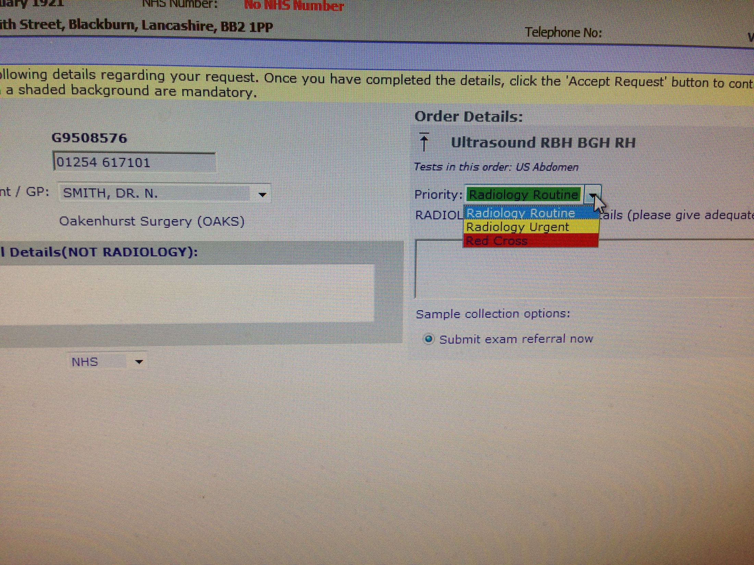
Notes:
Ordering an urgent USS, click on priority and highlight red cross.

Slide 58
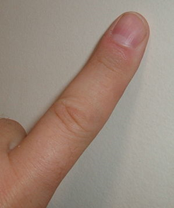
GP Secret Weapon

Slide 59

6. Urology Clinics in Accrington & Clitheroe
DRE- for LUTS, haematuria & ED
Refer men if their prostate feels malignant on digital rectal examination (“hard and knobbly”)
If the PSA is marginally above the age specific range (<10ug/l) and the Prostate feels benign then repeat the test after 2 to 4 weeks and only refer if still elevated. (If PSA >10ug/l or prostate feels abnormal refer immediately)
To delay PSA testing until 1 month after a urinary tract infection or urinary retention unless the Prostate feels frankly malignant.
Not to routinely test PSA in men over 80 unless they have symptoms or signs suggestive of progressive / metastatic disease or they have a life expectancy of >10 years
Take an MSSU and, if positive treat with antibiotics. If the test is negative and the haematuria remains unexplained please refer.
CONSIDER referring >60y recurrent unexplained UTI

Slide 60
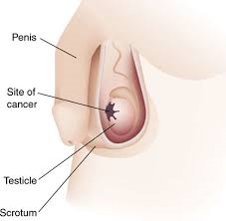
Testicular
Consider a direct access ultrasound scan for testicular cancer in men with unexplained or persistent testicular symptoms.
Refer men with an ultrasound result that suggests testicular cancer
Consider referral in men if they have a non painful enlargement or change in shape or texture of the testes.

Slide 61
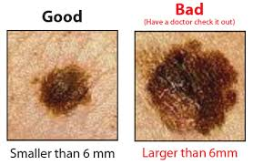
7. Skin Most go to dermatology Head, Neck, Face (head &neck /ophthalmology)
Melanoma score 3 or more on 7 point weighted check list
Dermatoscope suggest melanoma
CONSIDER referral for SCC
Low risk BCC not 2WR- refer routine to GPSI
Local guidance recommends only refer high risk BCC- lesions with a rapid rate of growth or on the upper eyelid
Notes:
Care not to overwhelm the system

Slide 62
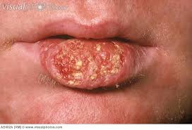
8. Head & Neck smoking, alcohol, FH important
Consider
Persistent unexplained hoarseness
Unexplained lump in neck
Unexplained ulceration in the oral cavity >3 weeks
Lump on lip or in the oral cavity
Red or red and white patch in the oral cavity
Unexplained thyroid lump
Notes:
Likely to be large increase in numbers or head and neck referrals

Slide 63
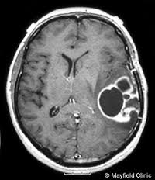
9. Brain/CNS 2WR finds <1% brain tumours
All old specific guidance has gone!
NICE recommends: Consider urgent MRI scan to be performed within 2 weeks in adults with progressive sub-acute loss of central neurological function.
NO REFERRAL FORM
NOT HELPFUL -?ADMIT
Ongoing local agreement G.P. Request CT scan in high risk groups
New onset headache over 50y
Absence of a diagnosed primary headache disorder

Slide 64
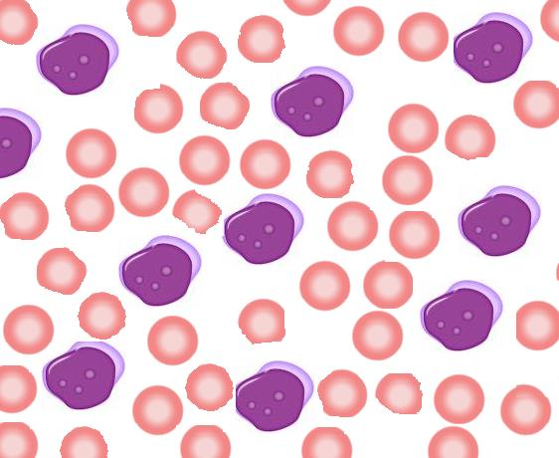
10. Haematology leukaemia, multiple myeloma, lymphoma
LEUKAEMIA
Refer urgently/admit if FBC indicates acute leukaemia
Local guidance is to admit to Medical Assessment Unit
Developing local guidance e.g. pathway to include urgent biopsy of LN prior to haematology review

Slide 65
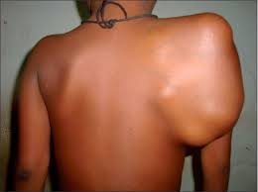
11. Sarcomas Soft tissue refer to Preston
11a Bone sarcomas -consider referral if X ray suggest possibility of bone sarcoma
11b Soft tissue sarcoma - Consider an urgent direct access ultrasound scan in adults with an unexplained lump that is increasing in size arrange
Consider referral if US findings suggestive of soft
tissue sarcoma or US findings are uncertain and of clinical concern

Slide 66
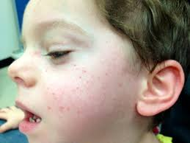
12.Children 15 years and under
Immediate referral petechiae, hepato-splenomegaly (admit)
Paediatrician referral within 48 hours for symptoms and signs (seen hot clinic or CMAU).
Consider safeguarding (clinical features of maltreatment).
Give information to the child.
Consider paediatric referral for persistent parental concern.

Slide 68
G.P. Feedback - How can referral forms be improved?
Generic comments: Are there any changes/amendments/improvements that could be made to the generic elements of the 2WR templates (e.g. patient demographics, information or discussion with patient, information that is drawn from EMIS system)
Comments: 1. 2. 3.
Tumour specific comments: Please indicate any issues/amendments/suggestions relating to specific tumour referral templates (e.g. your suggestions to improve the referral process for lung or gynaecology)
1. 2. 3.
Wallchart comments: Please indicate any issues/amendments/suggestions relating to the wallchart
1. 2. 3.

Slide 69
G.P. CONSENSUS OPINION
 |  |  | Comments
Should CCGS support practices to implement new NICE guidance as part of the cancer LIS 2016? | YES | NO
Do you agree that referrals should be submitted electronically and phase out the use of faxes? | YES | NO
Do you agree to the production of ‘Best Practice guidance for investigations and referrals for suspected cancer’. | YES | NO
Do you agree to the cancer team contacting and supporting practices to employ the Best Practice guidance? | YES | NO
When do you want the release of the new referral forms? | In stages, as each one is ratified | All together, aiming for March 2016
How many days after the receipt of a practice initiated test result should the result be viewed by the practice? | 1 2 3 4 5 6 7
How many days after viewing a test result that indicates a suspected cancer should the practice take action? e.g. make a referral, contact the patient etc. | 1 2 3 4 5 6 7

Slide 70


Slide 71
Notes:
If a G.P. does a test first (FBC, CXR, PSA, USS) the conversion rate is higher

Slide 72

When to arrange urgent FBC & ESR
Persistent back pain>60
Persistent bone pain>60
Fracture (unexplained) >60
Notes:
Could this be due to multiple myeloma or boney secondaries.

Slide 73
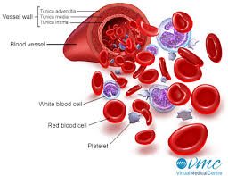
When to arrange urgent FBC (48h)
Unexplained bruising, bleeding, petechiae
Pallor
Persistent fatigue
Unexplained fever
Unexplained infection persistent/ recurrent
Hepatosplenomegaly
Notes:
This is likely to be available already

Slide 74

THROMBOCYTOSIS
Raised platelet >450 (2.5% normal population)
Strong association with cancer (up to 40% risk)
Especially lung, oesophageal, endometrial
NICE recommends for unexplained thrombocytosis
>40 consider CXR
>55 + n/v/wt loss/reflux/dyspepsia/abdo pain consider UDUGIE
>55F + haematuria/ vaginal discharge consider uUUS

Slide 75
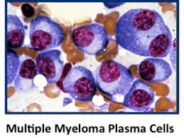
Multiple myeloma
>60 persistent bone pain, particularly back
pain or unexplained #
Offer FBC, Ca, ESR
If Ca^ or leukopenia or ESR^ offer very urgent BOTH protein electrophoresis & Bence-Jones protein urine test
Developing new lab pathway linking high Ca & ESR with electrophoresis, G.P. can ask for additional test within 3 days first, turnover within 48 hours.
REFER if protein electrophoresis or Bence-Jones protein urine test abnormal
Notes:
Multiple myeloma is a challenging cancer to diagnose in primary care. Often multiple G.P. appointments and long delays until discovered.

Slide 76
CHILDREN & YOUNG ADULTS
INVESTIGATIONS
FBC (48h) for unexplained
bruising/bleeding/pallor/lymphadenopathy/
fever/ infection/ fatigue
Contact numbers to arrange urgent blood tests
01254 733216 01282 804837
?ADMIT if unwell

Slide 78
NEXT UPDATE
Urgent and routine scans
FOB
More on anaemia
Abdominal or Pelvic Pain
Weight Loss
Appetite Loss
Fatigue
DVT
Risk Assessment Tools

Slide 79
WHAT DO YOU WANT IN FUTURE
Another event like this?
Detailed information circulated?
Webinar?
Newsletters with brief outline?
Plans for cancer resource folder on EMIS web and CCG/practice web sites

Slide 80

Thank you

