Slide 1
Every 30 seconds a lower limb is lost somewhere in the world as a consequence of Diabetes.
The Lancet Volume 366
Issue 9498

Slide 2
Diabetic Foot Screening
Pathways, Posters and Leaflets
Produced by:
Foot and Lower Limb Working Group
Approved by:
East Lancashire Diabetes Network Clinical Standards Group
Approved for use in:
Lancashire Care
East Lancashire Hospitals NHS Trust

Slide 4
LOW RISK
Protective sensation intact
(10g pressure)
Optimise diabetes and blood pressure control (<139/80)
Foot education/Low risk leaflet
Podiatry only for problems

Slide 5
MODERATE RISK
Loss of protective sensation
No deformity
No callus
No previous ulcer
Optimise diabetes and blood pressure control (<139/80)
Foot education/Moderate risk leaflet
Consider Consultant opinion
Footwear advice and assessment
Regular Podiatry (12 weekly)

Slide 6
HIGH RISK
Loss of protective sensation
Deformity and/or callus present
No previous ulcer
Optimise diabetes and blood pressure control (<139/80)
Foot education/High risk leaflet
Consultant opinion
Specialist prescribed Footwear/Shoe review
Regular Podiatry (4 – 12 weekly)

Slide 7
Very High Risk
Loss of protective sensation (10 g pressure)
Ulcer present or
Previous ulcer
Optimise diabetes & blood pressure control (<130/80)
Foot education leaflets/ very high risk leaflet
Consultant opinion
Specialist prescribed footwear / shoe review
Regular podiatry and review
(1-4 weekly)

Slide 8
Arterial Disease
Abnormal flow
+/- History of claudication
If you suspect acute vascular insufficiency
telephone: 07793 119344
Optimise diabetes & blood pressure control (>139/80)
Prescribe aspirin/statin
‘Stop smoking and keep walking’
Foot education/leaflet
Consider consultant opinion
Specialist prescribed footwear /shoe review
Regular Podiatry especially nail care (1-12 weekly)

Slide 10
Annual Screening Review
Advice and Urgent Assessments:-
Screening referrals:- fax 617287
phone 282708
Podiatry Referrals: – Local Health Centres
Footwear: – Initial supply – Consultant referral
Repairs and renewals:
Blackburn – 01254 734040
Burnley -- 01282 804602
Hot Foot Line: – Blackburn 07866684362

Slide 11
Referral Pathways For The Diabetic Foot
Referral for Urgent Problems
Referral for Non-urgent Problems
Referral for Diabetic Footwear
Urgent Patient
Non Urgent Patient
New patient
Existing patient
Referral letter, or fax (01254 736032)
Dr G.R. Jones, Diabetes unit, RBH
Prescribed footwear
Same Day Referral
Letter of Referral to
Dr G.R. Jones, Diabetes unit, RBH
Continue treatment until Outpatient Appointment
Ring :-
Diabetes Hot Foot line
07866684362
Orthotics
RBH 01254 294040
BGH 01282 804602
Orthotics
RBH
01254 294040
BGH
01282 804602
Condition becomes urgent refer via RED Pathway

Slide 12
Ulceration/Hot Foot
REFER patients to a multidisciplinary foot care team within
24 hours if any of the following occur:
new ulceration (wound)
new swelling
new discolouration (redder, bluer, paler, blacker, over part or all of foot).
(NICE Guideline – Type 2 diabetes: prevention and management of
foot problem)
REFER non-healing wounds from 0 – 4 weeks duration

Slide 13
The Diabetic Foot Clinics
Since 1987 to heal foot ulceration
Multi-disciplinary team
Out Patients – Shorter or no admission
One stop clinic with holistic care
Management plan/ Shared care
Reduced no of amputations
Maintain patients independence
Easy accessibility

Slide 14
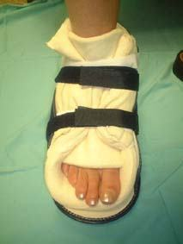
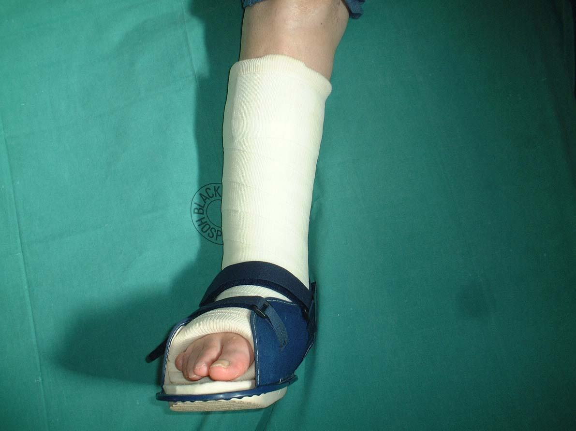
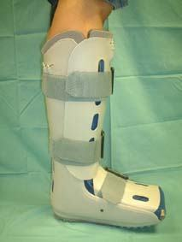
The Diabetic Foot Clinics
Pressure Relief

Slide 15
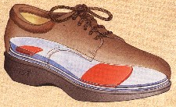
The Diabetic Foot Clinics
PRESCRIBED INSOLES AND FOOTWEAR CAN PREVENT FOOT PATHOLOGY

Slide 16
The Diabetic Foot Clinics
Ulcers are healed
Shoes and insoles are fitted/Lifelong review
Discharged back to you
Refer back at any time

