Slide 1






WELCOME G.P. Cancer event 10/4/18
Neil Smith

Slide 2

Slides and handouts*
gpteamnet.co.uk
clinical support/cancer
Or search in library

Slide 3
CHALLENGES OF G.P. & CANCER
Gatekeeper V Increased referrals = better survival
Rare presentation V Presents with common symptoms
Easy to miss V Catastrophic consequences
Shift demand V Lack resources
Evidence of what is best V No service
Specific pathways V Very narrow, inflexible
Generalist with expertise V Hospitals too specialised

Slide 4
Good news! You are making a difference!

Slide 7
2WW REFERRALS INTO ELHT (Source: ELHT)

Slide 8
QUALITY OF REFERRALS

Slide 9
2 week wait referrals for suspected cancer
Cancer LIS 2018/19
2018 all referrals electronic
Most already using E referral system
18,000 2ww to ELHT
Sorry- updated forms needed
Minimal impact G.P.s
Cancer champion/ managers/ secretaries training event 24/4/18

Slide 10
HELPING PATIENTS ENGAGE
Do the appropriate tests before or at the time of referral
Use the correct most up to date referral form and complete the clinical details
Inform the patient they are on a suspected cancer referral pathway
Give out patient information leaflets or cards
Stress the importance of attending to ensure it is a priority for them (e.g. changing holiday plans)
Advise them to accept the first available appointment whenever and wherever that may be
Offer extra support and checks for patients with cognitive difficulties

Slide 11
Cancer LIS 2018/19
Cervical Screening #25itstime -Cancer champions telephone offer appointments.
Bowel Cancer Screening practice endorsement banner, re-order kits opportunistically, review patients with positive result.
Significant Event Audit – Lung cancer.
Diagnostic tests for suspected cancer- urgent USS and CT for suspected cancer. New FIT for bowel cancer.
Referrals for suspected cancer- Establish E Referral system, new “vague symptoms” pathway.
Prostate cancer – audit patients, appointments and zoladex to help improve follow up.

Slide 12

61 year old man has just retired.
Infrequent attendee.
One of his friends has recently been diagnosed with prostate cancer.
His partner has encouraged him to get a test.
What would you do?

Slide 13
Prostate Cancer
Most common cancer in men (1/4 all male cancers)
Increases with age- so is rising as population ages
Men have 1/8 chance of having prostate cancer
84% survive >10 years, continues to improve
Risks: age; black ethnic origin; family history, obese (no modifiable risk factors)

Slide 14
PROSTATE CANCER- NICE Guidelines
Act on lower urinary tract symptoms
Nocturia, urinary frequency, hesitancy,
Urgency, retention, haematuria
Erectile dysfunction
Ensure not UTI
DRE- digital rectal examination
PSA test (no ejaculate or vigorous exercise <48h)

Slide 15
PSA screening- not a good enough test
PSA - one off blood test 50-69y
(CRUK trial 2018- 400,000 men)
Found more prostate cancers
Did not save any more lives
Picks up cancers that unlikely to cause harm
Misses aggressive cancer

Slide 16
Not sufficient evidence to justify population based PSA screening
Over investigation/ diagnosis/ treatment
Anxiety of cancer, and side effects –incontinence, erectile dysfunction- for decades
Significant risk of testing asymptomatic patients- men need to make informed decision

Slide 17
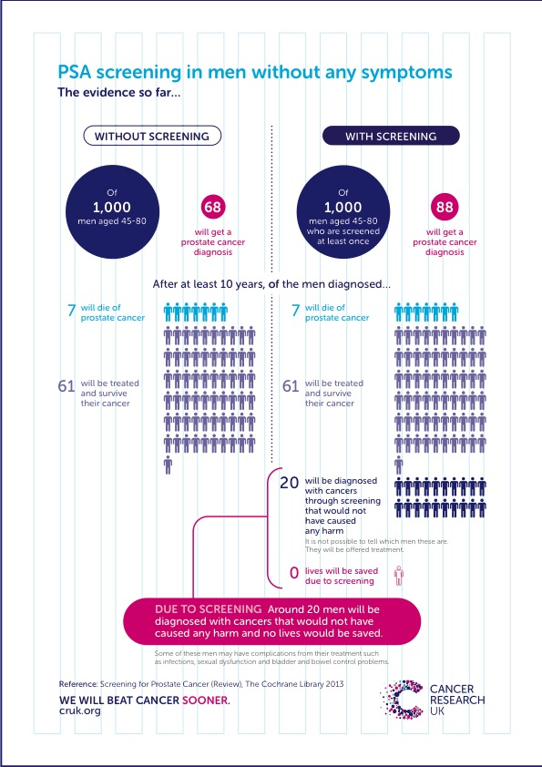
No lives saved
2% over-treated
Act on symptoms!

Slide 18
What should a G.P. do? Act on symptoms
Do not proactively raise issue of PSA testing with asymptomatic men
If asked- discuss pros and cons (CRUK, PCUK)
Consider higher risk group: black ethnic origin (x2) family history, obese
Offer PSA men over 50 if they make informed decision- + DRE
Option- if <2 lifetime risk is v low and not repeat

Slide 19
Future opportunities for Prostate Cancer
Prostate cancer UK recommends refer all men with PSA >3 (not age related threshold)
Baseline PSA could predict future cancer risk
Proposed screen aged 60 PSA <1 reassure, PSA >3 continue screening, PSA 1-3 individualised decision
Research into distinguishing potentially lethal prostate cancers
MRI scanning - map out size, location and potential aggressive cancers/ reducing painful biopsy.

Slide 20
CONSULTANT VIEW- PROSTATE Mr Mohan-Pillai
What does a malignant prostate feel like?
Does a DRE interfere with PSA result?
What to do about haemospermia?
Potential of MRI as diagnostic tool?
Stratified risk follow up of prostate cancer survivors- who will be discharged to G.P.?
When to refer (local recommendations)?

Slide 21
Refer men if their prostate feels malignant on digital rectal examination
Refer men if their PSA levels are above the age specific reference range
Elevated age specific PSA with life expectancy > 10 years Age 50 – 59: =/> 3.5
60 – 69: =/> 4.5
70+: =/> 6.5
Local guidance recommends:
if the PSA is marginally above the age specific range (<10ug/l) and the Prostate feels benign then repeat the test after 2 to 4 weeks and only refer if still elevated.(If PSA >10ug/l or prostate feels abnormal refer immediately)
To delay PSA testing until 1 month after a urinary tract infection or urinary retention unless the prostate feels frankly malignant.
Not to routinely test PSA in men over 80 unless they have symptoms or signs suggestive of progressive / metastatic disease or they have a life expectancy of >10 years

Slide 22
PROSTATE FOLLOW UP REDESIGN
Cancer LIS 2018/19
Inform risk stratified follow up prostate cancer
Establish a PSA follow up system for low risk patients.
Understand primary care workload
Improve patient care
EMIS Search
All patients with malignant neoplasm of prostate B46
Number diagnosed within the last year
Number of G.P. consultations in last year.
Number of zoladex injections in last year

Slide 23
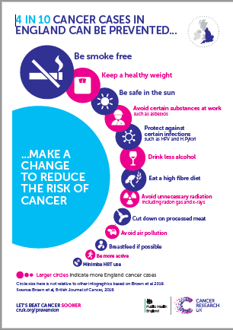
Smoking causes
>15% of all cancers
>50,000 avoidable cancer deaths per year in UK
+ CVD

Slide 24
A 38 year old man attends for the first time with a productive cough
He smokes 20 cigarettes daily
In the real world as a G.P. how can you assess his dependence and offer very brief advice?
What should you say if he asks about E cigarettes?

Slide 25
LUNG CANCER
SMOKING
24x risk lung cancer
Passive smoking increases risk by 25%
Shortens life by 11-12 years
Quitting <30y almost normalises life expectancy, <40y reduces risk by 90%

Slide 26
SMOKING CESSATION
Reduces not only cancer risk
Depression, anxiety, quality life improved
Harm reduction- cut down help on path to quit
Success without support 3-5% at 12 months
Brief intervention increases this by 66%
Add in drugs and increases by a further 100%
Regimes have equal effect (nicotine patch OR varenicline OR combination) 20% success at 12 m

Slide 27

What should a G.P. do?
Dependence high if early fag on waking,
smoking >10 daily and cravings on withdrawal
Motivation to change?
Very brief advice- 30 seconds
ASK- I see you are a smoker- how is that going?
ADVISE- recommend support and drugs
ASSIST- refer smoking cessation service
BUT local authority funding crisis!

Slide 28
Consultant view- Lung Cancer Dr Fawad Zaman
Please can you tell us more about E cigarettes:
What evidence is there for their use?
Are they safe?
What should we say to patients?
Please share your work on speeding up diagnosis of lung cancer.
How can G.P.s help?

Slide 29
Pennine Lancashire Primary Care Cancer Educational Event
Dr Fawad Zaman
Lead for Lung Cancer ELHT

Slide 30
British Thoracic Society Tobacco Specialist Advisory Group January 2016
Electronic cigarettes
Notes:
E-cigarettes are increasing in popularity. Many smokers will have tried them – either as an aid to cutting down, or in addition to traditional cigarettes
Ongoing debate and legislation – which may differ across the UK - may shape how they are used by patients
This talk aims to review the current knowledge on the topic
[Possible introductory questions – How many of you have had conversations with patients about e-cigarettes? How many think they should be promoted to smokers as means of cutting down or quitting? How many think we should be able to prescribe them? How many think they should be allowed on the wards to help smokers abstain from tobacco? How many think they should be banned until we have more information? Etc]

Slide 31
Can e-cigarettes help people stop smoking?
Overall:
Participants using EC: 9% chance of quitting at 6/12
Participants using placebo: 4% chance of quitting at 6/12
RR 2.29, 95% CI 1.05-4.96
No significant difference: e-cigarette vs patch
RR 1.26, 95% CI 0.68-2.34
Bottom line:
E-cigarettes better than placebo
but
Quality of evidence rated ‘low’ due to small number of trials
Notes:
The Cochrane review found that use of a nicotine-containing EC was associated with higher abstinence rates than placebo EC.
The studies were judged to be at low risk of bias, but the overall quality of evidence was graded as ‘low’ due to the limited number of studies.
Of note, both studies used ‘1st generation’ ‘cig-a-like’ products, that were widely available at the time, but have both now been surpassed by newer models – difficult to make conclusions for alternative models, let alone the newer ‘2nd generation’ devices.
Source:
McRobbie et al (2014) – Electronic cigarettes for smoking cessation and reduction (Cochrane Review).

Slide 32
What are the risks of e-cigarettes?
Direct harms to users
Due to inhalation of vapour
Presence of contaminants (lack of regulation)
Other harms using products
Indirect harms to others
Passive exposure to vapour
Inappropriate use of products
Encouraging children to vape / smoke
Encouraging others to smoke (re-normalizing smoking?)
Notes:
A number of concerns have been raised about the use of e-cigarettes – the main concerns being:
Safety during ‘normal’ use, by inhalation of vapour
Lack of regulation leading to harmful contaminants
Safety in other situations, eg burns from concentrated liquid, fires from incorrect chargers
Passive exposure of others to vapour
Encouraging young people to take up vaping and/or smoking
‘Re-normalizing smoking’ so that current smokers are less likely to stop, and ex-smokers re-start

Slide 33
Are e-cigarettes safe?
Overall:
Nicotine – generally low risk of harm
Propylene glycol – seems safe
Glycerine – rare cases of lipoid pneumonia
Contaminants – potentially harmful but low amounts if used correctly?
Risk of fire with inappropriate chargers
E-liquids can cause toxicity with overexposure

Slide 34
What do the experts say?
Two camps
Supporters vs Opposers
Take population view: e-cigarettes could re-normalise smoking and reverse years of progress
Suspicious of tobacco industry motives
E-cigarettes offer a harm reduction approach to tobacco control.
Less harmful than conventional cigarettes for smokers
Notes:
There are experts on either side of the debate who have strong views one way or the other. The debate has been heated as both sides see the others arguments as counter-productive: for example, the views of ‘opposers’ on potential harms may be confusing the public about safety and preventing smokers from switching; similarly the enthusiasm of some ‘supporters’ may be encouraging the public to use e-cigarettes more and more, thereby increasing exposure to non-smokers who may not have been aware...
Jonathan Gornall, writing in the BMJ, characterised ‘pragmatists’ and ‘idealists’: the former often clinicians who had witnessed countless patients suffering from tobacco-related ailments and felt this could be prevented with a less harmful alternative, and the latter often public health workers who were fearful of the explosion of interest in vaping and the potential impossible-to-know impact on the wider population. Clearly this is a generalization, in that some clinicians remain strongly opposed to e-cigarettes, whereas the recent Public Health England document endorses them.
Simon Chapman, Professor of Public Health in Sydney, considered best and worst case scenarios in the BMJ in 2014. The ‘best’ scenario was a rapid switch of smokers to e-cigarettes, with vaping being a gateway out of smoking rather than gateway into it, and no long-term harms from vaping in follow-up studies – essentially, e-cigarettes leading to the end of tobacco. The ‘worst’ scenario was that vaping would take off hugely and become a common population behaviour, attracting many who would never have smoked, with the talk of low risk meaning that it was acceptable despite longer-term studies showing harms and many switching over to tobacco due to the greater nicotine ‘hit’. Like many, Chapman worried that the huge progress in reducing population cessation rates could be at risk by the role of e-cigarettes.
Sources:
Gornall (2015) Why e-cigarettes are dividing the public health community. BMJ. 350:h3317
Chapman (2014) E-cigarettes: the best and worst case scenarios for public health. 349:g5512

Slide 35
What should we tell patients?
E-cigarettes are not harm-free, but likely to be considerably less harmful than tobacco
They may help you stop smoking, although most evidence is currently with licensed products and behavioural support offered by the NHS
The best thing you can do for your health is stop smoking: if e-cigarettes can help you do this, then we would encourage this.
Notes:
The NCSCT (National Centre for Smoking Cessation and Training) advises that practitioners should be open to e-cigarette use in people keen to try them, especially those who have tried, but not succeeded, in stopping with licensed products such as NRT.
Providing advice and information on e-cigarettes is important. It may be useful to explain that there are a wide range of products available and people may need to try various brands or flavourings to find one that suits them, or that the vaping behaviour is slightly different to smoking, and users may need to learn how to use e-cigs effectively – for example, longer ‘drags’, short puffs at the start to activate the device, etc.
The best quit rates are with NHS stop smoking services, but e-cigs are the most popular means of quitting – so it makes sense for NHS services to support e-cig use.
Leicester has become the first Stop Smoking service to support e-cigarettes – this approach is likely to expand to elsewhere, so that those choosing e-cigs can get the behavioural support available to others.
Source:
McRobbie (2014) Electronic Cigarettes – National Centre for Smoking Cessation and Training briefing.

Slide 36
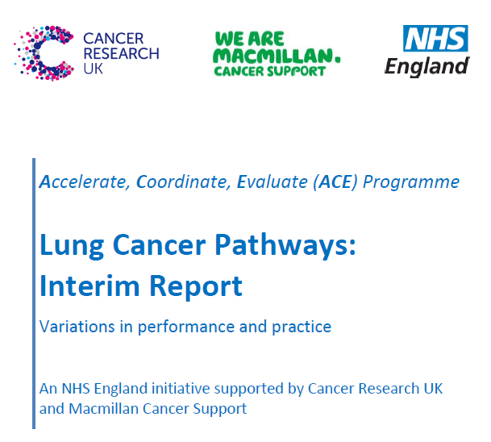

Slide 37
Lung Optimal Pathway at time of referral
High suspicion of cancer
CXR
CXR Abnormal
CXR Normal
But suspicion of cancer high
CT Scan
CT Scan
Normal
Abnormal but non-cancer
Cancer
Normal
Abnormal but non-cancer
Cancer

Slide 38
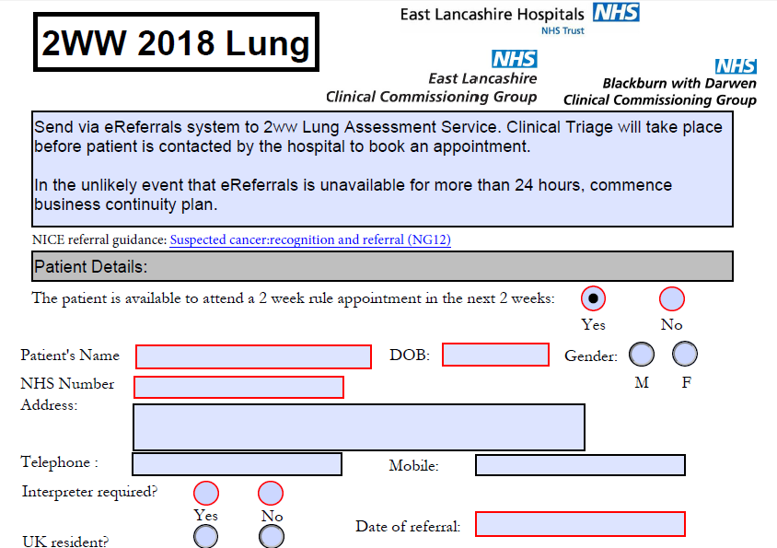

Slide 39
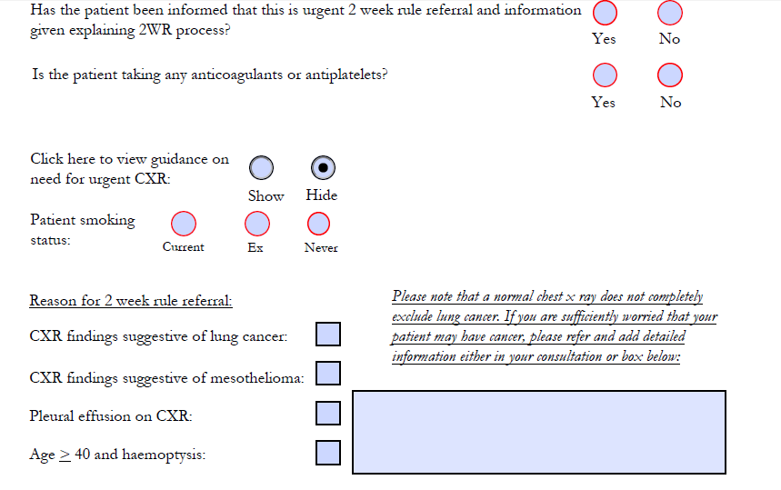

Slide 40
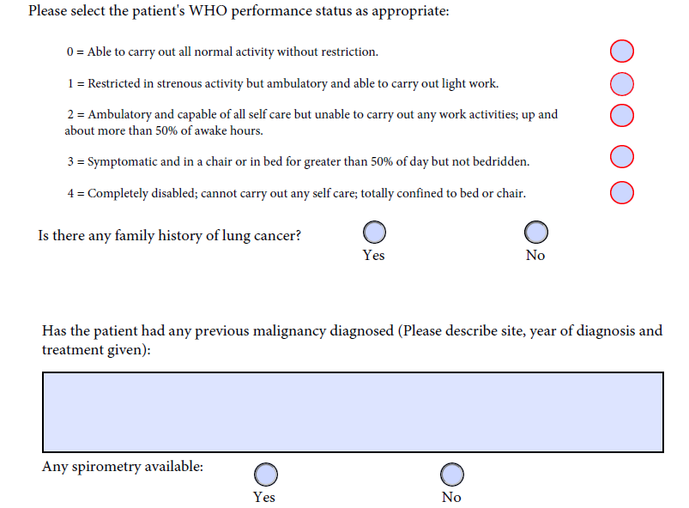

Slide 41
SEA lung cancer
Cancer LIS 2018/19
Same as previous year
EMIS search ready - malignant neoplasm lung in last 3 years (12/10000)
Select interesting cases (1/3000 population)
Discuss in house
Share at locality
Learning and recommendations contribute to improved patient care

Slide 43
ONCOLOGICAL EMERGENCIES
You are visiting a 58 year old women who is feeling unwell, complaining of back pain.
She has recently had her 3rd cycle of chemotherapy for recurrent breast cancer.
What is your plan?

Slide 44
NEUTROPENIC SEPSIS
Potentially fatal complication of cancer treatment
Chemotherapy within 6 week
Radiotherapy - bone marrow suppression
Mortality 2-21%
Needs prompt recognition and IV antibiotics
Medical emergency requires immediate hospitalisation for investigation and treatment

Slide 45
Suspect neutropenic sepsis in patients having anticancer treatment (NG151)
Who become unwell
Are known to have neutrophils <0.5
Have a temperature >38
Have other signs or symptoms consistent with clinically significant sepsis
*https://sepsistrust.org/wp-content/uploads/2017/08/GP-adult-NICE-Final-2.pdf

Slide 46
ONCOLOGY PERSPECTIVE- Dr Jasima Latif
What are patients and families told about the risk of their treatment?
Who can the patient contact (other than G.P.)?
Where can G.P.s get advice?
What should a G.P. do if they suspect neutropenic sepsis?
Briefly- what happens to the patient in hospital?

Slide 47
METASTATIC SPINAL CORD COMPRESSION
Metastatic tumour grows into epidural space
Impinges on dural sac & contents
Causes irreversible neurological damage
Oncological emergency
Requires early diagnosis and treatment

Slide 48
PRESENTATION MSCC
Any cancer
Commonly prostate, breast, lung (80% all boney metastasis)
Can be presenting symptom of cancer (late, co-morbidity and poor prognosis)
BACK PAIN- increasing in severity with time

Slide 49
NATURE OF THE PAIN (MSCC)
Lumbar, thoracic, cervical spinal pain
Progressive, severe, unremitting
Aggravated by straining, cough, sneeze
Nocturnal, disturbing sleep
Localised spinal tenderness

Slide 50
NEUROLOGICAL SYMPTOMS & SIGNS
Radicular pain
Limb weakness
Difficulty walking/ transferring
Sensory loss
Bladder/ bowel dysfunction
Cauda equina syndrome
(below L1, sensory > motor or pain)

Slide 51
ONCOLOGY PERSPECTIVE – Dr Jasima Latif
What are patients and families told about the risk of MSCC?
Who can the patient contact (other than G.P.)?
Where can G.P.s get advice?
What should a G.P. do if they suspect metastatic spinal cord compression
Briefly- what happens to the patient in hospital?

Slide 52

https://www.youtube.com/watch?v=fDWFVI8PQOI
How many animals can you name in 1 minute?
What famous pop song has the contains the words “its as serious as cancer”
What word is used to rhyme with cancer?

Slide 53
FIT testing

Slide 54
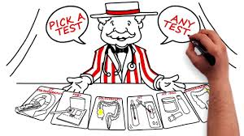
FIT- Faecal Immunochemical Test
BETTER THAN FOB faecal occult blood
Specific to human haemoglobin
Less influenced by diet and medication
Machine analysed- more accurate
More sensitivity to small amounts of blood so detects cancers and pre-cancers earlier
Only needs a single test

Slide 55
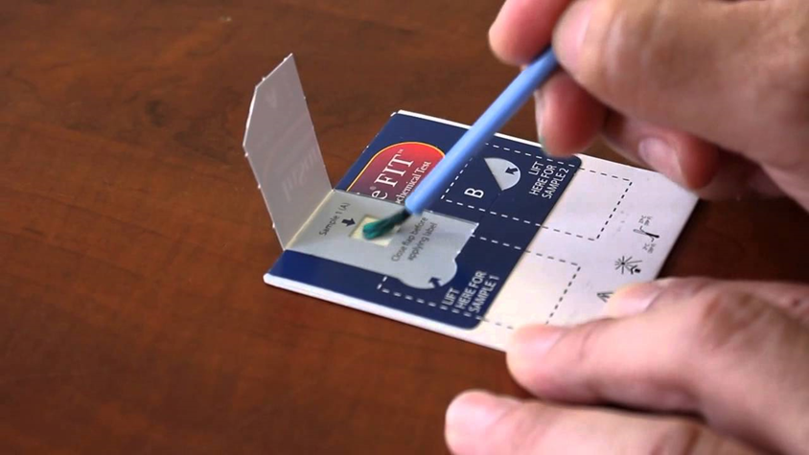
1. FIT for screening
BIG SWITCH UNDER WAY
One sample using a brush
Similar costs
More acceptable
Evidence in GUT 2016
7% overall uptake screening (from 59% to 66%)
Double previous none responders (especially in men)
FIT positivity 7.8%
Increased detection cancer x 2 and advanced adenoma x 5
BUT will increase pressure on colonoscopy

Slide 56
2 FIT for early diagnosis in symptomatic
GUT 2015:10.1136
In primary care a negative FIT has a negative predictive value of 98% for cancer and higher risk adenomas
Concluded “reliable and objective tool” to guide who needs referral and is a useful “rule out” test for significant bowel disease.
Be aware lower threshold than screening FIT

Slide 57

NICE GUIDANCE NG12 /DG30
“Use FIT in primary care to guide referral for suspected colorectal cancer in people without rectal bleeding who have unexplained symptoms but do not meet the criteria for a suspected cancer pathway referral”
aged 50 or over with unexplained:
abdominal pain or
weight loss or
aged under 60 with:
changes in their bowel habit or
iron-deficiency anaemia or
are aged 60 or over and have anaemia without iron deficiency.

Slide 58
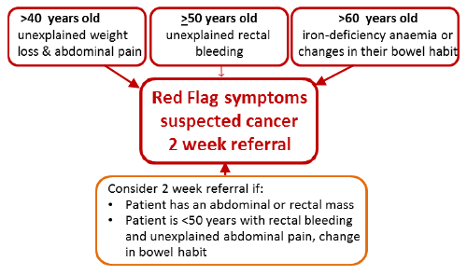
Still refer 2ww- do not do FIT

Slide 59
IRON DEFICIENCY ANAEMIA 2ww
The patient should have a new UNEXPLAINED Iron Deficiency Anaemia
Definition :- Anaemia (Hb<120g/l male: <100 g/l female) and iron deficiency (MCV<79 or low ferritin or low iron saturation)
(menstruating females if they have:
GI symptoms, Age 50 or over, or Strong family history of GI cancer = one first degree relative diagnosed under the age of 45 or 2 affected first degree relatives)

Slide 60
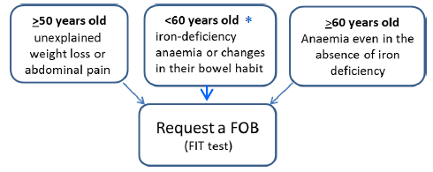
Which patients should have a FIT?

Slide 61
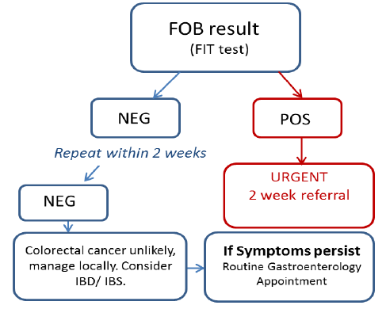

Slide 62
FIT- practicalities- Jane Oakley Consultant Biochemist
How do G.P.s get hold of the test?
What should they say to patients?
What happens at the lab?
What should G.P.s do when they get the result?

Slide 63

Faecal Immunochemical Testing- Practical Considerations
Jane Oakey
Consultant Biochemist
Clinical Laboratory Medicine

Slide 64
FIT
Test will be available across Lancashire & South Cumbria using the same analyser, same cut-off and same clinical pathway
Start date to be confirmed

Slide 65
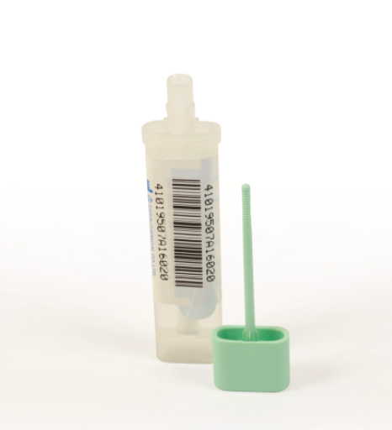
How to do the test?
Sample tubes for FIT will be available as part of the laboratory consumable ordering process
The test will be available to request on the ICE system
The patient needs to return the sample to their GP surgery for routine transport onto the laboratory
Notes:
There’s a buffer solution inside so the faecal sample is stable at room temperature for up to 7 days

Slide 66
FIT Information for patients
The test checks for blood in your faeces.
The main use for the FOB test is as a screen for early bowel cancer
A positive FOB test does not necessarily 'prove' that you have cancer. There are other possible causes of bleeding and other follow-up procedures will need to be done to find the source of the bleeding.
No dietary requirements prior to collecting the sample
No changes to medications prior to collecting the sample
They can collect the sample at any time
Information for patients available at Lab Tests Online UK
Notes:
Normally, there will not be enough blood lost through the gastrointestinal tract (stomach and intestines) to result in a positive test or for you to notice it by looking.

Slide 67

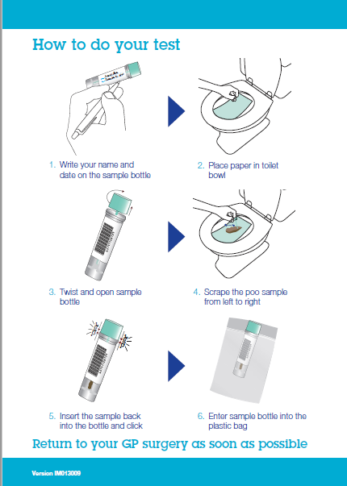
Patient Information Sheet

Slide 68
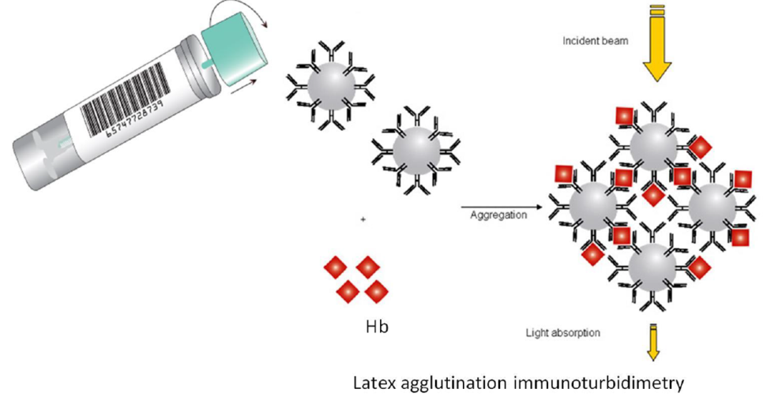
In the lab
The samples will be analysed in batches using an immunochemical method to detect haemoglobin in faeces
Results will be reported as ‘Positive’ or ‘Negative’ using the NICE recommended cut-off of 10µg Hb/g faeces

Slide 69
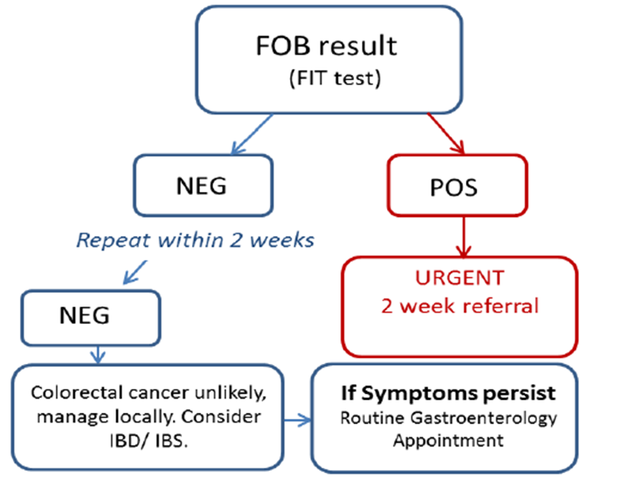
What to do with the result?

Slide 70
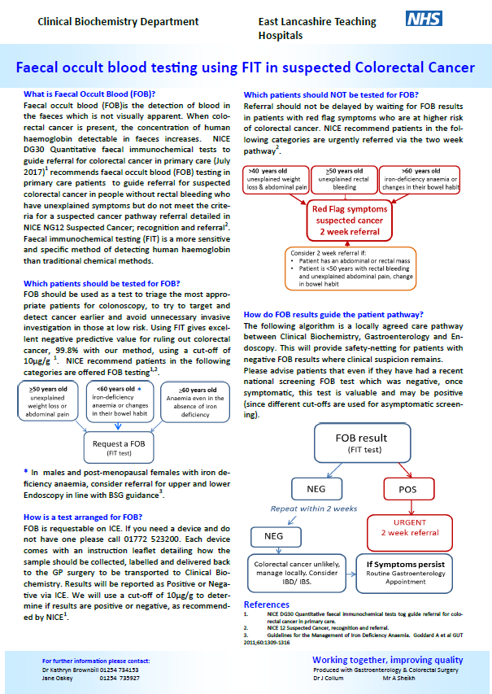
Further information and start date to follow
For further information on FIT, please contact us!

Slide 71
RESULTS URGENT DIAGNOSTIC TEST
Cancer LIS 2017/18
1350 Urgent test request
787 no evidence cancer found
290 resulted in 2WR (21% of requests)
170 malignancies found (13%)
62% conversion rate of 2WR where test done first

Slide 72
RESULTS MALIGNANCY UNKNOWN ORIGIN
Cancer LIS 2017/18
498 MUO referrals coded
218 no evidence cancer found
18 MUO cases picked up (half of all in ELHT)
3 other cancers found
Appreciate access to diagnostics to rule out cancer
Reduced referrals
Valued the service, rapid consultant input

Slide 73
REMINDER ABOUT URGENT TESTS AND REFERRALS
ELHT ICE system urgent 2WW CANCER
Read codes
1J0 suspected cancer (only for urgent investigations for suspected cancer)
1l2 no evidence cancer found
B code- malignant neoplasm of ….
All 2WW referral forms automatically coded (no need to code twice)
Only refer MUO pathway after CT chest abdomen and pelvis when result suggest MUO

Slide 74
URGENT SCANS
Cancer LIS 2017/19
USS URGENTLY AT SAME TIME AS 2WW REFERRAL (both within 24 hours of seeing the patient- ideally at the same time) Gynaecology Ovarian- CA125 >30 Gynaecology PMB- women aged 55 and over with postmenopausal bleeding Jaundice/Upper abdominal mass Testicular- non painful enlargement or change in shape or texture of the testes

Slide 75

Screening is best way to
Detect cancer early
Early treatment
Cure
Save lives

Slide 76
RESULTS- CERVICAL CANCER SCREENING- so far
Cancer LIS 2018/19
Overall smear uptake 71% BwD, 76% ELCCG
25-29 age group 58% BwD, 66% ELCCG
Baseline results- pre-intervention only 35% of 25 year olds engaged
Intervention group after card and text =45%
Preliminary results, ongoing over next year

Slide 77
#25itstime CERVICAL CANCER SCREENING
Cancer LIS 2018/19
Second year of project focussing on 25 year age group-
Cancer champions run a quarterly EMIS search to identify if a patient has participated in screening
If not, contact them again to offer further encouragement.

Slide 78
Bowel Screening Hub results – April 17 – February 18
Cancer LIS 2017/18
Bowel screening template >3,000
(54M, 46%F, 6.9/1,000- asked 2/1000)
Kits sent by HUB >2,500
Kits returned by patient >1,000
Percentage success >40%
Screening increase >1.5%
Positive results >42
Estimated neoplasia found >15

Slide 79
CHALLENGES- BOWEL CANCER SCREENING
Not every practice engaged (HUB data 68/83, CCG data 61/83 returns
Different data sets (HUB v returns)
Some practices asking patients to phone
Please keep going and use “bowel screening kit request template” to record discussion

Slide 81
What happens to positive results?
2% screening test positive
Of those with positive result (G.P. told ‘no action’)
10% have bowel cancer,
20-30% adenomatous polyps
36% colorectal neoplasia
BUT 10% of those with positive results do not attend for follow up and colonoscopy
Practice 10,000 patients approximately 2 unknown patients who have a 36% risk bowel Cancer

Slide 82
BOWEL CANCER SCREENING
Cancer LIS 2018/19
Agree Banner
Advocate screening opportunistically
Same numbers 2/1000
Search on positives in last 2 years, audit to ensure attended colonoscopy & discuss if not

Slide 83
VAGUE SYMPTOMS
A 67 year old woman
3rd appointment in 6 weeks.
She is feeling tired, with reduced appetite and says her daughter thinks she has lost weight.
You have already done a few blood test but they have not helped.
There is nothing obvious from her history and examination but you have this 6th sense that she may have cancer.
What can you do now?

Slide 84
VAGUE SYMPTOMS
Some cancer diagnoses are easier than others (haemoptysis, dysphagia, haematuria)
Most cancers present with undifferentiated symptoms
Most people with vague symptoms do not have cancer
Myeloma usually presents late as emergency after multiple appointment
Pancreatic cancer no obvious early symptoms and signs and often have false reassurance from normal test
Lung cancer commonest early symptom is fatigue

Slide 85
NG12 – investigations and referral for none specific features of cancer
Weight loss
Appetite loss
Fatigue
DVT
Diabetes
Fever
Infections
Night sweats
Pallor
Pruritis

Slide 86
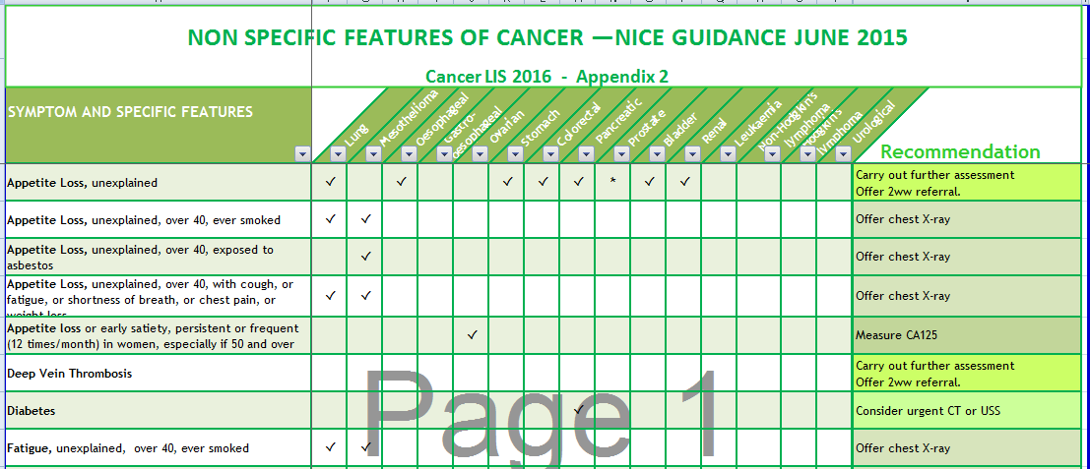

Slide 87
Multi-diagnostic centres for cancer One stop shop
High G.P. suspicion but no pathway
CRUK- ACE project of pilots
Useful for G.P.s and patients
Not overwhelming if well organised
Nice guidelines (weight loss, appetite loss, fatigue)

Slide 88
OUTCOMES of vague symptom pilots
Conversion rates 3-48% (depends on referral criteria)
Picked up other diseases (GI, lung, cardiac)
Types cancer- wide range as variable systems
Often late stage/ metastatic (prompt but not early diagnosis)

Slide 89
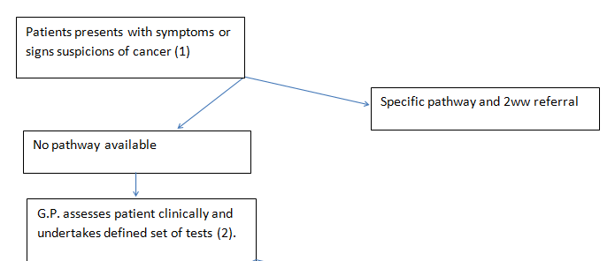
Proposed Multi-diagnostic Centre/ vague symptom clinic*
Minimum baseline tests: (but you can do more!)
Urinalysis, Chest X-ray,
FBC, U&E, eGFR, ESR, CRP, LFT, TFT, Calcium,
PSA or Ca 125

Slide 90
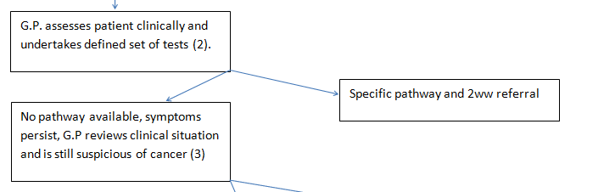
G.P. clinical review- THINK
Can these symptoms be “explained”
Dentition, depression, degree of weight loss >5%
GI, rheumatologic, cardiovascular

Slide 91
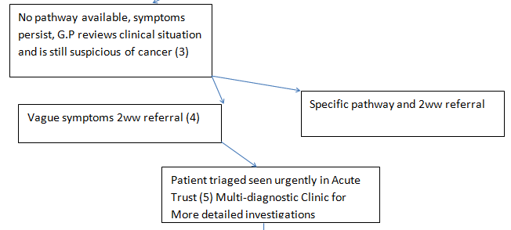
New vague symptoms referral form

Slide 92
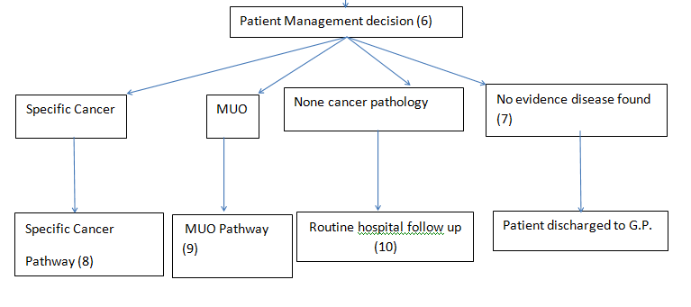

Slide 93
What about MUO or other test? not essential but consider based on patient
CT (Chest abdomen pelvis still available to G.P.s- you now have options)
USS- abdo/pelvis, soft tissue
FIT
Benz Jones protein and plasma electrophoresis
No proven value of other (than PSA and Ca125) tumour markers in primary care
Virology HIV, hepatitis, mononucleosis
Fe, folate, B12, Glucose, HBA1c, PTH, INR
Coeliac screen, auto-antibodies, autoimmune panel

Slide 94
ELHT perspective
What are to challenges for the hospital to provide this service?
Who and where is it likely to be delivered?
What will be the experience like from a patient perspective?
How is this going to be evaluated?
What do G.P.s need to do to make it work?

Slide 95
REFERRALS FOR SUSPECTED CANCER
Cancer LIS 2018/19
E Referral System- all 2ww (cancer champion event 24/04 /18
Vague symptoms pathway
Closely monitored
Work up patients first- H, E, I
Only then accepted

Slide 96
LEARNING FROM CANCER CASES
Previous work on SEA
Recognised common pitfalls
Improved process- safety netting
Access to investigations
Hospital responsibilities
Communication secondary care

Slide 97
RESULTS BOWEL CANCER SEA
Cancer LIS 2017/18
Numbers 200 SEA
Age 24y – 93y (22 <50y, 24 50y-59y)
97 male, 92 female
Route to diagnosis
82 2WW
12 screening programme
Screening programme (47 – too young)
31 – yes
100 – no

Slide 98
Your Important findings
Bowel cancer screening important
>6% detected by screening
76% of cases (60-74) had declined screening
Never too young for cancer
Youngest was 24 years
23% less than 60

Slide 99
YOUR LEARNING
Value using 2WW referrals
Challenges when some cases don’t fit
Importance false negatives (FOB and USS)
Need to encourage patient engagement
Infrequent attenders

Slide 100
YOUR RECOMMENDATIONS
PRACTICE- systems: encourage screening; know 2WW; encourage attendance; act on results; safety netting
CCG- commission: education, access urgent diagnostics; campaigns
EHLT- communication: patient; between departments; to G.P. (not block 2WW, MDT, discharge)

Slide 101

BEWARE
Constant pain
New diagnosis in older people
Persistent recurrent infection
Young people (23% bowel Ca <60y)
Infrequent attenders
Importance false negatives

Slide 102
False Negatives
CXR -25% false negative rate for lung cancer
Pancreatic cancer with normal OGD, pre-diagnostic symptoms none specific and can be intermittent
Bowel cancer screening FOB misses cases
Do not feel or give false reassurance

Slide 103
Good, safe practice
Continuity- pros and cons
Good record keeping
Safety netting
Systems for test results to be reviewed, acted on and communicated to patients
Specific in terms of alarm symptoms and timing

Slide 104
New symptoms in older people
Avoid making rash diagnoses if never had before
Migraine
Irritable Bowel Syndrome
Mechanical back pain
Lower threshold for investigation and referral

Slide 105
HEADACHE- BRAIN TUMOUR
NICE “progressive sub-acute loss of central neurological function.”
Symptoms have v low PPV (apart from seizure)
60% present as emergency
5 year Survival Rate 20%
Headache, new onset, constant, older person
Cluster of symptoms:
(low mood; poor memory; clumsy; tired)

Slide 106
MANAGING RISK BRAIN TUMOURS
Consider type headache
Ask about cluster of new symptoms
Examine for papilledema, visual fields (or ask to see optician/optometrist)
Cognitive screen- semantic verbal fluency test “How many animals can you name in 1 minute?”
Options, 2WW CT, speak to radiology about MRI, admit ambulatory care (3rd visit)

Slide 107

BRAIN TUMOURS in Children
25% all childhood cancers
Commonest cause death
Survivors have life altering disability
Immediate referral recommended
None specific symptoms signs, 1 every 24 G.P. years
Depend on tumour site & on age of child
Recent reduction time to diagnosis 13-6.5 weeks

Slide 108
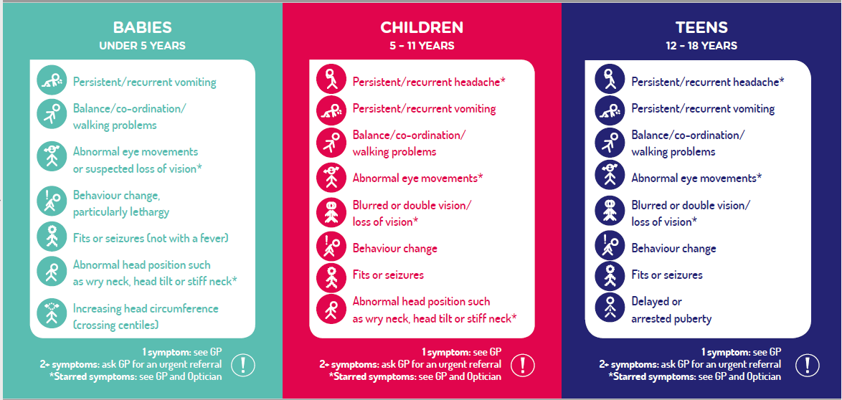

Slide 109
Cancer LIS 2018/19
Cervical Screening #25itstime -Cancer champions telephone offer appointments.
Bowel Cancer Screening practice endorsement banner, re-order kits opportunistically, review patients with positive result.
Significant Event Audit – Lung cancer.
Diagnostic tests for suspected cancer- urgent USS and CT for suspected cancer. New FIT for bowel cancer.
Referrals for suspected cancer- Establish E Referral system, new “vague symptoms” pathway.
Prostate cancer – audit patients, appointments and zoladex to help improve follow up.

Slide 110
Neil’s top 10 cancer tips 2018*
Support patients to engage
Inform men risks of PSA testing
Local guidance on prostate 2WR
Smoking very brief advice
Consider oncological emergencies
Use FIT (when available)
Process to work up patients with vague symptoms
Safety netting in practice
Beware false negatives/new symptom older person
Headache assessment

