Slide 1

RAMADAN AND TYPE 2 DIABETES
This meeting has been fully organised and funded by MSD.
Prescribing and adverse event reporting information can be found on the final slide.
The views of the speaker are their own and may not represent the opinions of MSD.
DIAB-1250789-0001
Date of preparation March 2018
Merck Sharp & Dohme Limited. Registered office: Hertford Road, Hoddesdon, Hertfordshire, EN11 9BU

Slide 2
Speaker Disclosures

Slide 3

Agenda
Ramadan: one of the five pillars of Islam
Ramadan and possible metabolic implications
Ramadan and diabetes in the UK
How to choose the appropriate therapy for this group

Slide 4

Ramadan: one of the five pillars of Islam
Fasting is an important spiritual aspect of many religions.
The Islamic month of Ramadan is one of the longest periods of religious fasting. During this time, Muslims abstain from eating, drinking and taking medication from before sunrise to sunset.
More than 50 million people with diabetes fast during Ramadan¹
According to guidelines from both religious and medical organisations, most people living with diabetes are excused from fasting because of the increased associated health risks, including hypoglycemia, hyperglycemia, dehydration and thrombosis¹.
Still, choosing to fast is a personal decision and many people with diabetes do not adhere to these guidelines.

Slide 5
What does Ramadan fast mean?
Ramadan or the Arabic translation, “sawm”, means “abstention from”.
Fasting is from the period of dawn (sahur) to sunset (iftar) and so most individuals observing Ramadan will have two meals in a 24-hour period. In the UK, each fast can last between 10 and 20 hours. During the period of fasting an individual must refrain from smoking, eating, drinking, sexual activity, consuming oral medications and using intravenous fluids.
The fasting period lasts for 29–30 days.

Slide 6
Exemptions to Ramadan^{2,3}
Not all Muslims are expected to fast if considered detrimental to health
Individuals can be either permanently or temporarily exempt
Those who are permanently exempt include^{2,3}
  children under the age of puberty
  the old and frail
  those with learning difficulties
  those with severe mental health illness
  those with a chronic condition in whom fasting would be detrimental to their health. (e.g. type 2 diabetes with unstable disease; diabetes with complications)³
Temporary exemption includes pregnant and breastfeeding women, travellers (journeys >50 miles in a single journey) and those who are acutely unwell
Those who are temporarily exempt may make up their fasts at a later date.
Those who are permanently exempt must pay compensation in the form of giving alms to the poor

Slide 7


Pathophysiology of feeding⁴
Meal
In healthy individuals, increased glucose levels in the blood after eating stimulates
insulin secretion from the islet cells of the pancreas, which triggers the liver and muscles to store glucose as glycogen
Glucose
Insulin secretion
Inhibits
stimulates
Pancreas
Gluconeogenesis
Glycogen stores
Glucose
Liver
Muscle
Adapted from Diabetes and Ramadan:Practical Guidelines. International Diabetes Federation (IDF), in collaboration with the Diabetes and Ramadan (DAR) International Alliance (2016) c

Slide 8
Pathophysiology of fasting⁴
Meal
During fasting, circulating glucose levels fall and insulin secretion is suppressed
Glucagon and catecholamine secretion is increased, stimulating glycogenolysis and gluconeogenesis, which then leads to an increase in blood glucose level
Liver glycogen can provide enough glucose for the brain and peripheral tissues for around 12 hours.
When glycogen stores are depleted and levels of insulin are low, fatty acids are released from adipocytes and oxidised to generate ketones, which can be used as fuel by many organs, preserving glucose for the brain and erythrocytes
Glucose
Insulin secretion
stimulates
Inhibits
Pancreas
Gluconeogenesis
Glycogen stores depleted
Glucose
Liver
Muscle
Adapted from Diabetes and Ramadan:Practical Guidelines. International Diabetes Federation (IDF), in collaboration with the Diabetes and Ramadan (DAR) International Alliance (2016) c

Slide 9
Pathophysiology of fasting in diabetes⁴
Meal
In diabetes, glucose homeostasis is disturbed by both the underlying pathophysiology and the medications used to treat the condition.
When fasting, insulin resistance/deficiency can lead to excessive glycogen breakdown and increased gluconeogenesis in patients with diabetes
The risks facing people with diabetes are heightened during Ramadan, including hypoglycaemia, hyperglycaemia, diabetic ketoacidosis, dehydration and thrombosis
Feasting during Ramadan also carries risks for those with diabetes.
Glucose
Insulin secretion decreased or absent/Insulin resistance
stimulates
Inhibits
Pancreas
Gluconeogenesis (and ketogenesis)
Glycogen stores depleted
Excessive breakdown
Glucose
Liver
Muscle
Adapted from Diabetes and Ramadan:Practical Guidelines. International Diabetes Federation (IDF), in collaboration with the Diabetes and Ramadan (DAR) International Alliance (2016) c

Slide 10
Major risks associated with fasting in people with diabetes¹
Hypoglycaemia
Hyperglycaemia
Diabetic ketoacidosis
RISKS
Dehydration and thrombosis
Notes:
During Ramadan, the normal diet changes considerably and physical activity levels fall during the daytime compared with other times of the year. These changes
can result in metabolic disturbances and also lead to alterations in the timing and doses of diabetes medication. Ramadan lasts for 29–30 days, and over the next few
years will fall during the summer months in a majority of countries. Summer fasting periods last up to 20 hours per day and are often undertaken in hot and humid conditions
which can exacerbate the risks. Dehydration, in particular, is a serious risk associated with fasting.
There is a potential risk of dehydration in particular among those whose employment entails physical labour (although it is not as great in the UK as in hotter or more humid climates). Individuals should be encouraged to have ample fluid intake during the sahur and iftar period.

Slide 11
Possible Metabolic Complications⁵
From the Epidemiology of Diabetes and Ramadan (EPIDIAR) study⁶
HYPOGLCAEMIA
Risk is increased for patients with diabetes during fasting
Maybe under-reported as mild to moderate hypoglycaemia does not require medical assistance
Precipitating factors - long fasting hours, missing Suhur (dawn) meal and failure to modify drug dosage and timing
HYPERGLYCAEMIA
Risk is increased (x3.2 in T1DM and x5 in T2DM)
Precipitating factors – lack of diet control during Iftar meal and excessive reduction of drug dosages due to fear of hypoglycaemia
In T2DM during Ramadan risk of⁶:
severe hypoglycaemia increased about 7.5 fold
severe hyperglycaemia increased about 5 fold

Slide 12
Other possible Metabolic Complications⁵
Diabetic ketoacidosis
Precipitated by lack of diet control during Iftar (sunset) meal
Excessive reduction of insulin dosage due to fear of hypoglycaemia, acute stress and illness/infection
Dehydration and thrombosis
Increased risk of dehydration through sweating in hot weather, physical exercise and osmotic diuresis in poorly controlled diabetes
Diabetes is a procoagulant condition and dehydration increases risk of thrombosis

Slide 13



Risk stratification for fasting in people with diabetes⁷
HIGH Advised not to fast | • Type 1 diabetes • Poor glycaemic control, defined as HbA1c>69 mmol/mol (>8.5 %) • Hypoglycaemic unawareness • Severe hypoglycaemia or recurrent hypoglycaemia in the 3 months prior to Ramadan • History of DKA or hyperosmolar hyperglycaemic coma in the 3 months prior to Ramadan • Comorbidities, including advanced macrovascular complications, renal disease, liver disease, cognitive dysfunction, uncontrolled epilepsy (particularly precipitated by hypoglycaemia) • Acute illness (eg, diabetic foot, etc) • Pregnant women • Frequent intense physical labour
MODERATE May fast with patient and HCP collaboration | • Moderate glycaemic control, defined as HbA 1c 58-69mmol/mol (7.5–8.5%) and no major diabetic complications • Well-controlled diabetes, defined as HbA1c <58mmol/mol (<7.5% ) treated with sulphonylurea, short-acting insulin secretogogue, insulin, or treated with a combination oral or oral and insulin treatment
LOW Should be able to fast with advice | • Diet-controlled diabetes • Diabetes well-controlled with monotherapy and otherwise healthy (Metformin, dipeptidyl peptidase-4 inhibitors, acarbose, GLP-1 agonists, SGLT 2 or thiazolidinediones)
Adapted from Ali et al. Diabet Med 2016; 33: 1315-1329

Slide 14
The Muslim Council of Britain: Ramadan and people with diabetes
“Fasting in Ramadan has many spiritual and health benefits.
Ramadan gives us the opportunity to fulfil our duty to Allah (SWT), cleanse our bodies and souls, and practice self-restraint.
For some people with diabetes, fasting can be dangerous or can cause problems to your health.
In the UK, Ramadan is now in the summer months. With long hours of fasting, this can also cause additional health problems, especially if you have diabetes.
Before you choose to fast, please read the advice below and consult your GP, diabetes doctor or diabetes nurse.”
The Muslim Council of Britain. Ramadan and diabetes: guide for patients (2013) http://www.mcb.org.uk/wp-content/uploads/2014/06/Ramadan-and-diabetes-A-guide-for-patients-2013.pdf

Slide 15
NICE NG28: Individualised care
Adopt an individualised approach to diabetes care that is tailored to the needs and circumstances of adults with type 2 diabetes, taking into account their personal preferences, comorbidities, risks from polypharmacy, and their ability to benefit from long - term interventions because of reduced life expectancy.
Such an approach is especially important in the context of multimorbidity. Reassess the person's needs and circumstances at each review and think about whether to stop any medicines that are not effective.
Take into account any disabilities, including visual impairment, when planning and delivering care for adults with type 2 diabetes.
NICE NG28 www.nice.org.uk/guidance/ng28 published Dec 2015

Slide 16
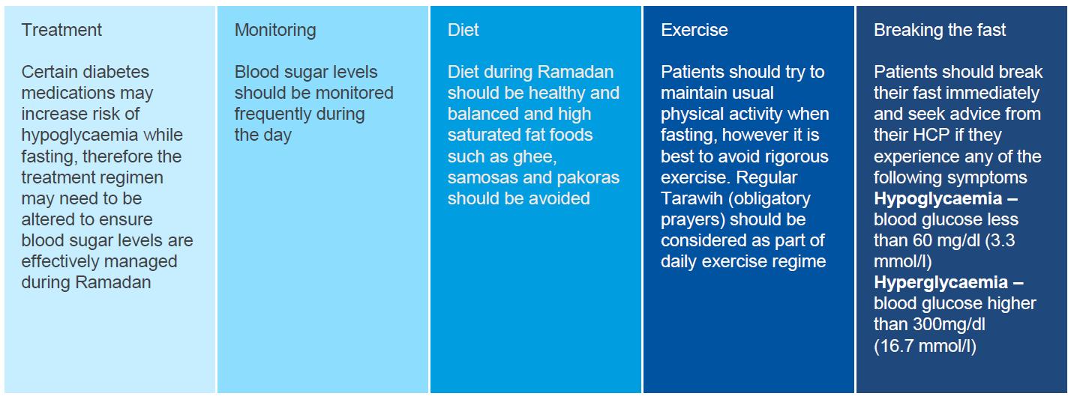
Fasting Considerations for Ramadan¹
During Ramadan it is important for the patient to monitor their condition, specifically looking at:
*
Patients should be encouraged to schedule a follow-up consultation after Ramadan to discuss any necessary readjustment of medicine
* if blood glucose reaches 70 mg/dl (3.9 mmol/l) in the first few hours after the start of the fast, especially if insulin, sulfonylurea drugs, or meglitinide are taken at predawn.

Slide 17
Recommendations for adjusting diabetes medications during Ramadan fasting⁷
Medication | Risk of Hypoglycaemia | Recommendations
Metformin | Low | Usually no dosage modification required. Split the dose: one-third predawn, the rest at sunset
Sulfonylurea | High | Consider reducing dose for HbA1c <7.5% (58 mmol/mol) or if patient has history of hypoglycaemia. Consider switching to an alternative therapy with lower risk of hypoglycaemia (e.g. DPP-4 inhibitor) in patients with history of hypoglycaemia With short-acting gliclazide recommend reducing morning dose and larger dose be taken at evening meal (Iftar)
Thiazolidinediones (TZD) | Low (May augment hypoglycaemia caused by other medications when used in combination) | No dosage modification May cause unwanted weight gain and increase in appetite

Slide 18
Recommendations for adjusting diabetes medications during Ramadan fasting^{3,5,7}
Medication | Risk of Hypoglycaemia | Recommendations
DPP-4 inhibitors | Low | No change required
SGLT-2 inhibitors | Low | Avoid during Ramadan fasting due to risk of osmotic diuresis, dehydration and ketoacidosis² Increased risk of urinary tract infection and postural hypotension due to lack of fluids during fasting hours
GLP-1 RA | Low | No dosage modification if taken alone. Dose reduction required when taken with sulfonlyurea³ Dose reduction recommended if severe nausea³
1. Ali et al. Diabet. Med. (2016); 33: 1315-1329 2. Raveendran and Zargar Cleveland Clin J Med 2017 84(5): 352-356
3. Karamat et al.(J R Soc Med 2010: 103: 139–147
1. Ali et al. Diabet. Med. (2016); 33: 1315-1329 2. Raveendran and Zargar Cleveland Clin J Med 2017 84(5): 352-356
3. Karamat et al.(J R Soc Med 2010: 103: 139–147

Slide 19
Recommendations for adjusting diabetes medications during Ramadan fasting^{3,5,7}
Medication | Risk of Hypoglycaemia | Recommendations
Basal insulin | High | Long-acting insulin dose to be reduced by 20% and taken after Iftar (evening)
Rapid-acting (meal-time) insulin | High | Omit lunch dose and take twice daily with meals at Suhur and Iftar
Mixed insulin | High | Reverse doses so morning dose taken at Iftar and evening dose taken at Suhar (halve Suhar dose), or consider changing to basal bolus regime
Notes:
We recommend for patients well controlled on twice-daily mixed insulin that the morning dose should be taken instead with Iftar (at dusk) and half the evening dose taken with
Suhoor (at dawn) [8,47].
Another strategy during Ramadan would be to use long acting insulins, such as glargine, and short-acting insulins with the two meals of Ramadan. In this scenario, the basal
insulin should be administered with the larger evening Iftar meal. Those already taking long-acting basal insulin should be advised to reduce the dose by 20%
During fasting, human soluble insulin preparations may remain in the system for 8–12 h with a late long-lasting peak 2 h after administration. This could potentially put an
individual at risk of late postprandial hypoglycaemia [49].
There is some evidence that using rapid-acting insulin analogues instead of human insulin before meals in patients with Type 2 diabetes during Ramadan is associated with lesshypoglycaemia and smaller postprandial glucose excursions

Slide 20
Pilot Study: Nearly 20% of SU-Treated Muslim Patients With Type 2 Diabetes Experienced Symptomatic Hypoglycaemia During Ramadan Fasting⁸
Incidence of Symptomatic Hypoglycaemia events during Ramadan in 2009
by Treatment Group
n=428
n=386
n=535
n=29
n=1378
1095 occurred among the 271 patients who recorded ≥1 symptomatic hypoglycaemic event
Most common symptoms reported were: headache (14.5%), sweating (10.2%), tremor (8.5%), and palpitations (7.0%)
Mean daily doses of SUs were: 2.8 mg for glimepiride, 129.3 mg for gliclazide, 10.7 mg for glibenclamide (glyburide), and 6.6 mg for glipizide.
SU=sulphonylurea.

Slide 21
Pilot Study: 6.7% of SU-Treated Muslim Patients With Type 2 Diabetes Experienced Severe Hypoglycaemia During Ramadan Fasting⁸
Incidence of Severe Hypoglycaemia event during Ramadan in 2009
by Treatment Group
n=428
n=386
n=535
n=29
n=1378
No marked differences in the incidence of severe hypoglycaemia between treatment groups
The incidence of severe hypoglycaemia requiring medical assistance was 3.7% (n=51) for the entire patient cohort
1.2% (n=16) of all subjects experienced a serious complication (e.g., loss consciousness, seizure, coma, or physical injury) related to hypoglycaemia during Ramadan.

Slide 22
Sitagliptin vs Sulphonylurea in Muslim Patients With
Type 2 Diabetes Treated During Ramadan: Study Design⁹
Muslim patients
≥18 years of age with T2DM on stable dose of SU for
≥3 months with or without metformin (stable dose) before enrollment
HbA_{1c} <10% at screening
Intended to fast during Ramadan
Open-Label study
Sitagliptin 100 mg od ± Metformin (n=529)
R
Sulfonylureaª ± Metformin (n=537)
Treatment Period
(Ramadan 2010)
Screening Period
Screening Visit
(≥5 weeks prior to start of Ramadan)
Patients were randomised in a 1 : 1 ratio to either switch to sitagliptin 100 mg od or to remain on their prestudy sulphonylurea (with or without metformin).
od=once daily; R=randomization; SU=sulphonylurea; T2DM=type 2 diabetes mellitus.
ªSulphonylurea used by patients in the study included glibenclamide (glyburide), glimepiride, and gliclazide.

Slide 23
Switching to Sitagliptin Treatment Was Associated With a Significantly Lower Incidence of Symptomatic Hypoglycaemia Compared With Remaining on Sulphonylurea Treatment⁹
Primary End Point (APaT Population): Incidence of Symptomatic Hypoglycaemia (Proportion of Patients With ≥1 Events)
RRR (95% CI) = 0.51 (0.34, 0.75); p < 0.001
195 symptomatic hypoglycaemic events were reported by 68 patients in the SU group compared with 128 events in 34 patients for the sitagliptin group
Most common symptoms were headache, sweating, dizziness, hunger, and tremor
Mean doses of SUs were: 3.5 mg in the morning and 3.1 mg in the evening for glimepiride; 71.9 mg and 89.0 mg for gliclazide; and 6.1 mg and 5.9 mg for glibenclamide (glyburide).
APaT=All Patients as Treated; CI=confidence interval; od=once daily; RRR=relative risk ratio; SU=sulphonylurea.

Slide 24
Guidance on self-monitoring of blood glucose⁷
Blood glucose monitoring during fasting does not break the fast.
Monitor blood glucose levels at the beginning of the fast and then regularly every 4 h.
Blood glucose levels should be checked if any symptoms of hypoglycaemia or if the patient becomes unwell.
Patients should be aware and stop fasting if:
there is hypoglycaemia with blood glucose < 3.9 mmol/l at any time during the fast;
blood glucose levels are 3.9 mmol/l at the start of the fast and the patient is taking insulin or sulfonylureas;
there is hyperglycaemia with blood glucose levels > 16.7 mmol/l.
Adapted from Ali et al. Diabet Med 2016; 33: 1315-1329

Slide 25
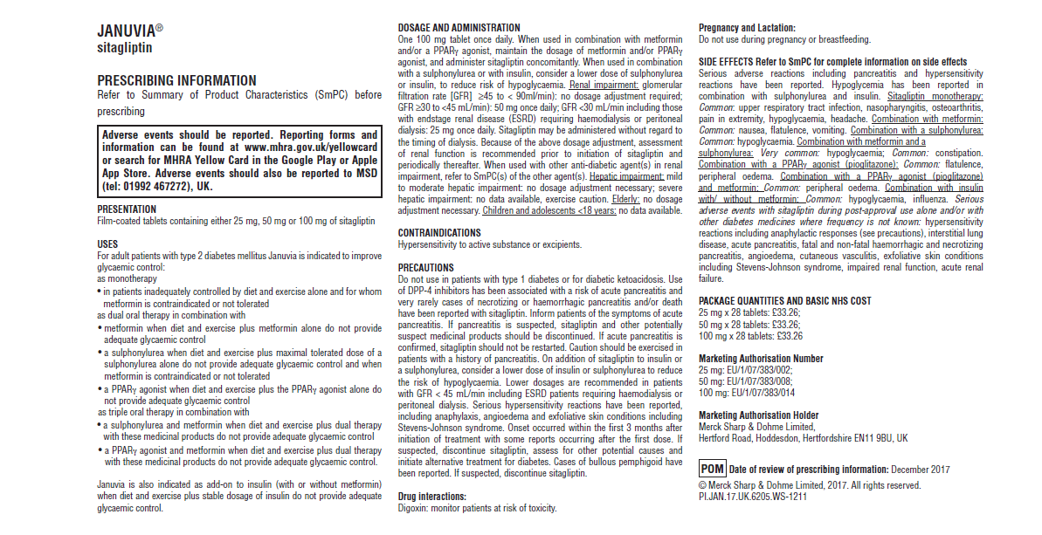
Prescribing information
DIAB-1244412-0000
Date of Preparation: January 2018

Slide 26
References
Al-Arouj M, Assaad-Khalil S, Buse J, et al. Recommendations for the management of diabetes during Ramadan: Update 2010. Diabetes Care. 2010;33:1895-902.
Gilani, A Diabesity in Practice 2012 1 (2): 63-68
Karamat et al. J R Soc Med 2010: 103: 139–147
Diabetes and Ramadan:Practical Guidelines. International Diabetes Federation (IDF), in collaboration with the Diabetes and Ramadan (DAR) International Alliance (2016)
Raveendran and Zargar Cleveland Clin J Med 2017 84(5): 352-356
Salti I, Bénard E, Detournay B et al (2004) EPIDIAR study. Diabetes Care 27: 2306–2311
Ali et al. Diabet Med 2016; 33: 1315-1329
Aravind SR et al. Curr Med Res Opin. 2011;27(6):1237–1242
S. Al Sifri et al. Int J Clin Pract, November 2011, 65, 11, 1132–1140.
Adapted from Ali et al. Diabet Med 2016; 33: 1315-1329
Adapted from Ali et al. Diabet Med 2016; 33: 1315-1329

