Slide 1

Rosacea
Alison Barton
Dermatology Specialist Nurse

Slide 2
Aim of the session
To review current guidelines for best practice in diagnosis and management of rosacea
Review of different sub types and phenotypes
To discuss the psychological aspects of living with rosacea
To identify when to refer

Slide 3
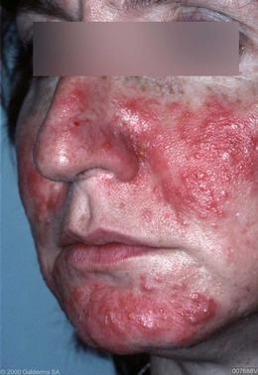
Notes:
https://www.dermquest.com/image-library/image/5044bf007688VB

Slide 4
Epidemiology
A common, inflammatory rash affecting the cheeks, forehead, chin and nose
Characterised by flushing, erythema, dilated blood vessels, papules and pustules
Commonly seen in middle aged, fair skin individuals
More common in women but usually more severe in men
May be transient, recurrent or persistent
Notes:
http://www.bad.org.uk/shared/get-file.ashx?id=229&itemtype=document
http://www.dermnetnz.org/topics/rosacea/

Slide 5
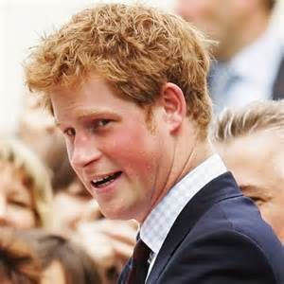
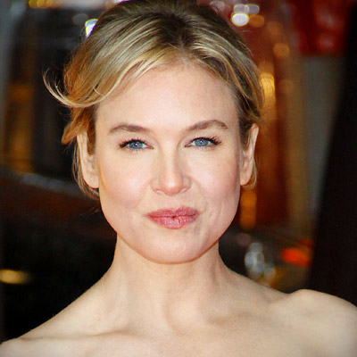
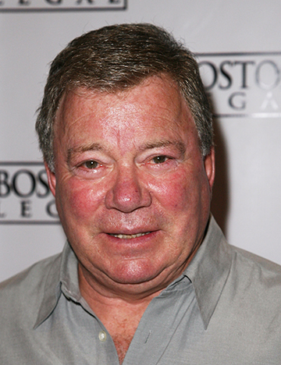
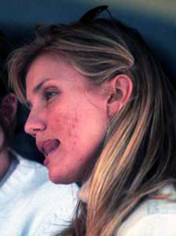
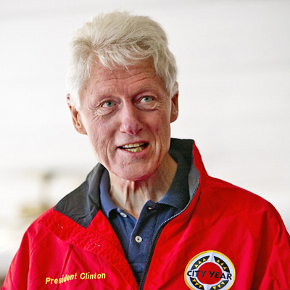
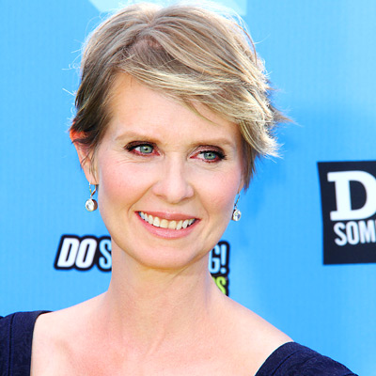
Rosacea
Notes:
William Shatner, Prince Harry, Renee Zellweger, Cameron Diaz, Cynthia Nixon, Bill Clinton

Slide 6
What causes rosacea?
The pathophysiology of rosacea has yet to be fully determined. Theories include:
Genetic
Environmental including chronic exposure to UV
Vascular and inflammatory factors
The skin’s innate immune response
Trigger factors including UV radiation and the demodex mite
Notes:
http://www.dermnetnz.org/topics/rosacea/
J.Tan et al (2017) Updating the diagnosis, classification and assessment of rosacea: recommendations from the global ROSacea Consensus (ROSCO) panel. British Journal of Dermatology 176, pp431-438

Slide 7
Rosacea triggers
Notes:
Results based on a survey of 1,066 rosacea patients trigger for rosacea
National Rosacea Society
Rosacea.org
http://www.rosacea.org/patients/materials/triggersgraph.php
Website last accessed: March 2017

Slide 8

Diagnostic criteria
Primary Features
1 or more usually present
  Flushing (transient erythema is a common feature)
  Non transient erythema
  Papules and pustules
  Telangiectasia
Secondary Features
may be present
  Burning or stinging
  Plaque
  Dry appearance
  Oedema
  Ocular manifestations
  Peripheral location
  Phymatous changes
Notes:
8
https://www.rosacea.org/class/classysystem.php

Slide 9
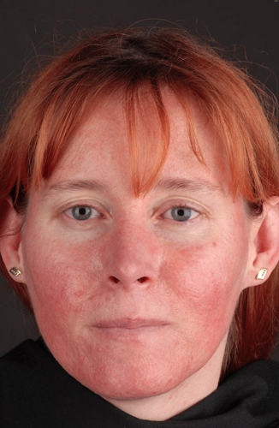
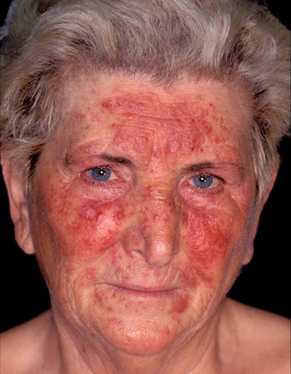


Rosacea subtypes
Subtype 1
Erythematotelangetatic
Flushing and persistent central facial erythema +/-telangiectasia
Sparing of periocular and nasolabial region
Oedema, stinging/ burning, scaling may be present
Subtype 2
Papular-pustular
Central facial erythema and telangiectasia
Transient pustules and/or papules present centrally or peri-orally.
Frequently associated burning/ stinging
Notes:
Adapted from NUR/007/0814 – Common Facial Dermatoses
https://www.rosacea.org/class/classysystem.php

Slide 10
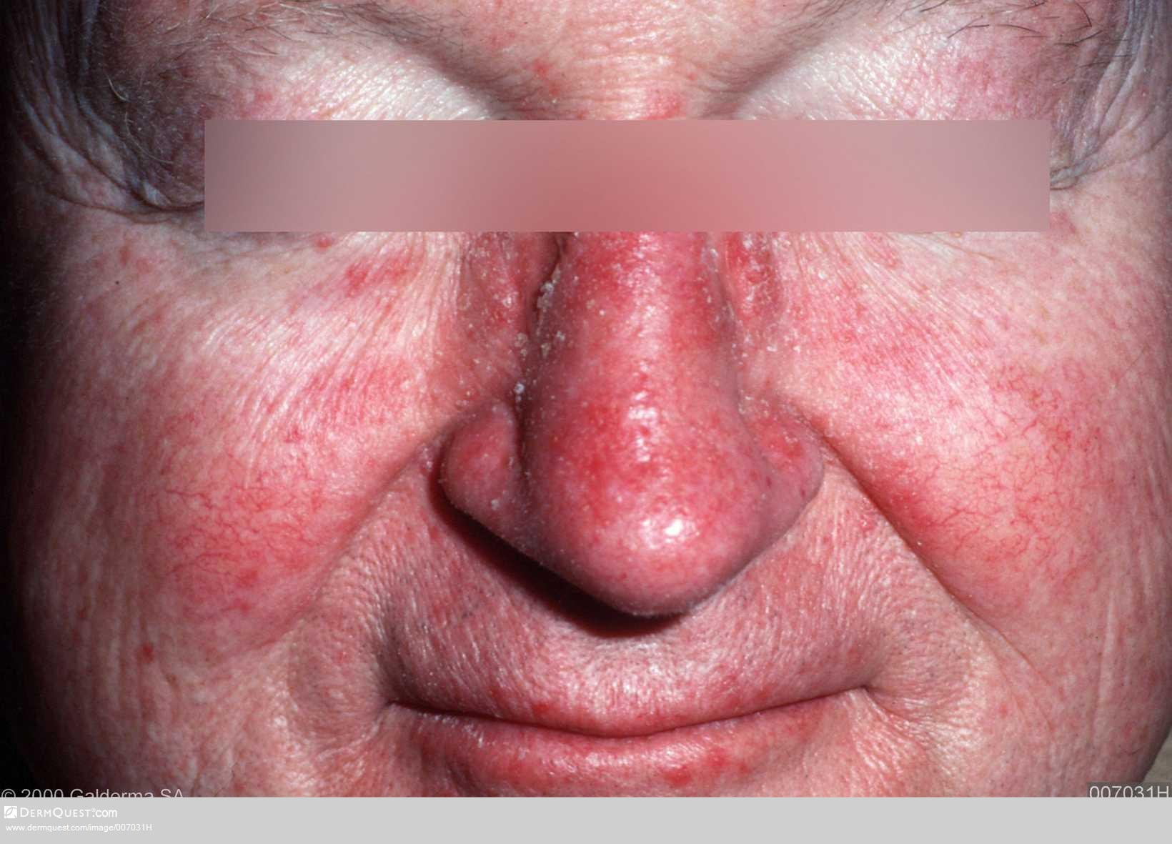
Notes:
https://www.dermquest.com/image-library/image/5044bfd0c97267166cd646bd

Slide 11
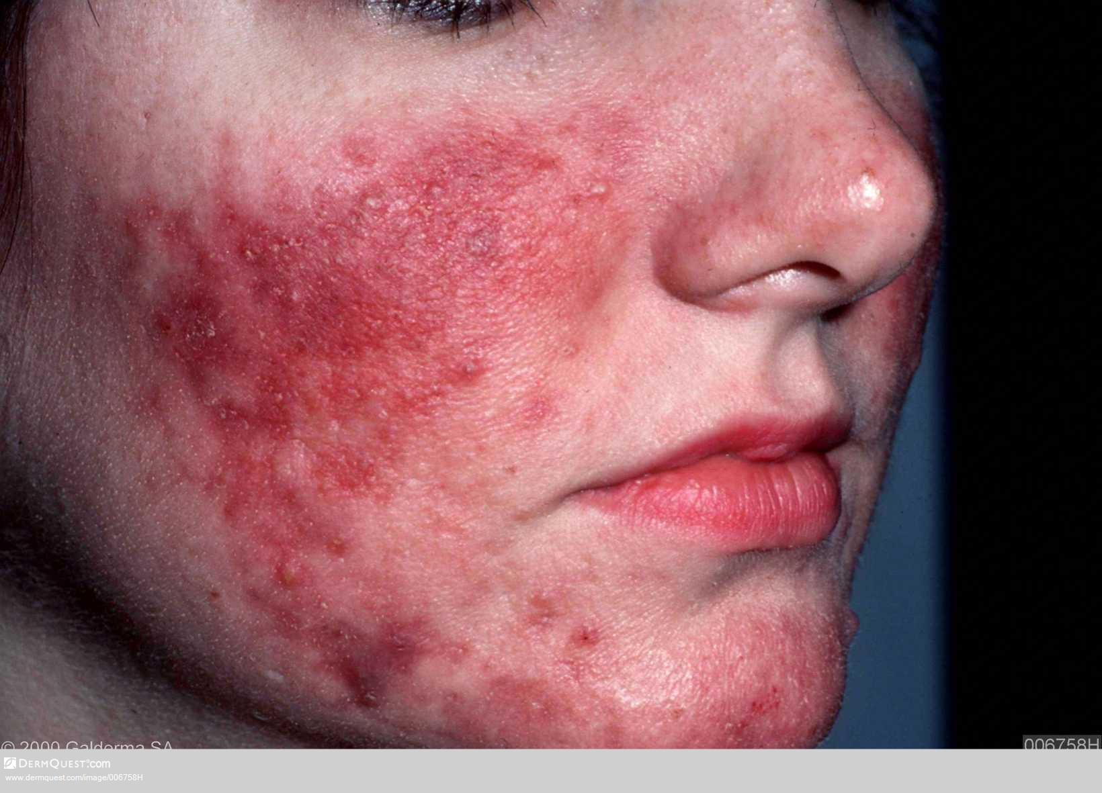
Notes:
https://www.dermquest.com/image-library/image/5044bfcfc97267166cd62ef7

Slide 12
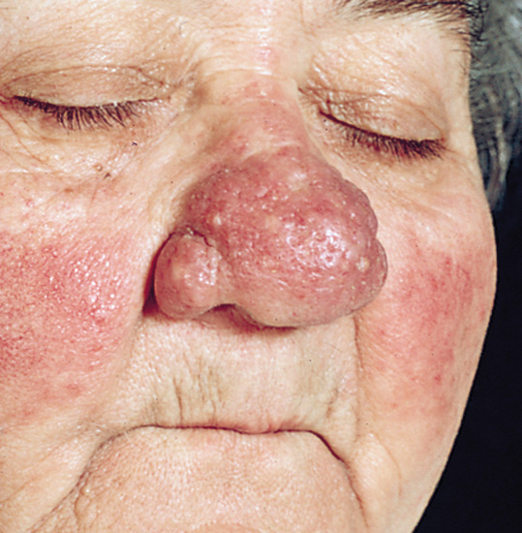
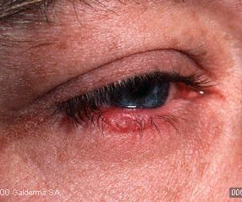

Rosacea subtypes
Subtype 3
Phymatous
Thickening skin, irregular surface nodularities with enlargement and prominent pores
Tissue hyperplasia
Typically on the nose (Rhinophyma)
Males > females 10:1
Subtype 4
Ocular
Burning , stinging, dryness
Foreign-body sensation
Eye photosensitivity, itching, blurred vision
Telangiectasia of conjunctiva and lid margin, stye, infections.
Lid/ periocular erythema
Blephritis, conjunctivitis
Notes:
Adapted from NUR/007/0814 – Common Facial Dermatoses
https://www.rosacea.org/class/classysystem.php

Slide 13
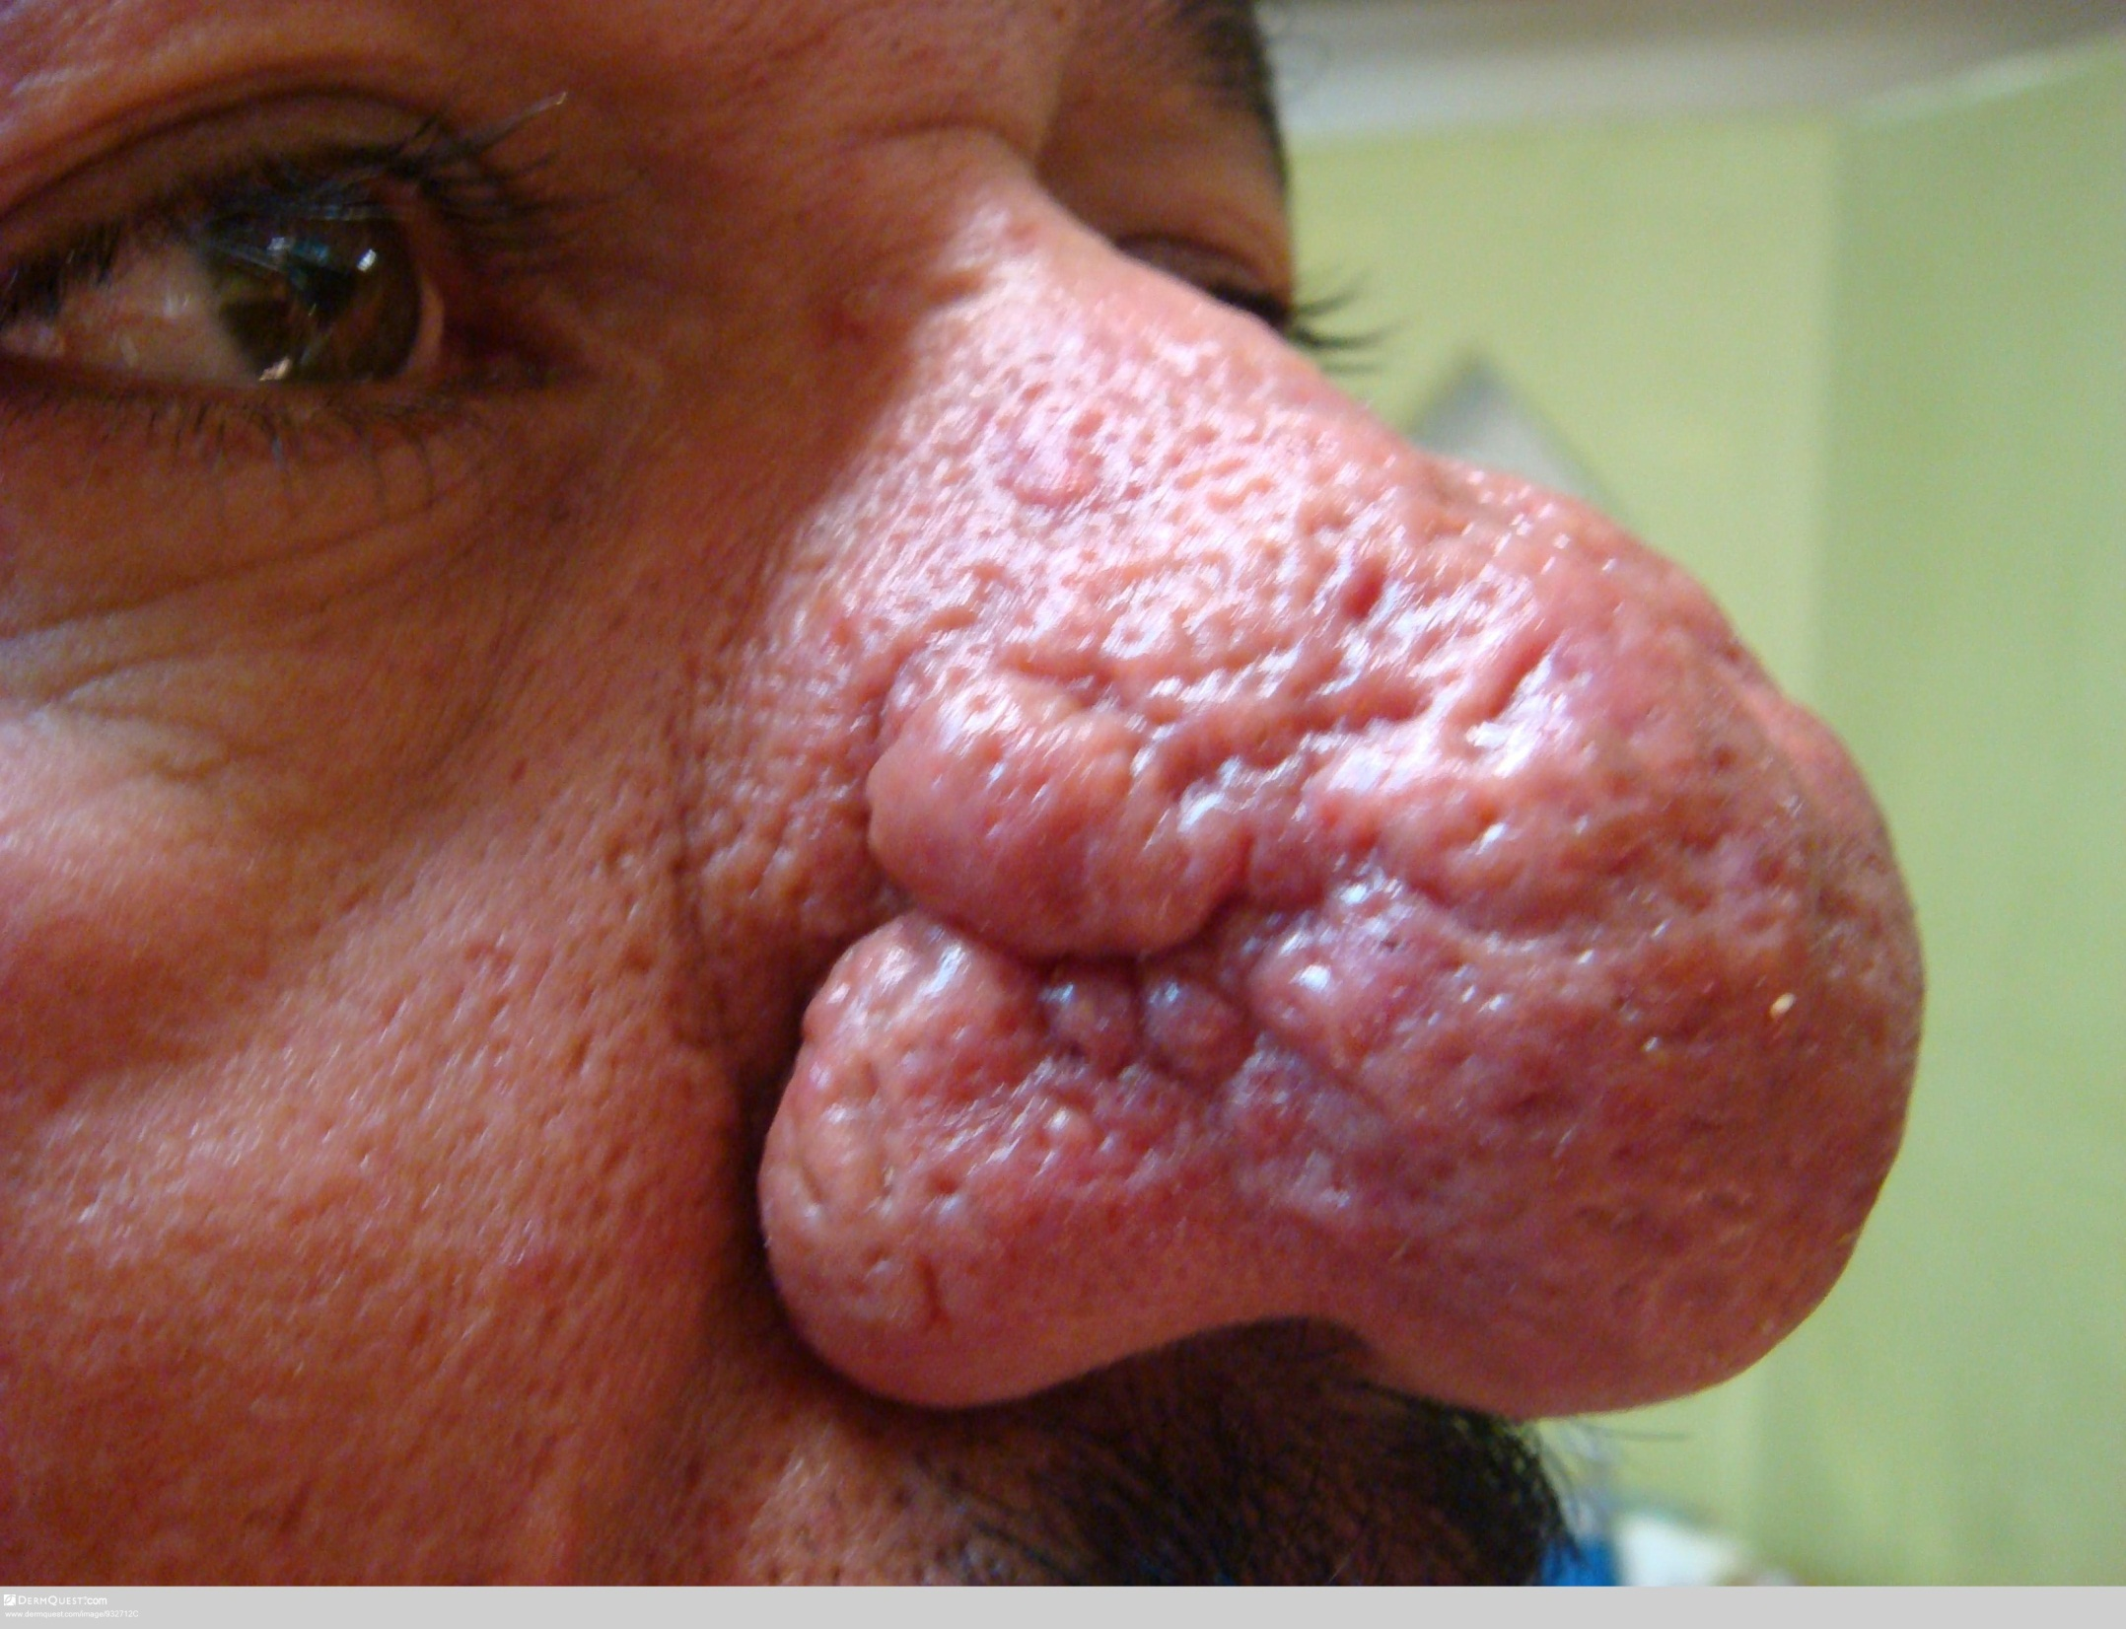
Notes:
https://www.dermquest.com/image-library/image/5044bf932712C

Slide 14
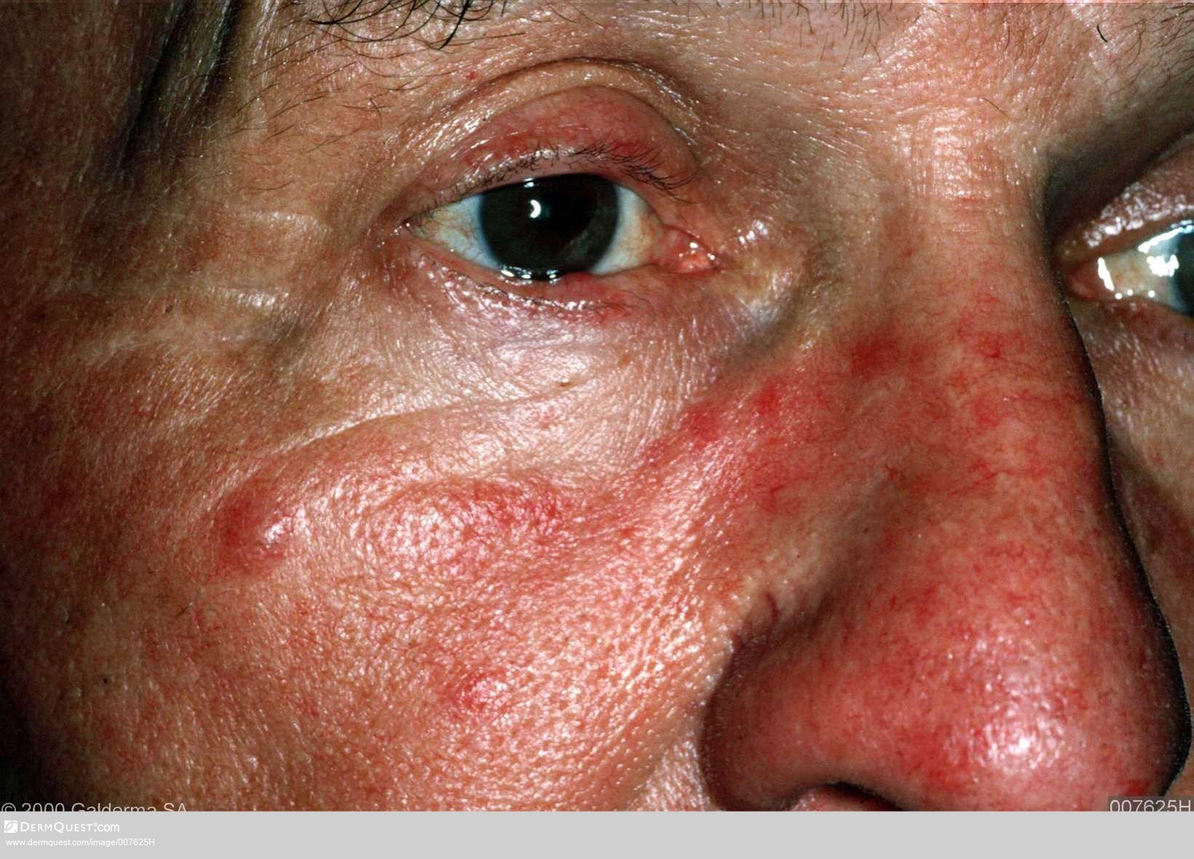
Notes:
https://www.dermquest.com/image-library/image/5044bf007625HB

Slide 15
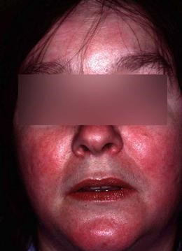
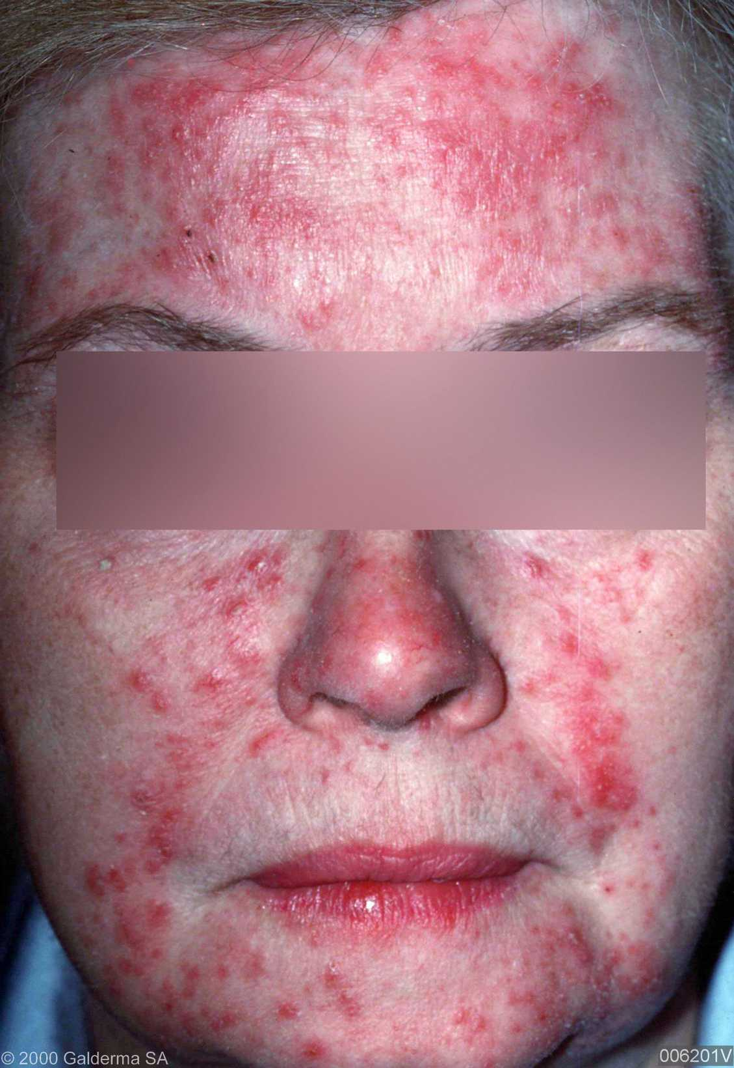
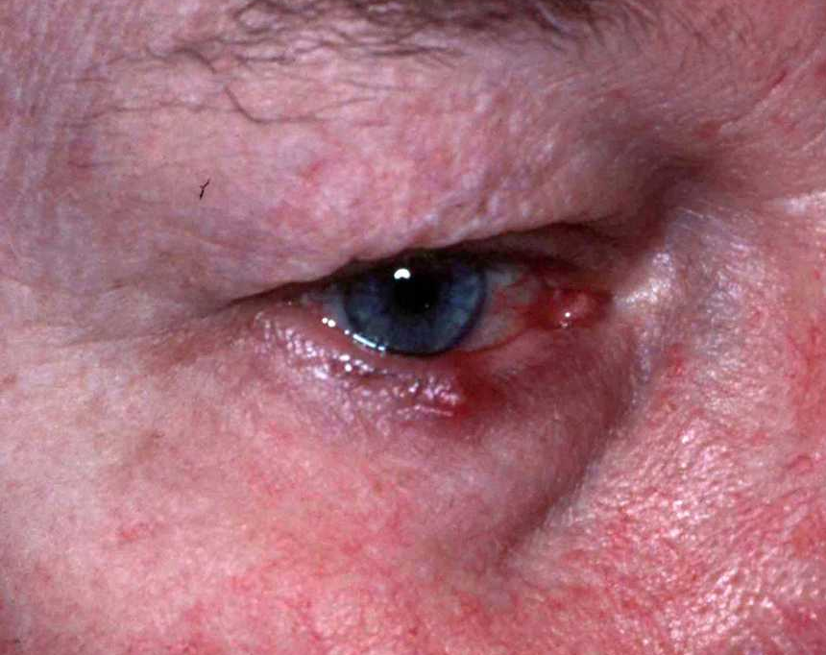

Topical and oral treatment PCDS 2017
Subtype I
Vascular Erythematotelangiectatic
Subtype II
Inflammatory Papulopustular
Subtype IV
Ocular
+++ Intense Pulsed Light
++ Brimonidine Gel 0.33%
++ Pulsed Dye Laser
++ Clonidine 25-50 mcg TDS
+ Propranolol 10-40mg TDS
+++ Ivermectin 10mg/g cream 1%
+++ MR Doxycycline 40mgs OD
++ Doxycycline 100mg/ Lymecycline 408mg
++ Azelaic Acid 15%
++ Isotretinoin
+ Metronidazole gel/cream 0.75%
+ Oxytetracycline 500mgs b.d
+ Erythromycin/Clarythromycin 500mgs b.d
+++ Eyelid hygiene measures, ocular lubricants
++ Doxycycline 100mg/ lymecycline 408mg
+ Oxytetracycline 250-500mg
Refer to ophthalmologist
+++ Strong recommendation ++ Moderate recommendation + Low recommendation
Notes:
http://www.pcds.org.uk/ee/images/uploads/general/Rosacea_Pathway-aw_cx.pdfhttps://www.dermquest.com/image-library/image/5044bfd1c97267166cd6683a

Slide 16
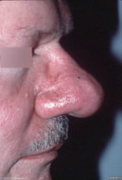
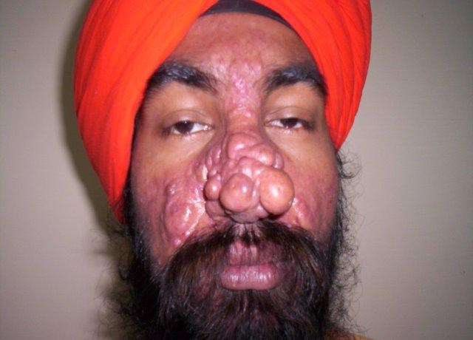
Management of rhinophyma
CO2 Laser ablation
Surgical reduction/ shave excision
Notes:
Management of rhinophyma
Provide a patient information leaflet
Responds very well to CO2 laser ablation, or, shave excision of the affected tissue
http://www.pcds.org.uk/clinical-guidance/rosacea#management
Accessed March 2017
https://www.dermquest.com/image-library/image/5044bfd1c97267166cd6720c

Slide 17
Local treatment guidelines

Slide 18
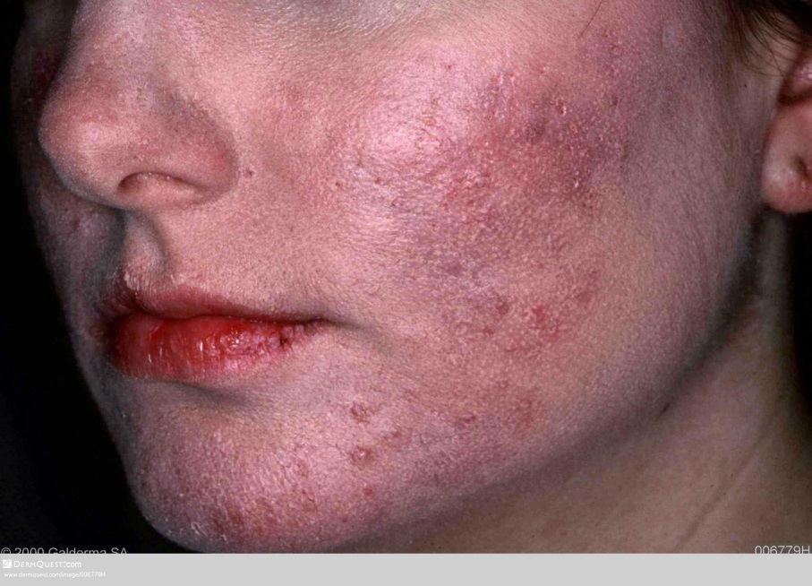
Steroid rosacea
Rosacea-like condition of the mid face caused by potent topical steroids or their withdrawal
Don’t get the typical sparing of nasolabial folds and peri-ocular areas
Notes:
http://www.pcds.org.uk/clinical-guidance/rosacea#!prettyPhoto
https://www.dermquest.com/image-library/image/5044bfd0c97267166cd65815
Website last accessed: 04/08/2015

Slide 19
Self care advice
Protect skin by using a sun block everyday, at least SPF 30
Avoid rubbing or scrubbing the face
Avoid perfumed soaps by using a soap substitute or cleanser
Use an unperfumed moisturiser on a regular basis
Notes:
http://www.bad.org.uk/shared/get-file.ashx?id=229&itemtype=document
Accessed March 2017

Slide 20
Self care advice
Identify trigger factors that can worsen rosacea; using a trigger diary can be helpful
Cosmetic camouflage www.changingfaces.co.uk
Avoid the use of topical steroids on the face
If on any medications, check they do not aggravate blushing
Contact rosacea society for more advice www.rosacea.org
Notes:
http://www.bad.org.uk/shared/get-file.ashx?id=229&itemtype=document
Accessed March 2017

Slide 21
When to refer
Criteria for referral
An uncertain diagnosis
Poor response to therapy
Severe phymatous disease
Severe ocular rosacea resistant to treatment (refer to ophthalmologist)
Cosmetic camouflage via Changing Faces
See local referral guidelines
Notes:
Adapted from NUR/007/0814 – Common Facial Dermatoses pcds

Slide 22
Thank you
Any questions?

Slide 23
References
BAD Patient Information Leaflets (PILs)
http://www.bad.org.uk/shared/get-file.ashx?id=229&itemtype=document
Cochrane - Which treatments are effective for rosacea? 28 April 2015
http://onlinelibrary.wiley.com/doi/10.1002/14651858.CD003262.pub5/pdf
www.dermnetnz.org/topics/rosacea
www.rosacea.org
www.pcds.org
J.Tan et al (2017) Updating the diagnosis, classification and assessment of rosacea: recommendations from the global ROSacea COnsensus (ROSCO) panel. British Journal of Dermatology 176, pp431-438

