Slide 1

Psoriasis
Alison Barton
Dermatology Specialist Nurse

Slide 2
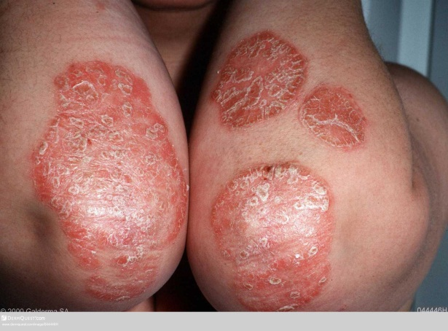
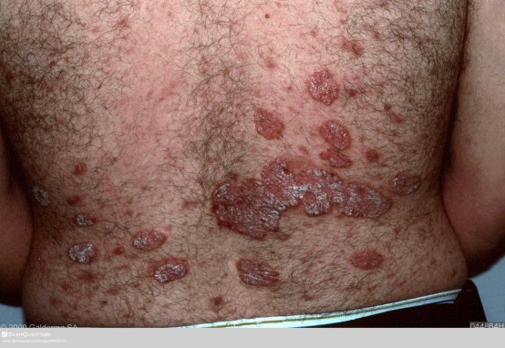
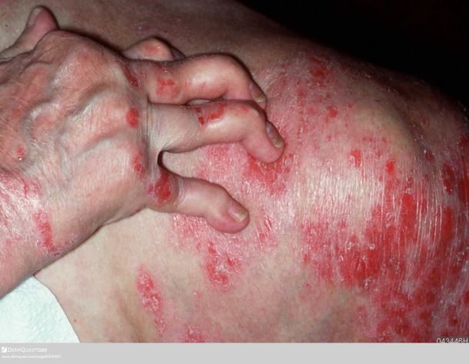
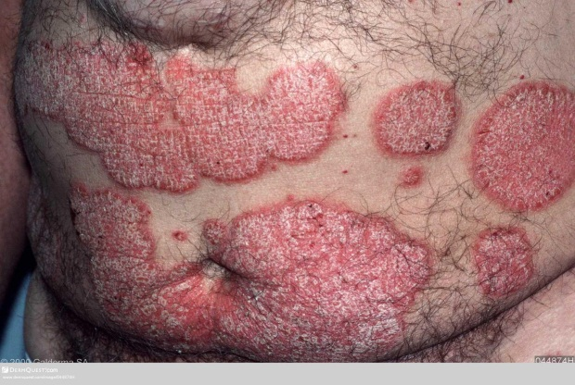
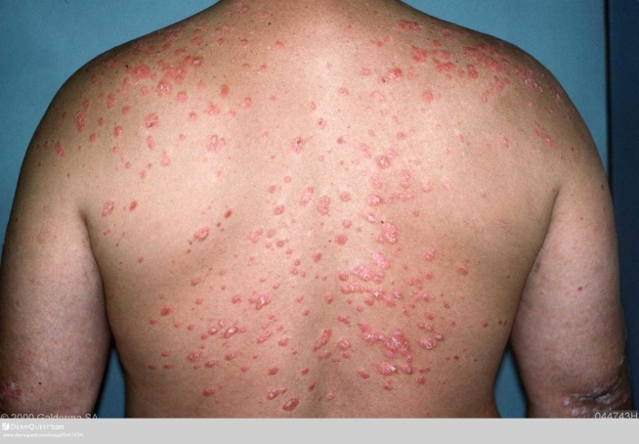
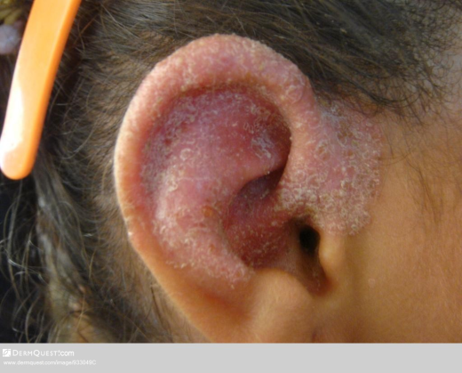
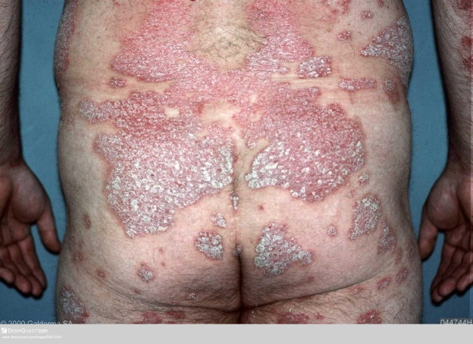
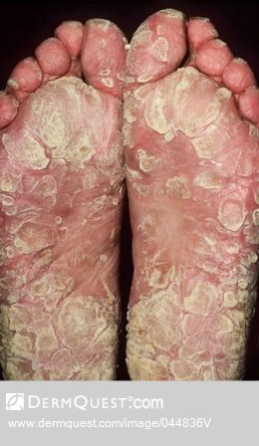
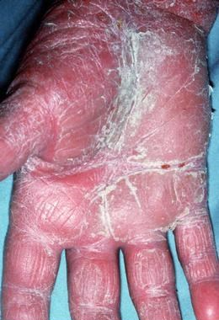
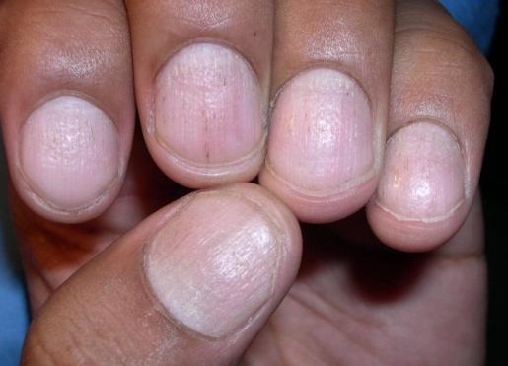
Notes:
All images DermQuest accessed 25th August 2015
Ear - https://www.dermquest.com/image-library/image/5044bfd1c97267166cd672a0r –
PSA - https://www.dermquest.com/image-library/image/5044bfd1c97267166cd66619https
Guttate: //www.dermquest.com/image-library/image/5044bfd0c97267166cd643d5
Nail https://www.dermquest.com/image-library/image/5044bfd1c97267166cd671beElbows - https://www.dermquest.com/image-library/image/5044bfd0c97267166cd64ed8
Palm - https://www.dermquest.com/image-library/image/5044bfd0c97267166cd64374
Scaly knee - https://www.dermquest.com/image-library/image/5044bfd0c97267166cd65a71
Back - https://www.dermquest.com/image-library/image/5044bfd0c97267166cd65a73
Elbows – bottom right https://www.dermquest.com/image-library/image/5044bfd0c97267166cd65a65
Flank - https://www.dermquest.com/image-library/image/5044bfd0c97267166cd64f
Back top left - https://www.dermquest.com/image-library/image/5044bfcfc97267166cd62c72
Feet - https://www.dermquest.com/imagelibrary/large/044836VB.JPG?dl=true&wm=true
Scaly plaque ankle (bottom right) - https://www.dermquest.com/image-library/image/5044bfd0c97267166cd65514
Images to show range of psoriasis including joint involvement :
Plaque
Nail
flexural,
Palmoplantar
Nail
PSA
Discuss how psoriasis involves skin in any area and can involve joints.
Patients severity varies widely as does impact on QOL and tis may not necessarily link woth disease severity
2

Slide 3
Learning outcomes
Overview of pathophysiology and aetiology of psoriasis including trigger factors
Describe different clinical presentations of psoriasis
Discuss assessment including identification of comorbidities
Describe management options in line with NICE guidance
Identify when to refer on

Slide 4
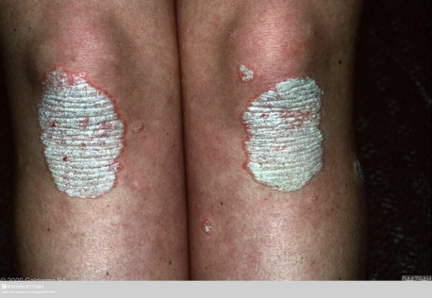
Overview
Psoriasis is a complicated, chronic inflammatory, multi-
aetiological auto-immune condition
Non-contagious and re-occurring
Predominantly affects skin and joints
Epidemiology
Affects between 1% and 3% of the UK population- up to 1.8 million people
Affects males and females equally
Can occur at any age; two peaks – late teens to early 30’s & around 50 to 60
Most common in white people, highest prevalence in Northern Europe/Scandinavian countries
Several clinical variants exist but plaque psoriasis most common form
Notes:
Source : Psoriasis Association
Web link: https://www.psoriasis-association.org.uk/pages/view/about-psoriasis
https://www.dermquest.com/imagelibrary/large/044794HB.JPG?dl=true&wm=true
Last accessed: 25.08.15

Slide 5
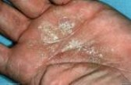
Why does psoriasis occur?
Changes begin in the immune system when T cells lymphocytes are triggered and become overactive
The T cells produce inflammatory chemicals leading to the rapid growth of skin cells causing psoriatic plaques to form
Not yet clear what initially triggers the immune system to act in this way
10% of the population inherits one or more of the genes that create a predisposition to psoriasis.
Only 2 to 3% of the population develops the disease
For a person to develop psoriasis, the individual must have a combination of the genes that cause psoriasis and be exposed to a trigger factor
Notes:
https://www.psoriasis.org/about-psoriasis/causes accessed 25th August 2015
The T cells act as if they were fighting an infection or healing a wound, which leads to them producing inflammatory chemicals, again leading to the rapid growth of skin cells causing psoriatic plaques to form. You may therefore hear psoriasis being described as an “auto-immune disease” or “immune-mediated condition”. It is not yet clear what initially triggers the immune system to act in this way.
https://www.dermquest.com/image-library/image/5044bfd0c97267166cd65530

Slide 6
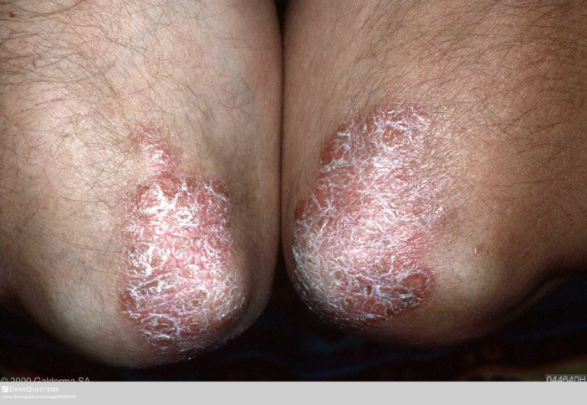
Diagnosis
Most cases of psoriasis can be reliably diagnosed by simple
physical examination
Skin, scalp, nails
Ruby-red, well defined plaques
Silvery surface scale
Often symmetrical
Extensor surfaces or can be widespread
Examine joints for psoriatic arthritis
Punctuate bleeding points (Auspitz’s sign)
Lesions on lower legs may be less typical
Notes:
http://www.pcds.org.uk/clinical-guidance/psoriasis-an-overview accessed 25th August 2015
Image of elbowshttps://www.dermquest.com/imagelibrary/large/044640HB.JPG?dl=true&wm=true

Slide 7
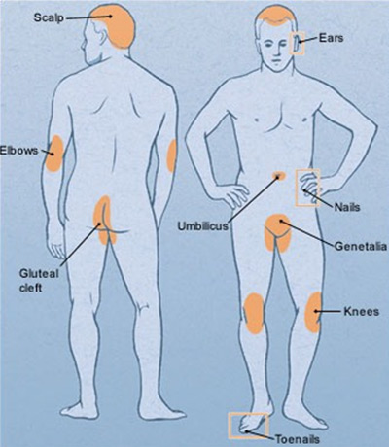
Presentations
Plaque
Scalp
Face, flexures and genital
Guttate
Pustular
palmoplantar
generalised
Nail
Erythrodermic
Psoriatic arthritis
Genitals
Notes:
Body map image from http://www.pcds.org.uk/clinical-guidance/psoriasis-an-overview accessed 24th August 2015

Slide 8
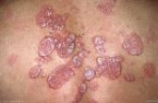
Assessment
For people with any type of psoriasis assess:
Presenting condition
Medical history
Family history
Previous treatments and responses
Disease severity – patients global assessment, physicians global assessment, PASI score
Impact of disease on physical, psychological and social wellbeing – DLQI
Presence of psoriatic arthritis - PEST
Presence of comorbidities
Notes:
Page 44 NICE CG153 October 2012
Image: https://www.dermquest.com/image-library/image/5044bfd0c97267166cd643da accessed 25/08/15
PASI = Psoriasis assessment and severity index
DLQI = dermatology life quality index
PEST = psoriasis epidemiology scoring tool
8

Slide 9
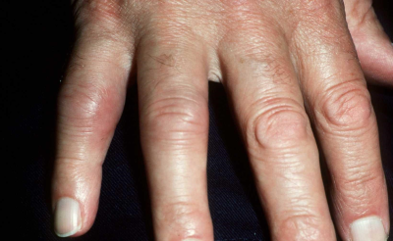
Psoriatic arthritis
Psoriatic arthritis (PsA) is a particular pattern of arthritis often seen in association with psoriasis
Most common in the joints in the hands and feet
Can also affect larger joints or areas where tendons join to bone, such as the knees, ankles, hips and lower back
Inflammation can also affect the tendons
Some people do develop PsA before they notice any psoriasis on their skin
Notes:
https://www.psoriasis-association.org.uk/pages/view/about-psoriasis/treatments-for-psoriatic-arthritis
https://www.dermquest.com/image-library/image/5044bfcfc97267166cd62c58

Slide 10
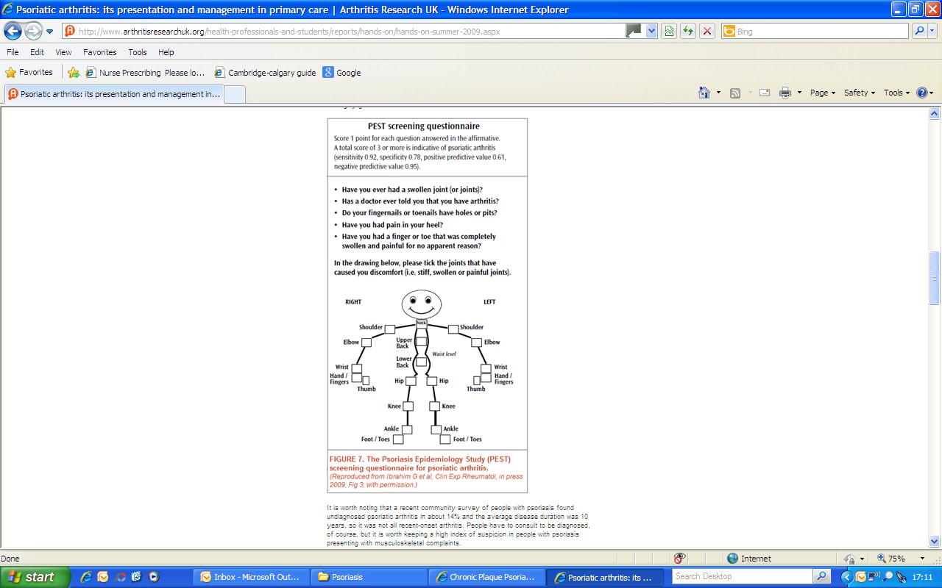
Psoriatic arthritis - PEST
As soon as psoriatic arthritis is suspected, refer the person to a rheumatologist for assessment and advice about planning their care
Notes:
Web link: https://www.psoriasis-association.org.uk/silo/files/Joint-Advances-2013-Abbvie.pdf
Last accessed: 12.02.2014

Slide 11

Co-morbidities
Discuss risk factors for cardiovascular comorbidities
Lipid modification
Obesity
Preventing type 2 diabetes
Prevention of cardiovascular disease
Alcohol use
Smoking cessation
Other comorbidities
Cancer (skin cancer, lymphoma, all cancer)
Liver disease
Depression
Inflammatory bowel disease
VT
Offer preventative advice, healthy lifestyle information & support for behavioural change
Notes:
NICE CG 153 Oct 2012 pages 201 & 203
Image - https://www.dermquest.com/image-library/image/5044bfd0c97267166cd6320a accessed 25/08/15
11

Slide 12
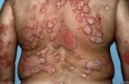
Disease impact
Encompasses functional, psychological and social dimensions:
Symptoms related to skin – chronic itch, bleeding, scaling, nail involvement
Problems related to treatments – mess, odour, inconvenience and time
Effect of living with highly visible, disfiguring skin disease – difficulties with relationships, securing employment and poor self esteem
About 1/3rd of people with psoriasis experience major psychological distress
Notes:
NICE CG153 October 2012 Page 15
Richards HL, Fortune DG, Weidmann A, Sweeney SK, Griffiths CE. The contribution of perceptions of stigmatisation to disability in patients with psoriasis. Journal of Psychosomatic Research. 2001; 50(1):10-15
Image - https://www.dermquest.com/image-library/image/5044bfd0c97267166cd63dc0 accessed 25/08/15

Slide 13
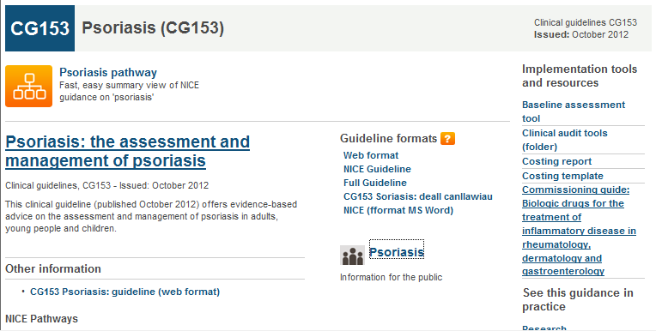
NICE guidance
Notes:
NICE
Web link: http://pathways.nice.org.uk/pathways/psoriasis
Last accessed: 12.02.2014

Slide 14
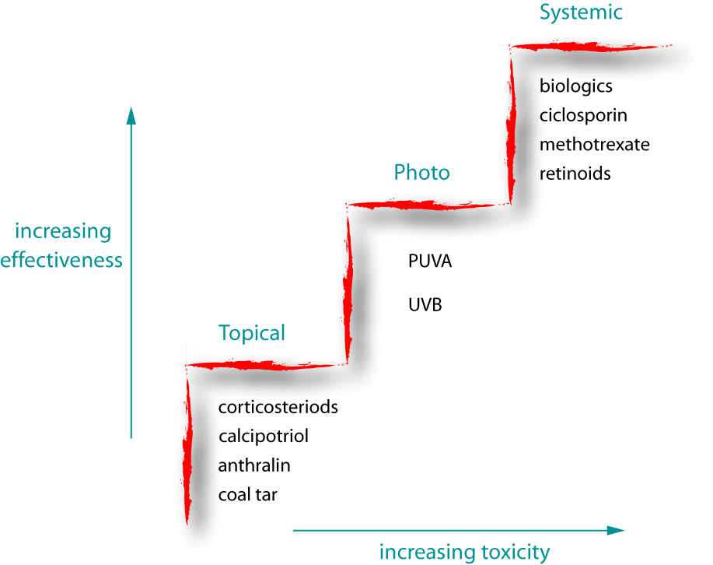
Treatments
Systemic biological therapy
For severe and very severe psoriasis
Etanercept *
Adalimumab *
Infliximab *
Ustekinumab
*recommended for the treatment of adults with active and progressive psoriatic arthritis
Systemic therapy
Methotrexate
Ciclosporin
Acitretin
Phototherapy
Increasing efficacy
Narrowband UVB for plaque or guttate
Psoralen (oral or topical) with local ultraviolet A (PUVA) for palmoplantar pustulosis
Risk of skin cancer!
Topical therapy
Emollients
Corticosteroids
Vitamin D/Vitamin D analogues
Vit D analogue/potent steroid
combination
Dithranol
Tar preparations
Increasing toxicity
Notes:
https://en.wikipedia.org/wiki/File:Psoriasis_treatment_ladder.svg
Last accessed 26th August 2015

Slide 15
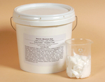
Emollients
NICE CG153 2012 starts the treatment pathway
with the assumption that, when appropriate,
emollients have been prescribed
Emollients reduce dryness, cracking, scaling of the skin, including itch
May be the only treatment necessary for mild psoriasis
Consider using humectants
Notes:
Before moving on to different treatments discuss importance of emollients and NICE stating that the assumption is that these will already been applied
https://www.medicinescomplete.com/mc/bnf/current/PHP7698-preparations-for-psoriasis.htm

Slide 16
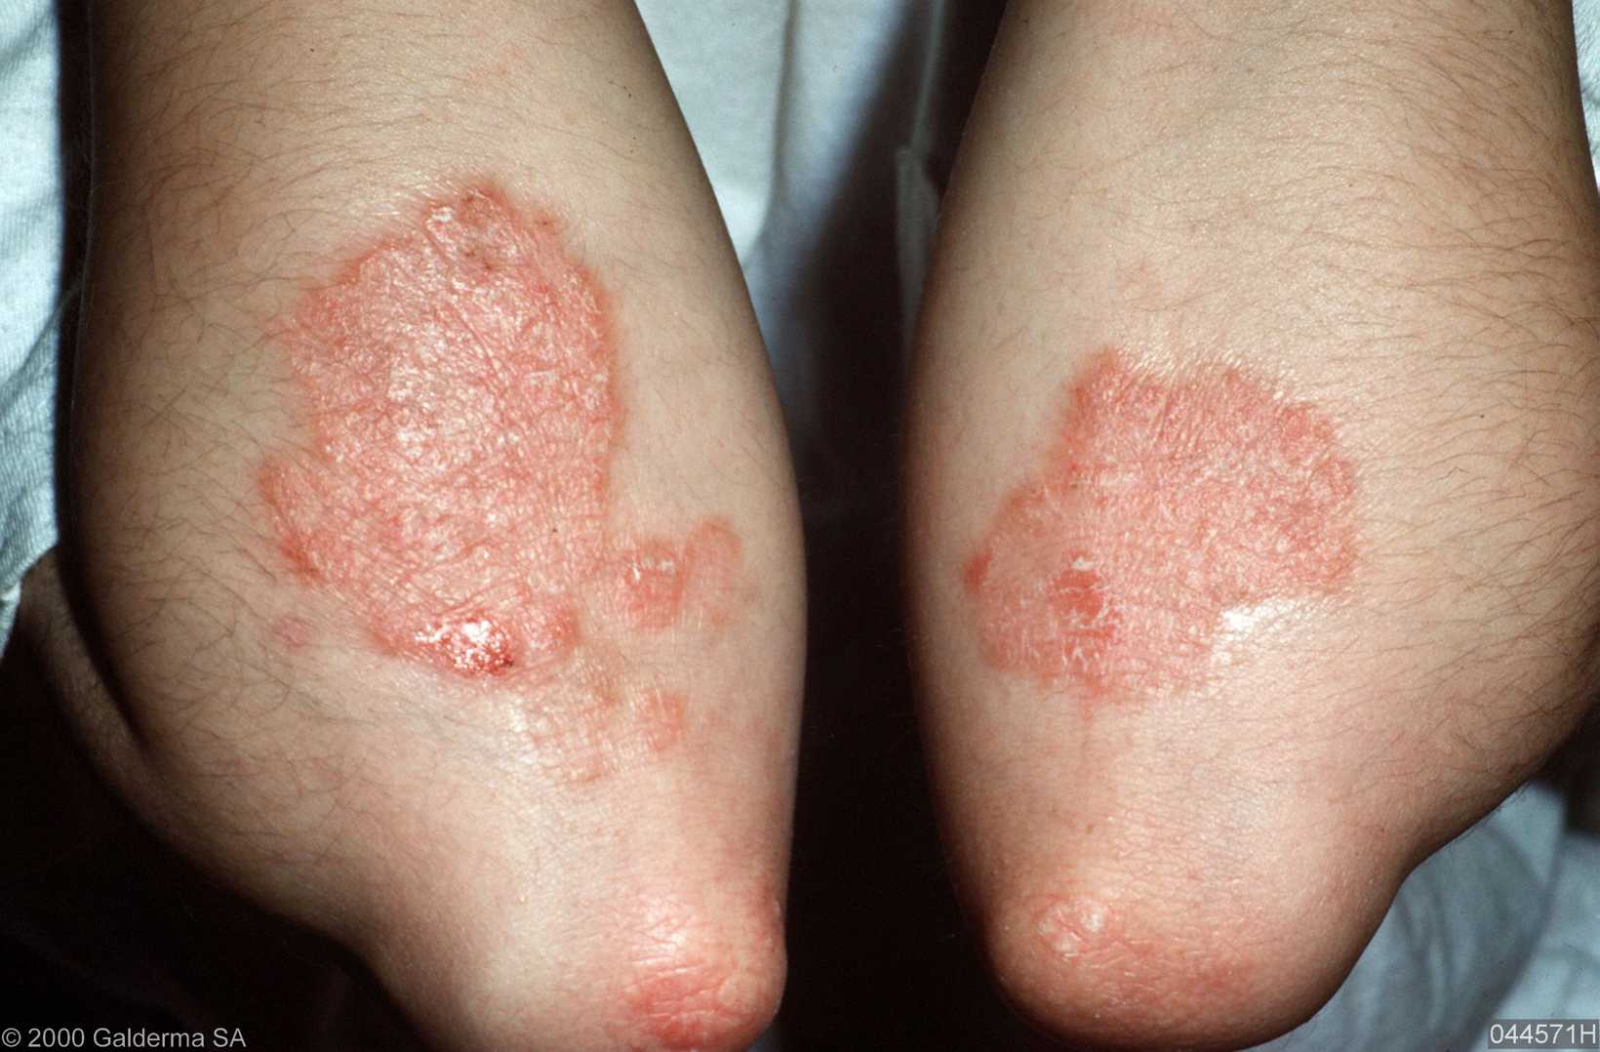
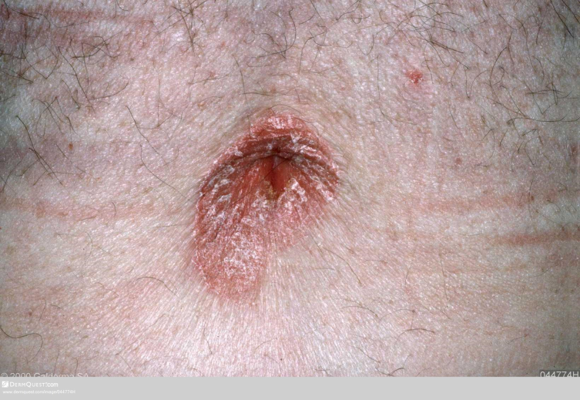
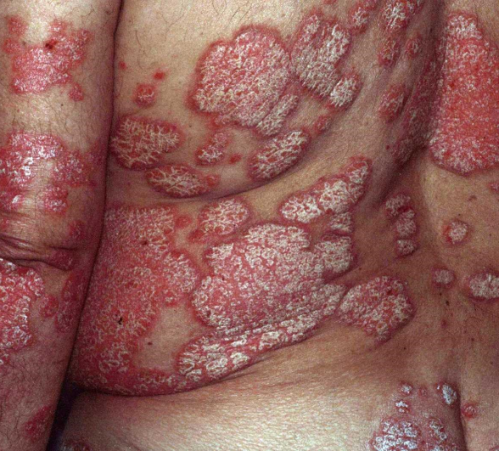
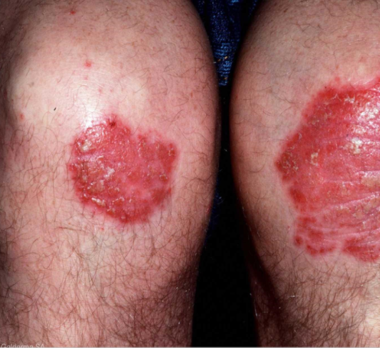
Plaque psoriasis
Notes:
Elbows - https://www.dermquest.com/image-library/image/5044bfd0c97267166cd64ed8
Back - https://www.dermquest.com/image-library/image/5044bfd0c97267166cd63dbf
Navel - https://www.dermquest.com/image-library/image/5044bfcfc97267166cd6216d
Knees - https://www.dermquest.com/image-library/image/5044bfd0c97267166cd64ecc

Slide 17
Topical treatment – trunk & limbs
Ist Line
Potent topical steroid OD and a Vitamin D or Vitamin D analogue OD for up to 8 weeks
2nd Line
Vitamin D or Vitamin D analogue alone BD for 8 – 12 weeks
3rd line
Potent topical corticosteroid BD or a coal tar preparation OD/BD for up to 4 weeks
4th line
if above cannot be used or a OD preparation would improve adherence offer a combination product of Calcipotriol and Betamethasone Dipropionate OD for up to 4 weeks
Notes:
NICE CG153 Oct 2012 page 52 and 53
17

Slide 18
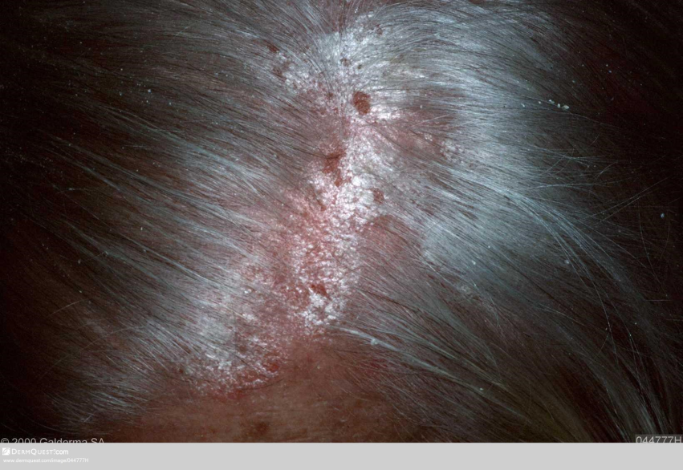
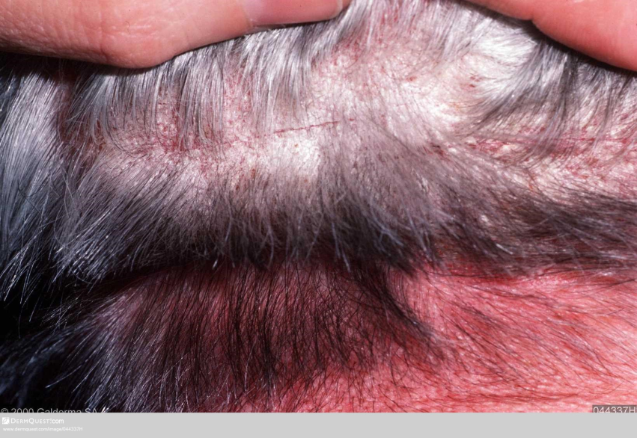
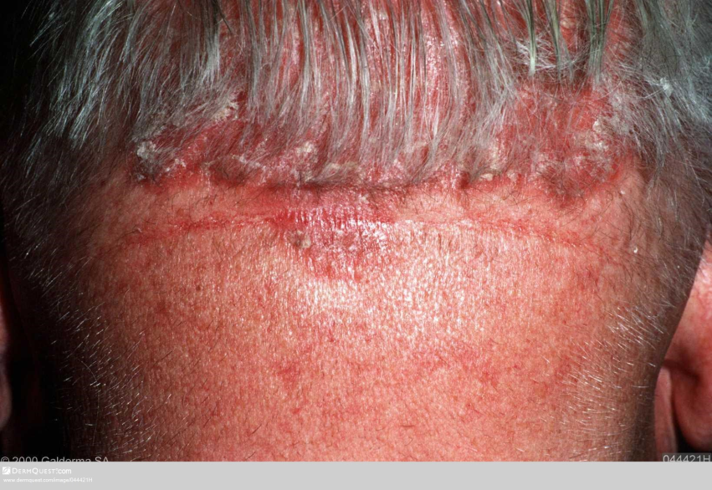
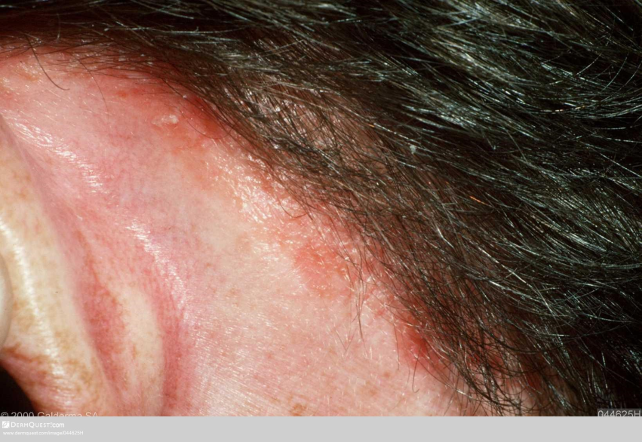
Scalp psoriasis
Notes:
Top Left image -https://www.dermquest.com/imagelibrary/large/044777HB.JPG?dl=true&wm=true
Top Right image - https://www.dermquest.com/imagelibrary/large/044337HB.JPG?dl=true&wm=true
Bottom left - https://www.dermquest.com/imagelibrary/large/044421HB.JPG?dl=true&wm=true
Bottom right - https://www.dermquest.com/imagelibrary/large/044625HB.JPG?dl=true&wm=true

Slide 19
Topical scalp treatments
1st line
Potent topical corticosteroid OD for up to 4 weeks
2nd line
A different formulation of the potent corticosteroid for up to 4 weeks and/or
Topical agents to remove adherent scale before application of the steroid for up to 4 weeks
3rd line
A combination product containing calcipotriol monohydrate and betamethasone dipropionate OD or
Vitamin D or vitamin D analogue OD up to 8 weeks
4th line
Very potent topical corticosteroid up to BD for 2 weeks or
Coal tar applied OD or BD or
Referral to specialist for additional support with topical applications and/or advice on other treatment options
Notes:
NICE CG153 Oct 2012 page 53 &
Topical agents to remove adherent scale before application of the steroid for up to 4 weeks – highlight this should be done first
54
19

Slide 20
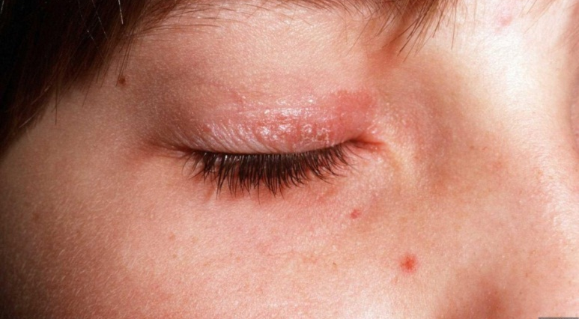
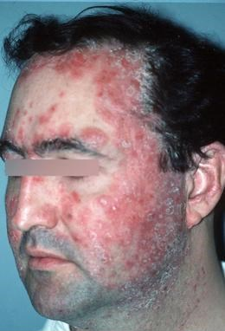
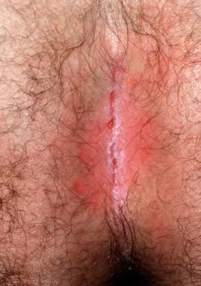
Face, flexural and genital psoriasis
Notes:
Male face - https://www.dermquest.com/image-library/image/5044bfd0c97267166cd64f05
Eyelid https://www.dermquest.com/image-library/image/5044bfd0c97267166cd65e54
Natal cleft - https://www.dermquest.com/image-library/image/5044bfcfc97267166cd61a77

Slide 21
Topical treatment face, flexures & genitals
1st Line
First line – short-term mild to moderate potency corticosteroid applied OD or BD for up to max 2 weeks
2nd Line
Second line – calcineurin inhibitor applied BD for up to 4 weeks
Notes:
NICE CG153 Oct 2012 pages 54 & 55
PCDS Facial – recommend using vitamin D analogues – tacalcitol or calcitriol
Tacrolimus 0.1% off licence
PCDS – flexural and genital – emollients, topical steroids, vitamin D compunds tacalcitol and calcitriol.
Off label pimecrolimus or 0.1% tacrolimus ointment
21

Slide 22
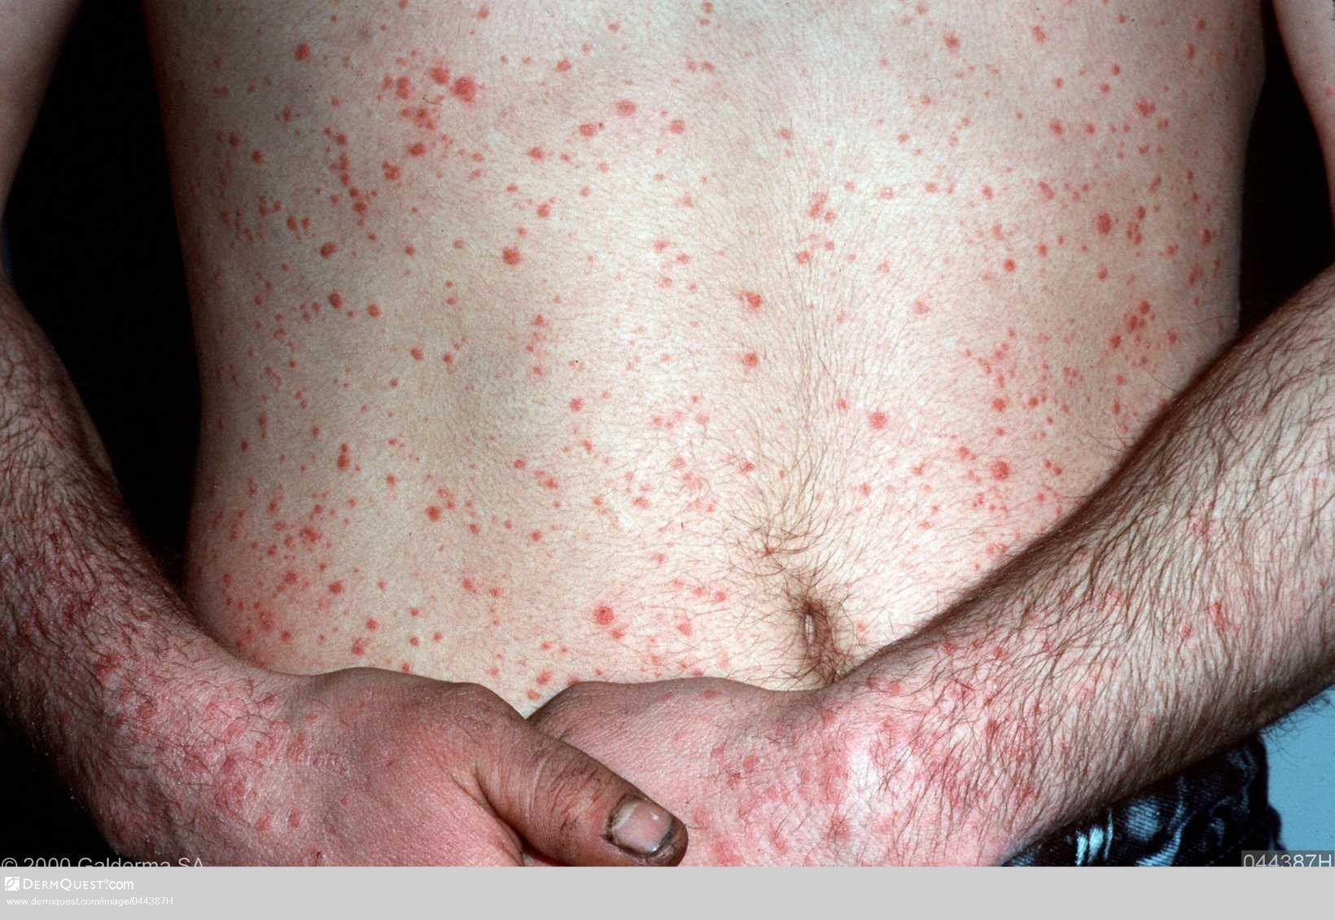
Guttate psoriasis
Notes:
https://www.dermquest.com/image-library/image/5044bfd0c97267166cd643bc

Slide 23
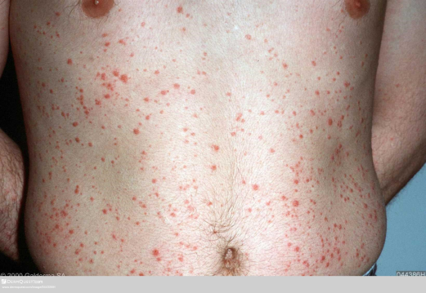
Guttate
Multiple small ‘tear drop’ scaly lesions
Can affect most of the body
Comes on quickly
May follow 7 – 10 days after an URTI
Tends to affect children & young adults
Can spontaneously clear within 2-3 months
May progress into chronic plaque psoriasis
Differential Diagnosis:
Pityriasis rosea, viral exanthems, drug eruptions
Notes:
www.pcds.org.uk
Image - https://www.dermquest.com/image-library/image/5044bfd0c97267166cd643bb

Slide 24

Treatment
Treat with emollients first
Also tar preparations, Vitamin D/Vitamin D analogues
Refer for narrow band UVB if unresponsive
Notes:
www.Pcds.org.uk
Image - https://www.dermquest.com/image-library/image/5044bfd0c97267166cd643bb

Slide 25
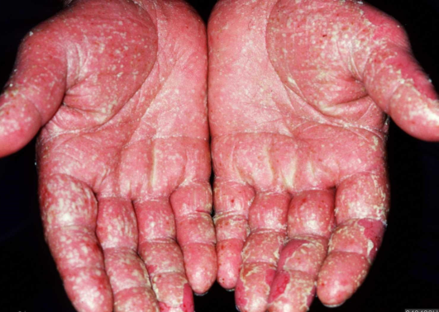
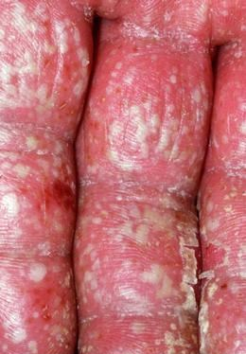
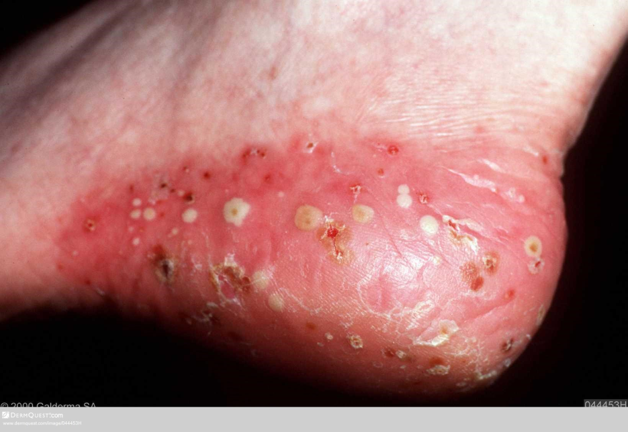
Palmoplantar pustulosis
Mainly older 50+ patients
Females>males
Strong link with smoking
25% linked with chronic plaque psoriasis
Palms/feet (heel and instep)
Erythematous plaques with yellow/brown pustules
Treatment:
potent steroids
light therapy
Systemic therapy
Notes:
www.pcds.org.uk
Hands - https://www.dermquest.com/imagelibrary/large/043428HB.JPG?dl=true&wm=true
Fingers - https://www.dermquest.com/imagelibrary/large/043425VB.JPG?dl=true&wm=true
Soles - https://www.dermquest.com/imagelibrary/large/044453HB.JPG?dl=true&wm=true

Slide 26

Nail psoriasis
Mainly occurs in patients who also have psoriasis of the skin
Less than 5% of patients have solely psoriasis of the nails
Pitting, onycholysis, subungual hyperkeratosis, oil drop or salmon patch
Treatment:
Mycology if diagnostic uncertainty
Treatment is difficult
Keep nails short
Vitamin D and steroids can be used for a trial of 3 months
Notes:
Nail https://www.dermquest.com/image-library/image/5044bfd1c97267166cd671be
www.pcds.org.uk
Onycholysis – a yellow/white discolouration where the distal nail plate has separated from the nail bed
Subungual hyperkeratosis – thickening of the nail bed
Oil drop or slamon patch – translucent yellow-red discolouration in the nail bed, resembles a drop of oil under the nail plate

Slide 27
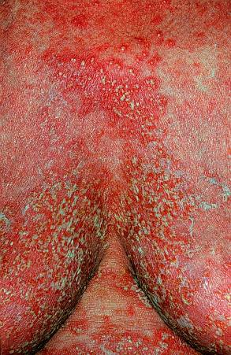
Generalised pustular
Rare
Widespread pustules on a background of red, tender skin
Systemic upset with sore skin, fever malaise
Can be drug induced, i.e. sudden withdrawal of topical or systemic corticosteroids, lithium or salicylates
Need admitting
Notes:
www.pcds.org.uk
Image ??

Slide 28
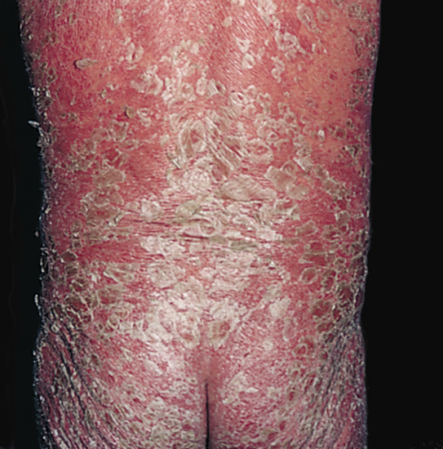
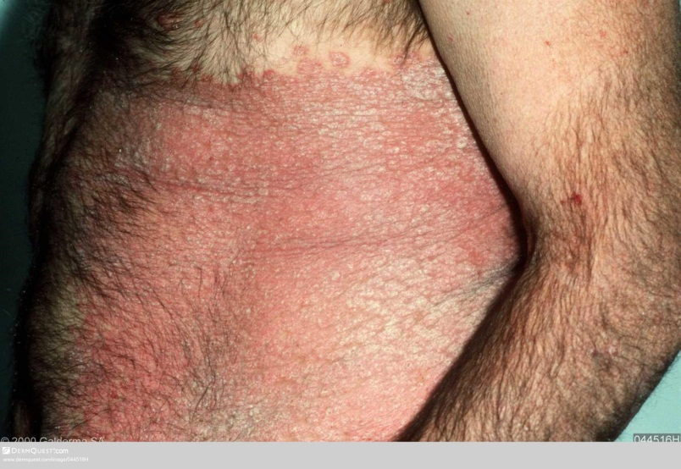
Erythrodermic
Lesions are replaced by erythema and scaling
Affects more than 90% of body surface
Disrupts the skin’s function
Problems with temperature regulation, dehydration, kidney and heart failure can develop
Medical emergency and may need admission
Notes:
Lower image : https://www.dermquest.com/image-library/image/5044bfd0c97267166cd65528
No link for above image
www.pcds.org.uk

Slide 29
Referral (NICE)
There is diagnostic uncertainty
Any type of psoriasis is severe or extensive e.g. more than 10% of the BSA affected
Any type of psoriasis cannot be controlled with topical therapy
Acute guttate psoriasis requires phototherapy
Nail disease has a major functional or cosmetic impact
Any type of psoriasis is having a major impact on a person’s physical, psychological or social wellbeing
See North Durham referral guidelines
Notes:
NICE CG 153 Oct 2012 pages 48 - 49
29

Slide 30
Resources
www.psoriasis-association.org.uk
www.papaa.org
www.pcds.org.uk
www.bad.org.uk
NICE Clinical Guidelines 153 October 2012 (updated November 2014)

