Slide 1
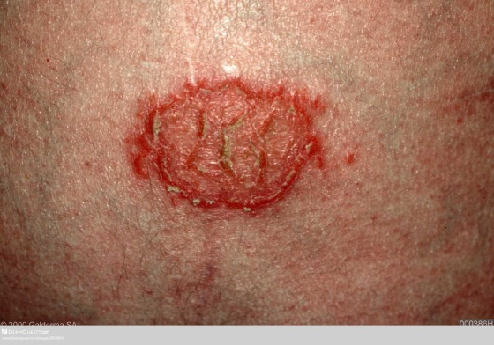
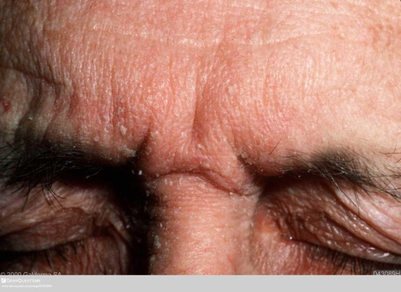
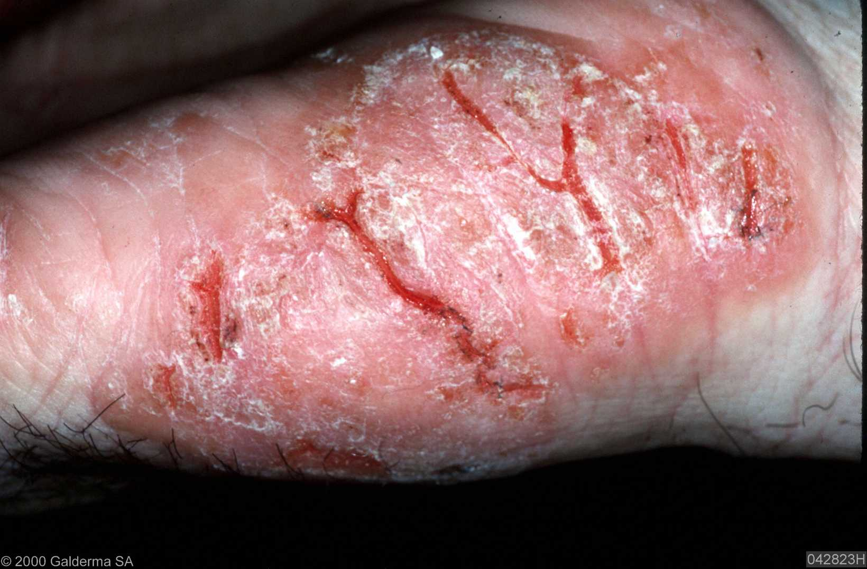
Eczema
Diagnosis & Management
Alison Barton
Dermatology Specialist Nurse
NUR/524/1011(1)
Date of preparation: February 2014

Slide 2
Types of eczema - dermatitis
Atopic eczema
Discoid eczema
Seborrhoeic dermatitis
Hand dermatitis
Pompholyx
Eczema asteototic
Perioral dermatitis
Varicose dermatitis
Allergic contact dermatitis
Irritant contact dermatitis
Nodular prurigo

Slide 3
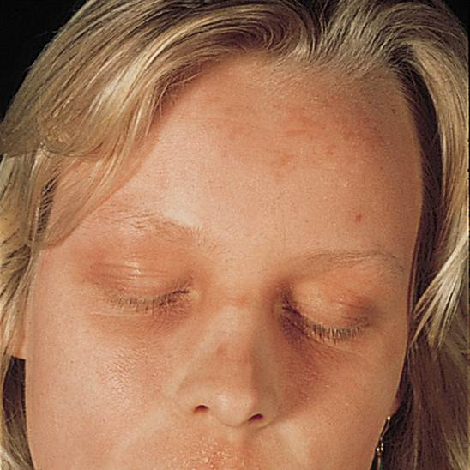
Notes:
https://www.dermquest.com/image-library/image/5044bfcfc97267166cd62141

Slide 4
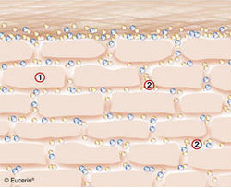
Skin barrier function
NMF
Filaggrin
H2O
H2O
Filaggrin
NMF
NMF
Filaggrin
NMF
The skin barrier:
is the uppermost layer of the epidermis (stratum corneum)
protects the underlying skin from penetration of irritants/allergens and prevents loss of water from the skin
is made up of
  Corneocytes containing water and filaggrin, a protein essential for the generation of natural moisturising factors (NMF)
  Lipid lamellae, which surround the corneocytes, waterproofing the structure
NMF are essential because they attract water into the corneocytes
The surface is acidic with a pH of 5 – ‘acid mantle’
H2O
NMF
H2O
Notes:
Best Practice in Emollient Therapy Page S4

Slide 5
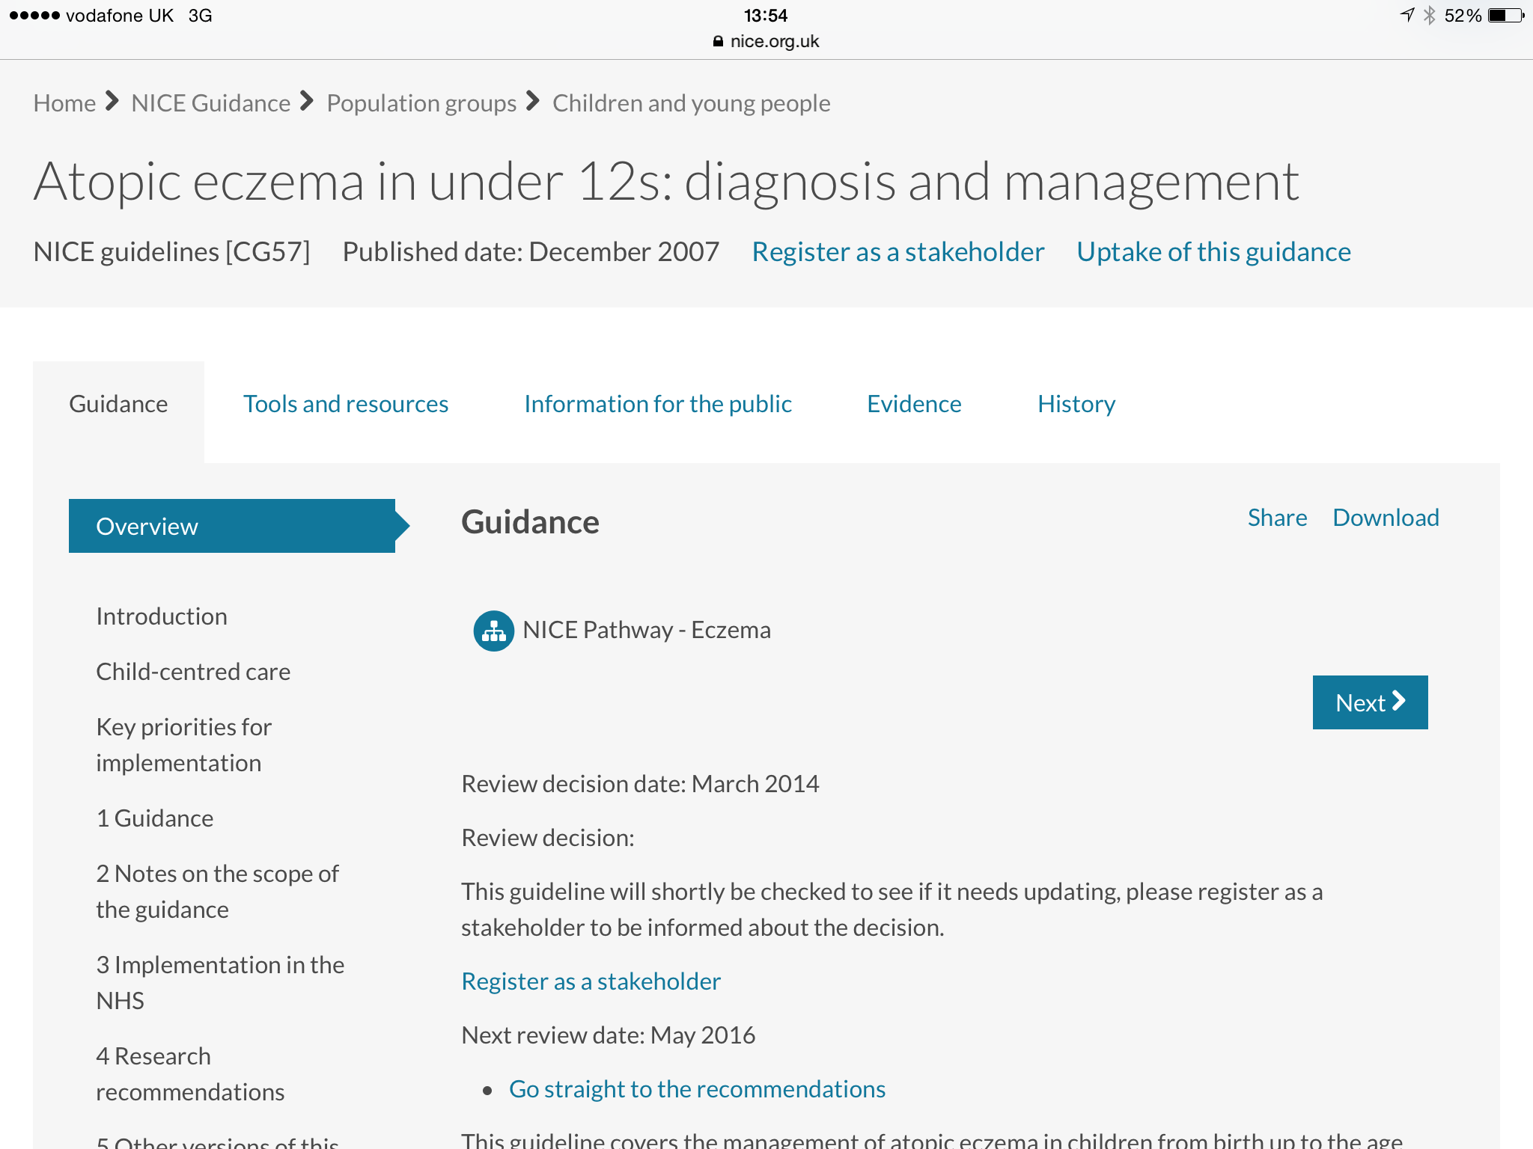
Notes:
NICE 2007 guidelines

Slide 6
History taking
Time of onset, pattern and severity of the atopic eczema
Response to previous and current treatments
Possible trigger factors (irritant and allergic)
The impact on quality of life
Dietary history including any dietary manipulation
Growth and development
Personal and family history of atopic diseases
Notes:
Parts of the body most often involved
Atopic eczema usually starts on the scalp or cheeks in infants. It may even start as cradle cap. It later spreads to the limbs and body and in some children may be widespread for a time. At the crawling stage it is usually worst on the backs of the elbows and the fronts of the knees. When the child is a little older the eczema settles in its characteristic location at the skin creases of the arms and legs. In teenagers and adults it may be worst on the hands.

Slide 7
Trigger factors
Spontaneous flare-ups are often the result of triggers
Common triggers are:
Soap / detergents
Overheating / rough clothing
Skin infection
Animal dander
Aeroallergens (pollens) – mainly older children and adults
Food - primarily in infants and young
House-dust mites
Stress

Slide 8
Dietary interventions
Dietary exclusion is not recommended for management of atopic eczema in patients without confirmed food allergy
Where there is suspicion of food allergy refer to an allergist or paediatrician with a special interest in allergy
Notes:
Text: SIGN guidance quick reference Eczema March 2011, page 2 (see PDF attached)

Slide 9
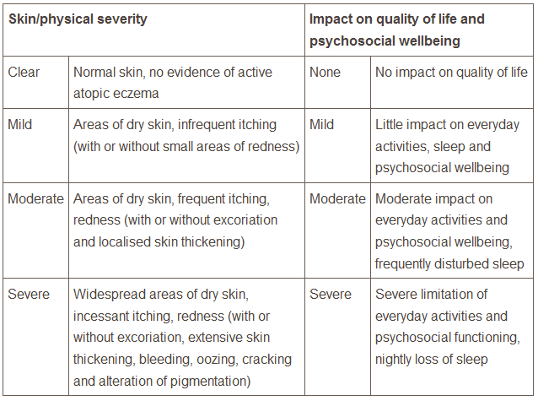
Assessment of severity, psychological and psychosocial wellbeing and quality of life
Take into account the impact of atopic eczema on parents or carers, as well as the child
Notes:
NICE 2013 page 50

Slide 10
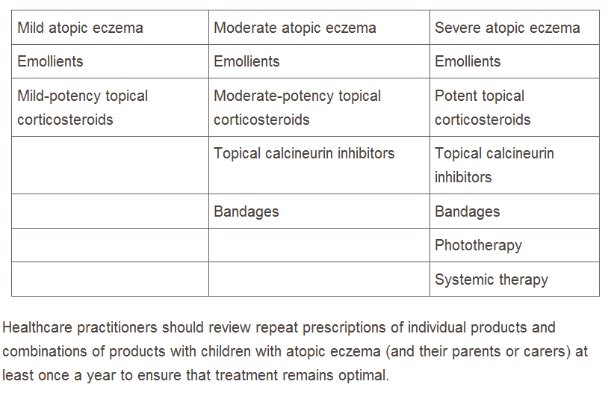
Stepped approach to management
Notes:
Data from: [NICE, 2007]
Severe atopic eczema: For delicate areas of skin such as the face and flexures, use a moderate potency corticosteroid (such as betamethasone valerate 0.025%, clobetasone butyrate 0.05%). Aim for a maximum of 5 days use
Antihistamines: If itching is severe and affecting sleep, consider prescribing a sedating antihistamine (such as chlorphenamine) for adults and children aged 6 months or over (maximum two-week course).
If a non-sedating antihistamine is required, prescribe cetirizine, loratadine, or fexofenadine once daily.
Antihistamines are rarely indicated for pregnant women with eczema, but if required, loratadine is probably a safe option.
If a sedating antihistamine is required, prescribe chlorphenamine. Chlorphenamine is not specifically licensed for pruritus, but is licensed for allergic conditions (including urticaria [a condition where itch is the predominant symptom]) in adults and children (older than 1 year of age). Chlorphenamine may be considered in pregnancy, if necessary.

Slide 11
Total emollient therapy
Vital treatment for dry skin conditions and for the promotion of skin health
Consists of:
Emollient lotions, creams, gels, mousses, sprays or ointments
Emollient wash products
Emollient bath or shower products
Notes:
Best Practice in Emollient Therapy – A statement for health care professionals Dec 2012 S4

Slide 12
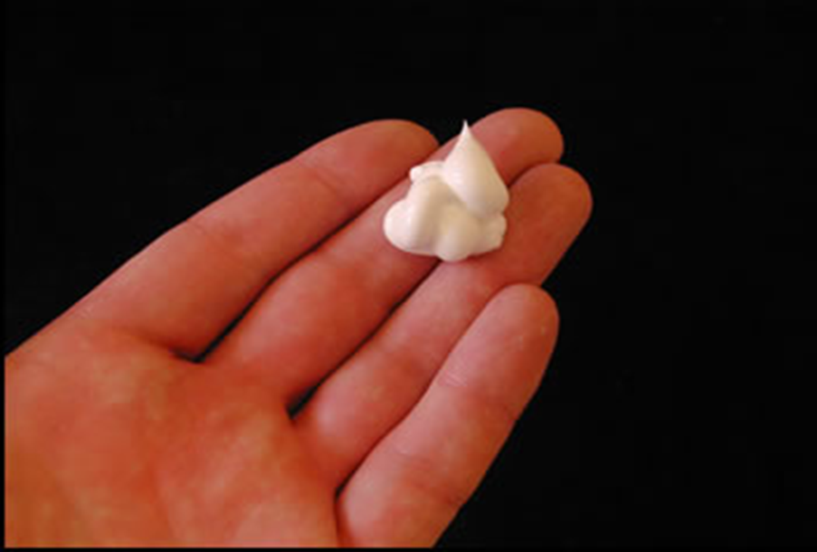
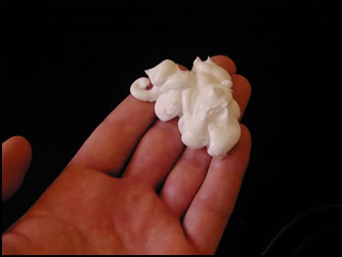
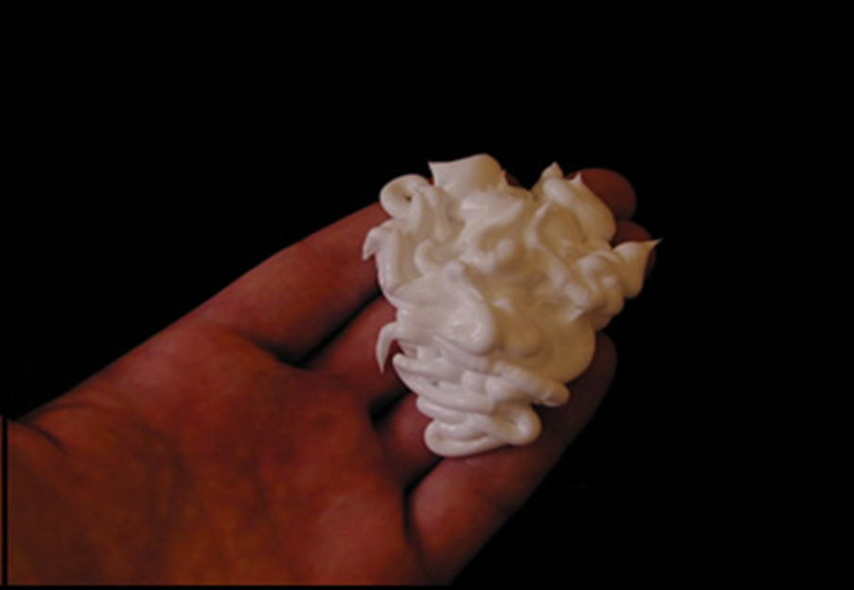
5 Grams
10 Grams
20 Grams
Notes:
Images courtesy of Isabel Lavers

Slide 13
Humectants
What are humectants?
Substances that promote retention of moisture
attract water from the dermis into the epidermis
that increase the pliability and flexibility of the skin, preventing it from cracking
such as urea, glycerine, lactic acid or glycolic acid
Humectants (some of which also have keratolytic properties) are particularly important in managing very dry/scaly skin

Slide 14
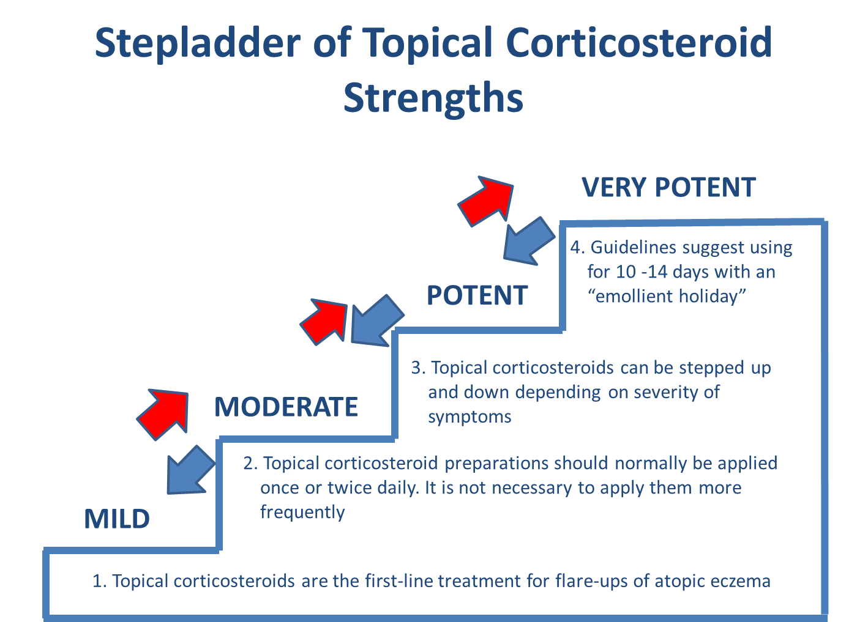
Notes:
Taken from NUR/005/0415

Slide 15
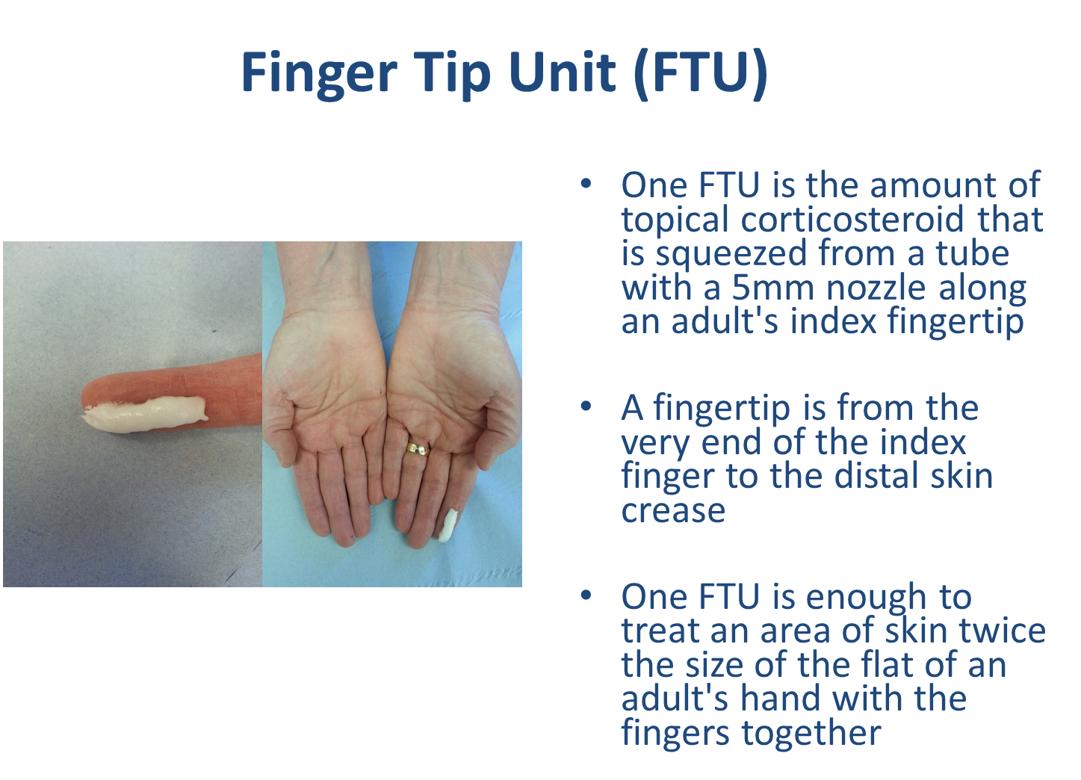
Notes:
Taken from NUR/005/0415

Slide 16
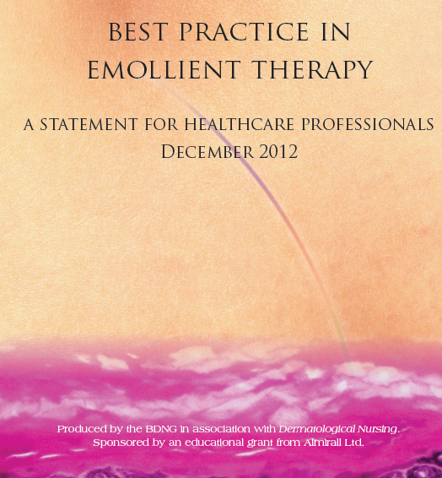
Applying emollients in relation to other topical products
Topical emollients can be steroid sparing
Topical steroids should be applied to well moisturised skin
Moisturisers should be allowed to absorb into the skin before the application of a therapeutic product
Notes:
www.bdng.org.uk

Slide 17
See local eczema guidelines

Slide 18
Topical calcineurin inhibitors
NICE 2004
Pimecrolimus (Elidel ®)
recommended second-line treatment of moderate atopic eczema on the face and neck in children aged 2 to 16 years, not controlled by topical corticosteroids
Tacrolimus (Protopic ®)
recommended for the second-line treatment of moderate to severe atopic eczema in adults and children aged 2 years and older, not controlled by topical corticosteroids
Topical calcineurin inhibitors should not be applied to skin which appears actively infected
Notes:
NICE : Quick reference guide Tacrolimus and Pimecrolimus for atopic eczema Issue date: August 2004 - latest
Text (precaution): SING guidance quick reference Eczema March 2011, page 2

Slide 19
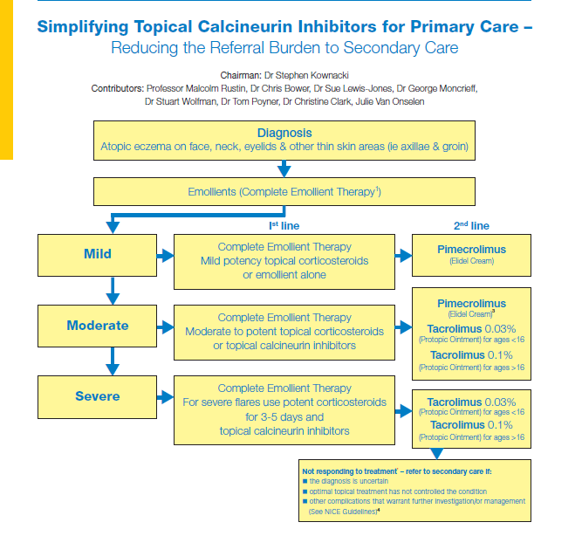
Primary Care Dermatology Society
Notes:
www.PCDS.org.uk

Slide 20
Other treatments
Impregnated tapes
Bandages/garments
Oral corticosteroids can be prescribed short-term in primary care for severe flares
Phototherapy
Systemic medications ( often secondary care)
Biologic therapies (once tried and failed others)
Notes:
Oral corticosteroid
Prescribe a short course of an oral corticosteroid. There are no data from controlled trials, but 30 mg prednisolone taken in the morning for 1 week should be sufficient.
The frequent or prolonged use of systemic corticosteroids is associated with serious adverse effects, including growth retardation in children, diabetes mellitus, high blood pressure, and osteoporosis. However, these are unlikely to be a problem with a single course of prednisolone.

Slide 21
Supported by education
How much of the treatments to use
How to apply and how often to apply prescribed treatments, including emollients, steroids, calcineurin inhibitors and medicated dressings (bandages)
When and how to step treatment up or down
How to prevent infection
How to treat infected atopic eczema
Notes:
Prevention of infection
What treatment and advice can I give to reduce infection?
Prescribe new supplies of topical products (emollients and corticosteroids) for use after the infection has cleared, and advise the person to discard the old products.
Consider advising the use of a topical antiseptic preparation (for example chlorhexidine or triclosan) as an adjunct to standard treatment, to reduce the bacterial load in areas that are prone to infection.
Encourage continued maintenance of the skin by advising:
Avoidance of trigger factors
Frequent and liberal use of emollients.
Appropriate use of topical corticosteroids.
http://cks.nice.org.uk/eczema-atopic#!scenariorecommendation:19

Slide 22
Complications of eczema

Slide 23
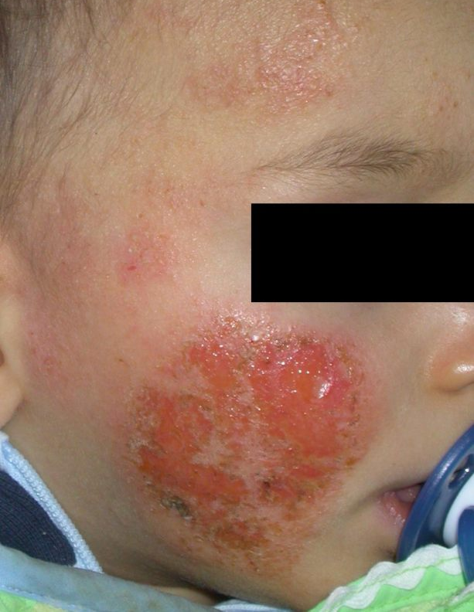
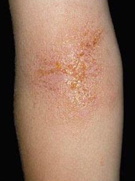
Notes:
Image – www.PCDS.org.uk (permission given)
Secondary infection: Impetigo is a highly contagious skin infection, which causes sores that quickly rupture (burst) to leave a yellow-brown crust (secondary infection) most often caused by staphylococcus aureus

Slide 24
Infected eczema (bacterial infection)
Signs and symptoms
weeping and crusted, pustules and/or surrounding cellulitis with erythema
eczema rapidly worsening or failing to respond to treatment
fever or malaise
Swab lesions only if
Suspected involvement of an atypical or resistant pathogen (eczema is failing to respond to antibiotic treatment)
extensive areas of infected eczema (a swab should be taken before treatment with an oral antibiotic)

Slide 25
Infected eczema
Localised
Topical antibiotic (separate products or combined with a corticosteroid)
Topical antibiotics should be used for no longer than 2 weeks
Extensive
Flucloxacillin 1st line
Erythromycin if 1st line contraindicated
Consider using clarithromycin if 1st or 2nd line not tolerated
Prescribe alternative if above failed
Continue treatment with topical corticosteroids and emollients while taking antibiotics
Notes:
CKS 2015 last accessed 26th April 2016
Flucloxacillin is licensed for the treatment of infected skin conditions, including eczema. Use clinical judgement to determine the appropriate dose and duration. The normal dosage for an adult is 250 mg, four times daily. This can be doubled if the skin looks very infected. Treat for 1 week. This can be extended to 2 weeks if the initial response is inadequate
Erythromycin is licensed for skin and soft tissue infections. It is usually prescribed at a dosage of 250 mg, four times daily, for 1 week. The dose and duration can be doubled in severe infection. Avoid erythromycin in people with severe hepatic impairment.
Clarithromycin is licensed for skin and soft tissue infection. It is usually prescribed at a dosage of 250 mg, twice daily, for 1 week.
The dose and duration can be doubled in severe infection. Avoid clarithromycin in people with severe hepatic impairment

Slide 26
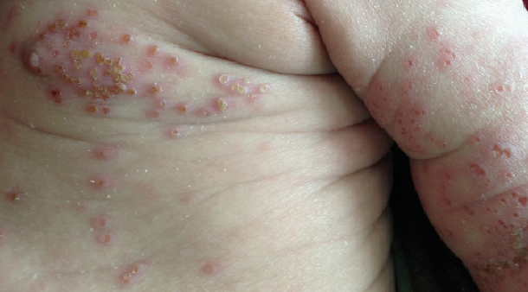
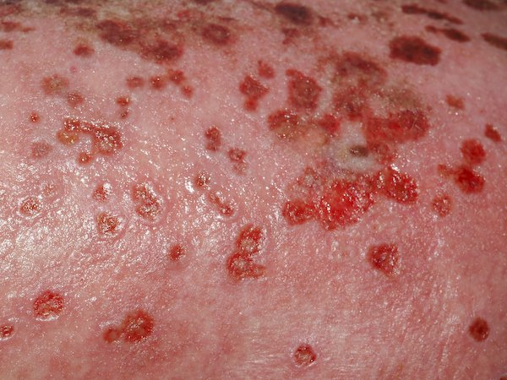
Eczema herpeticum
Cause: Herpes simplex virus types 1 or 2
Cutaneous features
Areas of rapidly worsening, painful eczema
Clustered vesicles / punched-out monomorphic erosions, which may coalesce
Systemic features
Fever, lethargy or distress
Treatment
oral or intravenous aciclovir can be given depending on the clinical situation
treatment with oral aciclovir should be started even if the infection is localised
If eczema herpeticum involves the skin around the eyes, same-day referral for ophthalmological and dermatological advice
Notes:
Images – www.pcds.org.uk (permission given)

Slide 27
Referral
See local eczema guidelines

Slide 28

Thank you. Any questions?

Slide 29
References and further reading
British Association of Dermatologist www.bad.org.uk
The NHS Clinical Knowledge Summaries www.cks.nhs.uk/home
BNF http://bnf.org/bnf/
National Eczema Society www.eczema.org
Helpline: 0800 089 1122 Email: info@eczema.org
SIGN guideline http://www.sign.ac.uk/pdf/qrg125.pdf
PCDS http://www.pcds.org.uk/clinical-guidance/atopic-eczema
NICE www.nice.org.uk/CG057
NHS http://www.nhs.uk/Conditions/Eczema-(atopic)/Pages/Introduction.aspx

