Slide 1

Acne Vulgaris
Alison Barton
Dermatology Specialist Nurse

Slide 2
Learning outcomes
Increased understanding of the pathophysiology of acne
Understand the assessment of acne
Case studies on management and treatment options in line with current guidelines
Discuss psychological impact
When to refer to a specialist
Notes:
Agreed learning outcomes for group

Slide 3

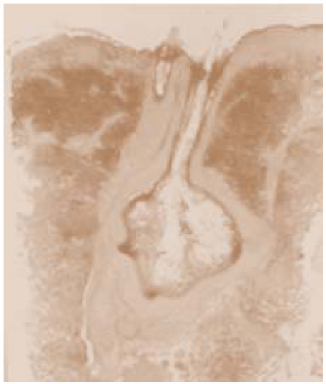
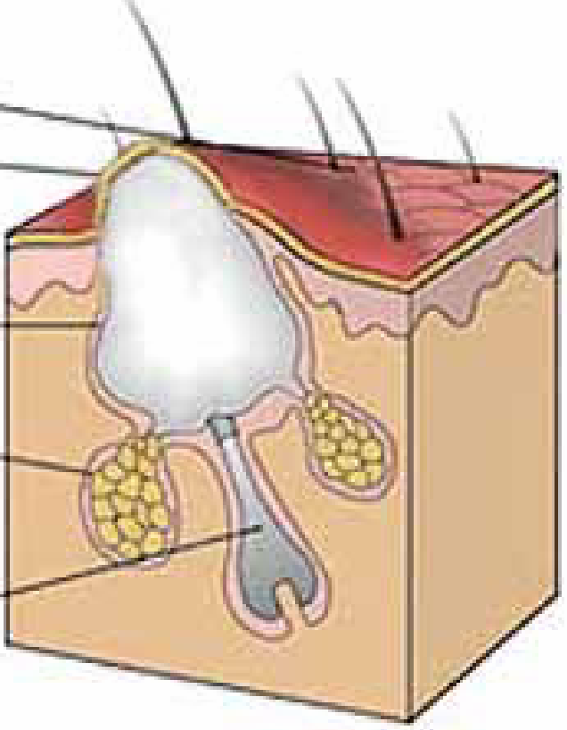
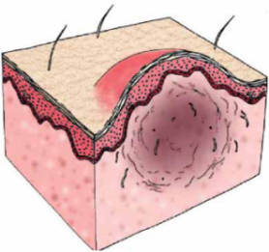
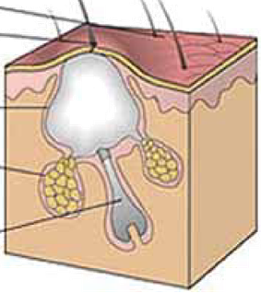
The acne disease pathway
1
Androgen hormone influences and stimulates sebaceous gland
Sebaceous glands enlarge
Excessive sebum production
Over production of epithelial cells lining follicles
Hyperkeratinization
2
Microcomedone formation
A thick hyperkeratotic plug
Scars
3
Inflammation and immune response
Formation of pustules and cysts
Propionibacterium acnes colonization in anaerobic environment
Pathogenic factors of acne
Excessive sebum production
Hyperkeratinization (abnormal cell turnover)
Inflammation and immune response
P. acnes colonization
Goal of treatment: To target as many pathogenic factors of acne as possible
4
White heads and black heads form
Notes:
Adapted from Common Facial Dermatoses – NUR/007/0814

Slide 4
Assessment
Duration
Family history
Response to previous treatments
Including over the counter products (OTC)
Adherence with treatments
Use of oil free/non comedogenic products
Differential diagnosis
Types of lesions
Notes:
Ref: www.PCDS.org.UK/acne

Slide 5
Psychological aspects
Stress
Anxiety and depression
Social implications
Occupational implications
Self esteem
Body image
Severity of psychological impact
Notes:
Explore the psychological aspects of the disease and importance to consider patients quality of life issues

Slide 6
Grading
Classified as:
Non inflammatory (comedonal)
Mild
Moderate
Severe
Useful to use a grading scale
Notes:
Ref: www.PCDS.org.uk/acne

Slide 7
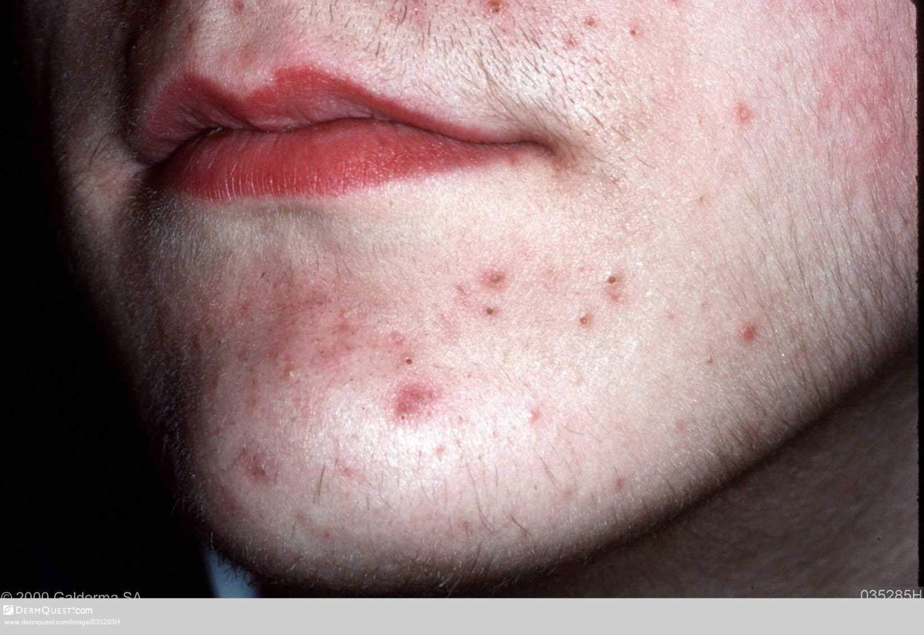
Notes:
www.dermquest.com/imagelibrary/acnevulgaris/035285H

Slide 8
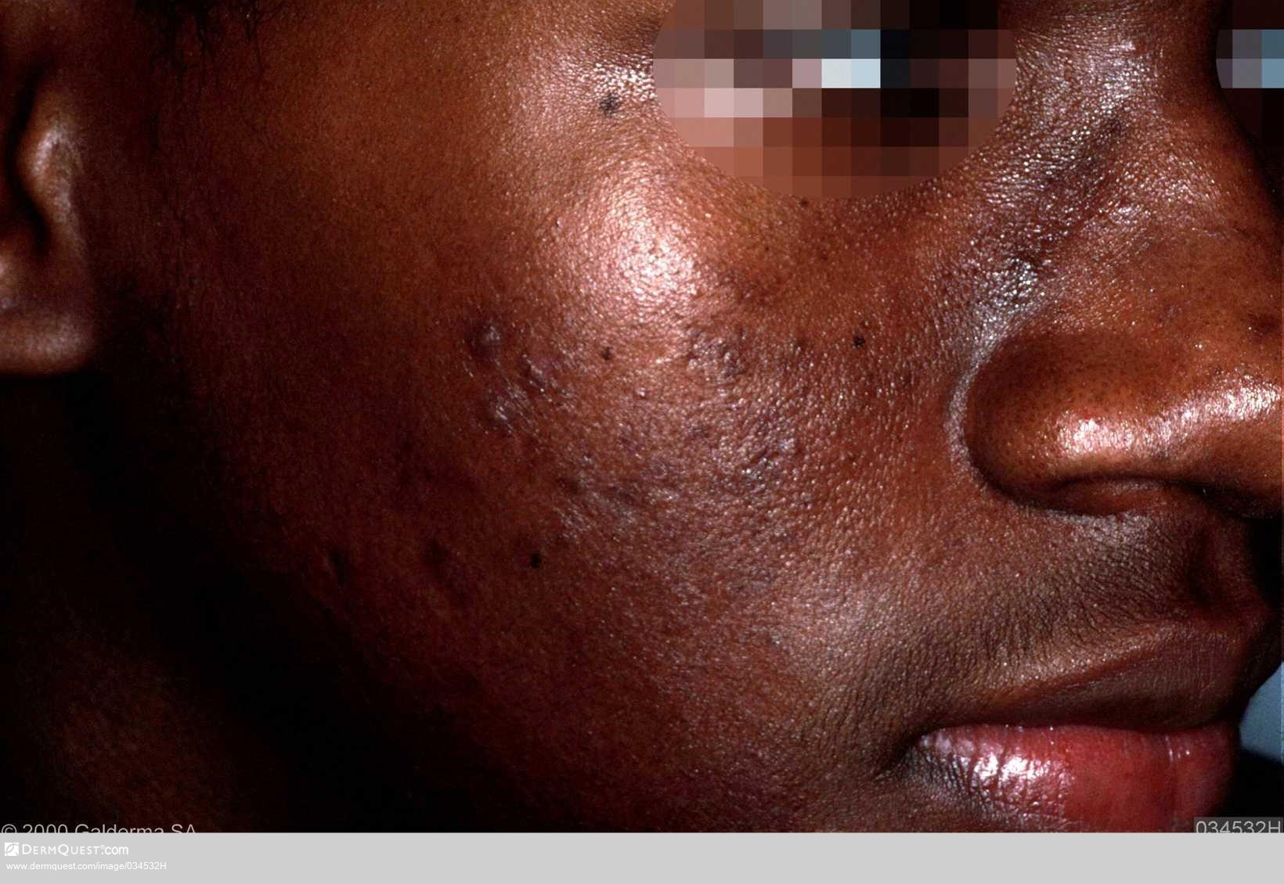
Notes:
www.dermquest.com/imagelibrary/acnevulgaris/034532H

Slide 9
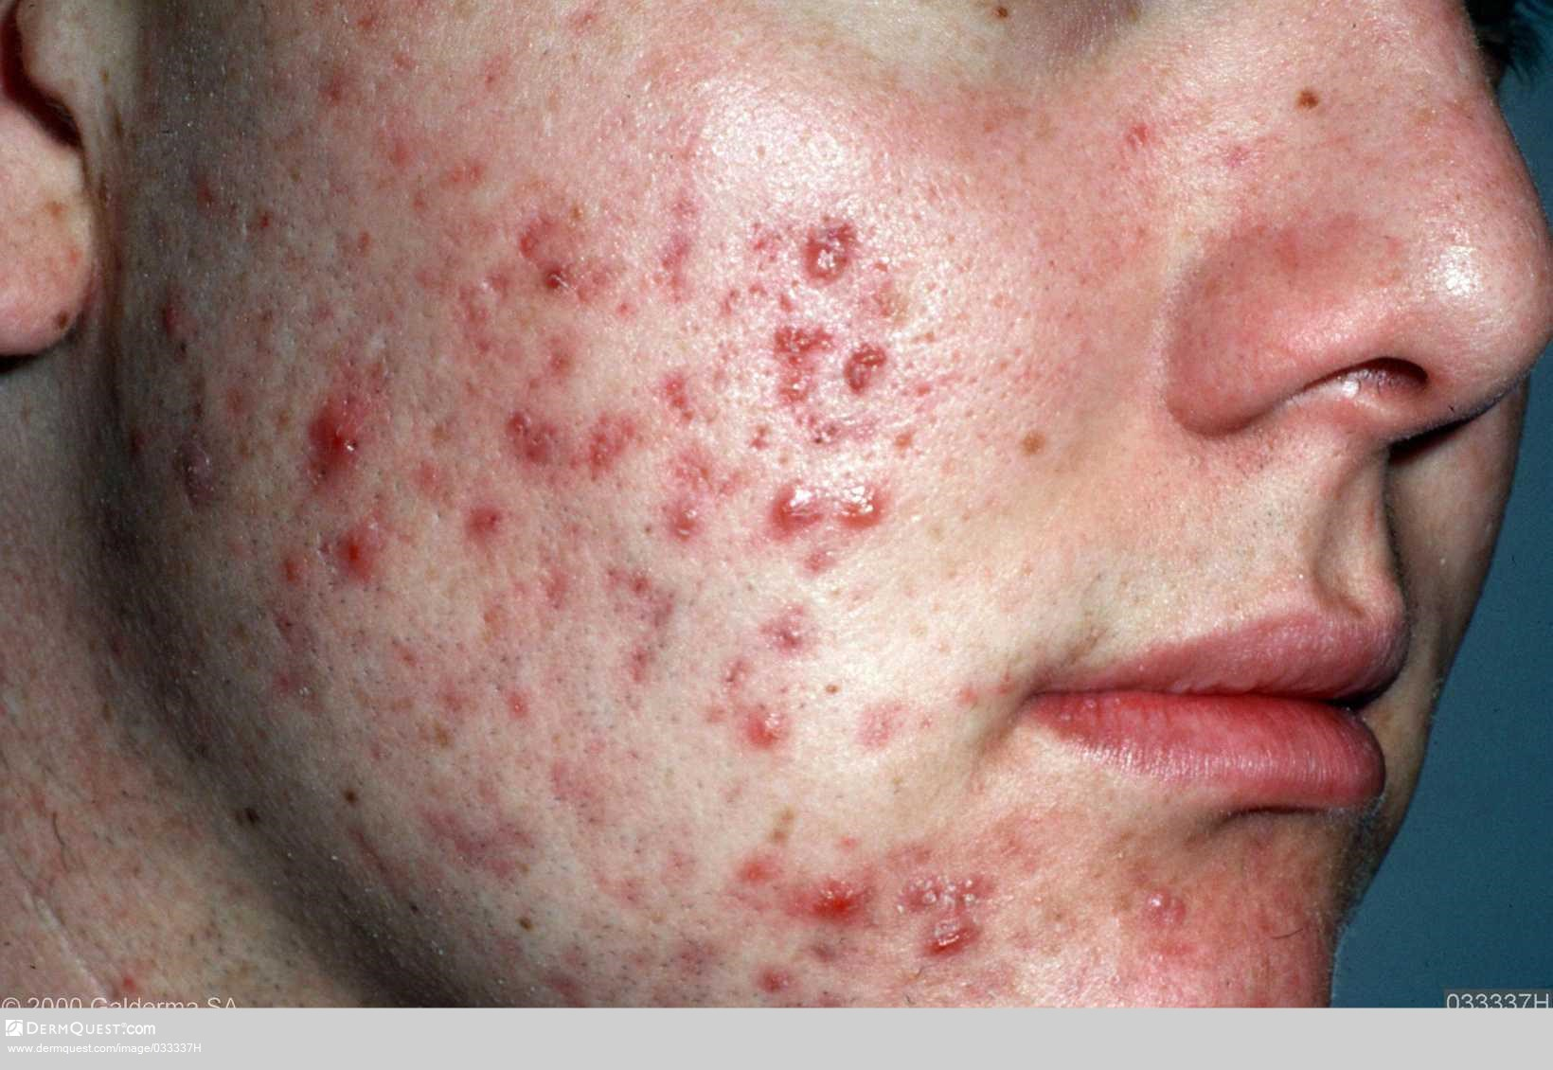
Notes:
www.dermquest.com/imagelibrary/acnevulgaris/033781V

Slide 10
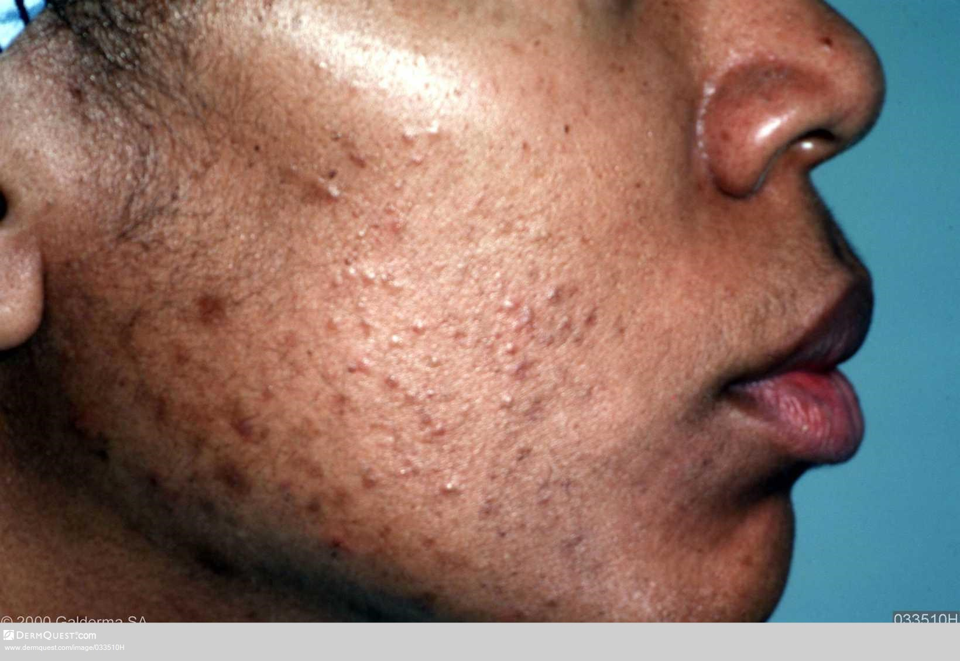
Notes:
www.dermquest.com/imagelibrary/acnevulgaris/033510H

Slide 11
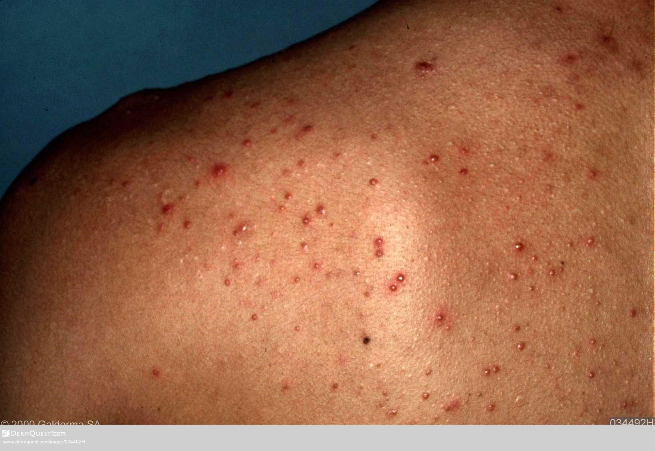
Notes:
www.dermquest.com/imagelibrary/acnevulgaris/034492H

Slide 12
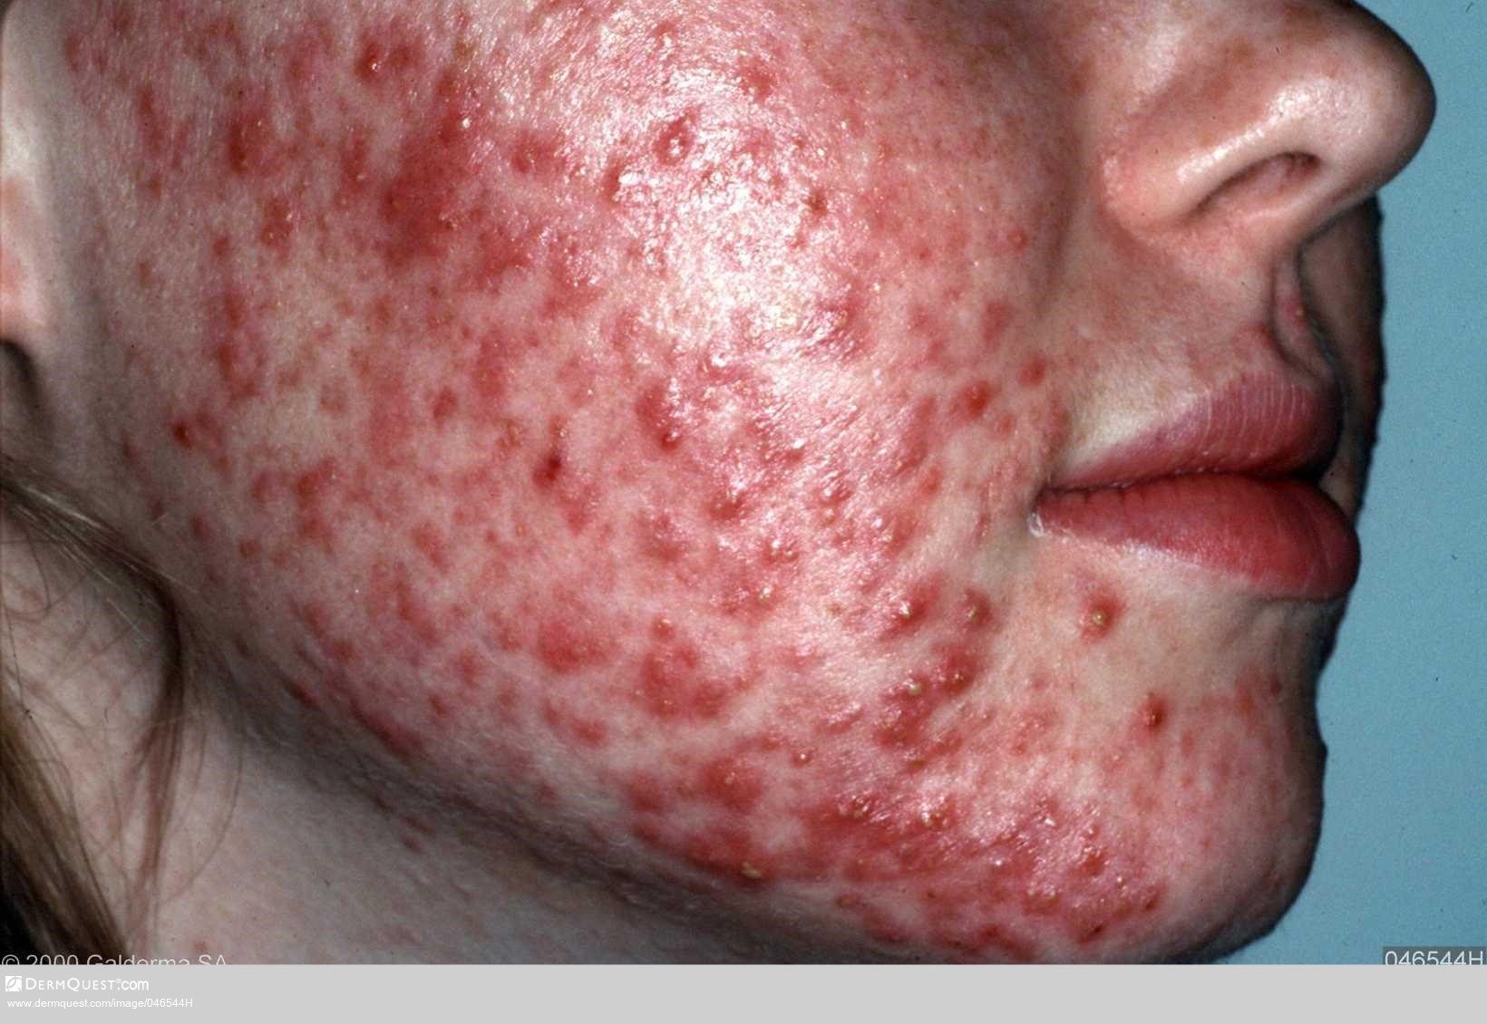
Notes:
www.dermquest.com/imagelibrary/acnevulgaris/046544H

Slide 13
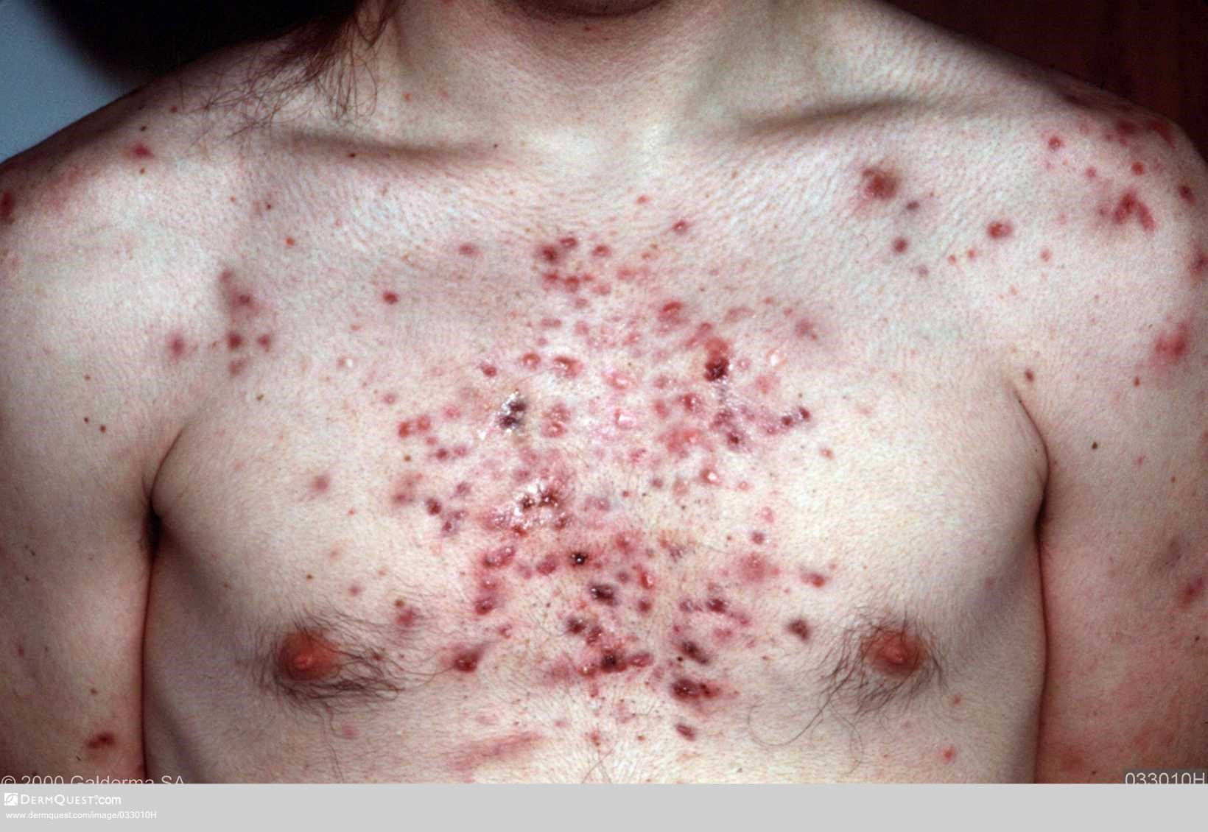
Notes:
www.dermquest.com/imagelibrary/acnevulgaris/033010H

Slide 14
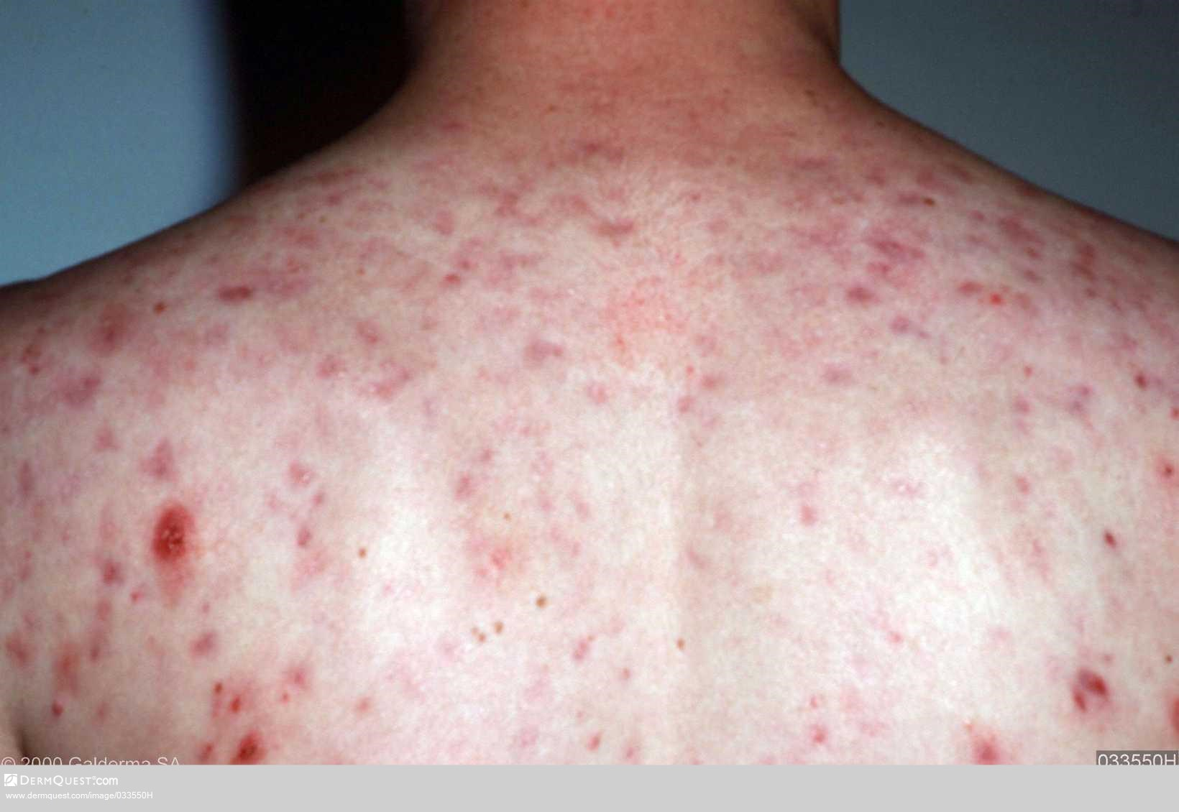
Notes:
Back acne
www.dermquest.com/imagelibrary/acnevulgaris/033550H

Slide 15
Tips on managing acne
Follow the guidelines
Early intervention vital
Manage expectations
Ongoing reassessment and support vital
Topical treatments ongoing throughout acne duration
Systemic treatment – intermittent therapy
Notes:
www.euroderm.org/edf/acne 2011
www.CKS.nice.org.uk/acne-vulgaris 2014

Slide 16
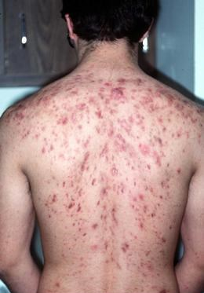
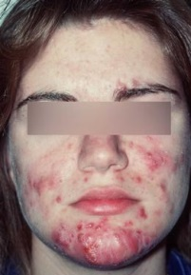
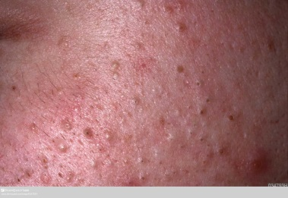
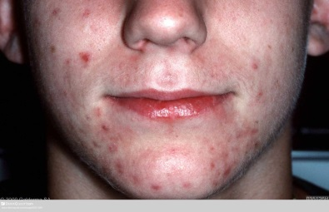
EDF Guidelines on acne
COMEDONAL
HIGH STRENGTH
None
MEDIUM STRENGTH
Topical retinoids
LOW STRENGTH
BPO or
Azelaic acid
MILD TO MODERATE PAPULOPUSTULAR ACNE
HIGH STRENGTH
Adapalene + BPO (FC) or
BPO + Clindamycin (FC)
MEDIUM STRENGTH
Azelaic acid or
BPO or
topical retinoid or
systemic antibiotic + Adapalene
LOW STRENGTH
Blue light or oral zinc or
topical erythromycin+ Isotretinoin(FC) or
Topical Erythromycin + Tretinoin (FC) or
systemic antibiotic + Azelaic acid or systemic antibiotics +Adapalene + BPO (FC)
SEVERE PAPULOPUSTULAR/MODERATE NODULAR ACNE
HIGH STRENGTH Isotretinoin
MEDIUM STRENGTH Systemic antibiotics +Adapalene or systemic antibiotics + Azelaic acid or systemic antibiotics + Adapalene+ BPO (FC)
LOW STRENGTH Systemic antibiotics + BPO
Females - hormonal antiandrogens +topical treatment or hormonal antiandrogens +systemic antibiotics
SEVERE
HIGH STRENGTH Isotretinoin
MODERATE STRENGTH
systemic antibiotics + Azelaic acid
LOW STRENGTH systemic antibiotics + BPO or systemic antibiotics + Adapalene or
Systemic antibiotics + Adapalene + BPO(FC)
Females – Hormonal antiandrogens + systemic antibiotics
Notes:
EDF Guidelines on acne 2011 page 19
Mild https://www.dermquest.com/image-library/image/5044bfcfc97267166cd624fb
Comedonal: https://www.dermquest.com/image-library/image/5044bfd0c97267166cd658d9
Severe: https://www.dermquest.com/image-library/image/5044bfd0c97267166cd64bfb
Severe PP and nodular acne:https://www.dermquest.com/image-library/image/5044bfd0c97267166cd63a81

Slide 17
Case studies
How would you treat?

Slide 18
Case 1
17 year old girl
Mild to moderate papular pustular acne
Acne since 14
Strong family history
Affecting face only

Slide 19
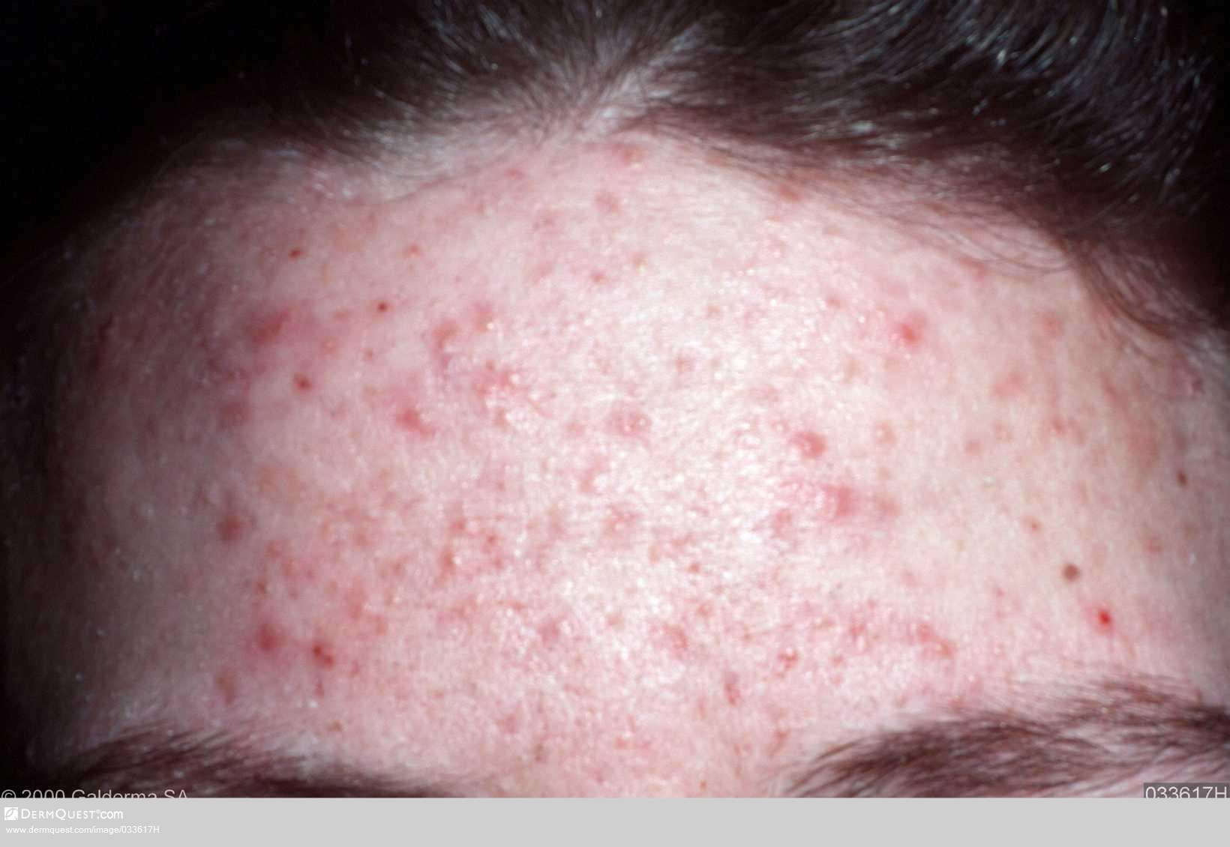
Notes:
www.Dermquest.com/imagelibrary/acne vulgaris/033617H

Slide 20
Discussion on treatment
BPO
Topical retinoid
Topical antibiotics
Oral antibiotics
Combination
Non comedogenic cleanser
Non comedogenic foundation
Notes:
Ref: EDF

Slide 21
Case 2
19 year old girl
Has had acne for 3 years, getting worse
Has tried some over the counter treatments
Really self conscious
Affecting whole face
Finding it difficult to cover up
How would you treat?

Slide 22
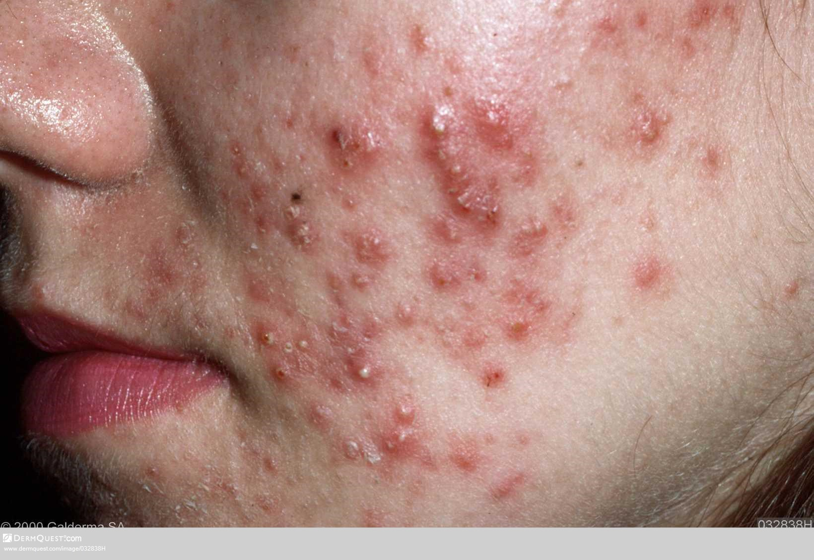
Notes:
www.dermquest.com/imagelibrary/acnevulgaris/032838H

Slide 23
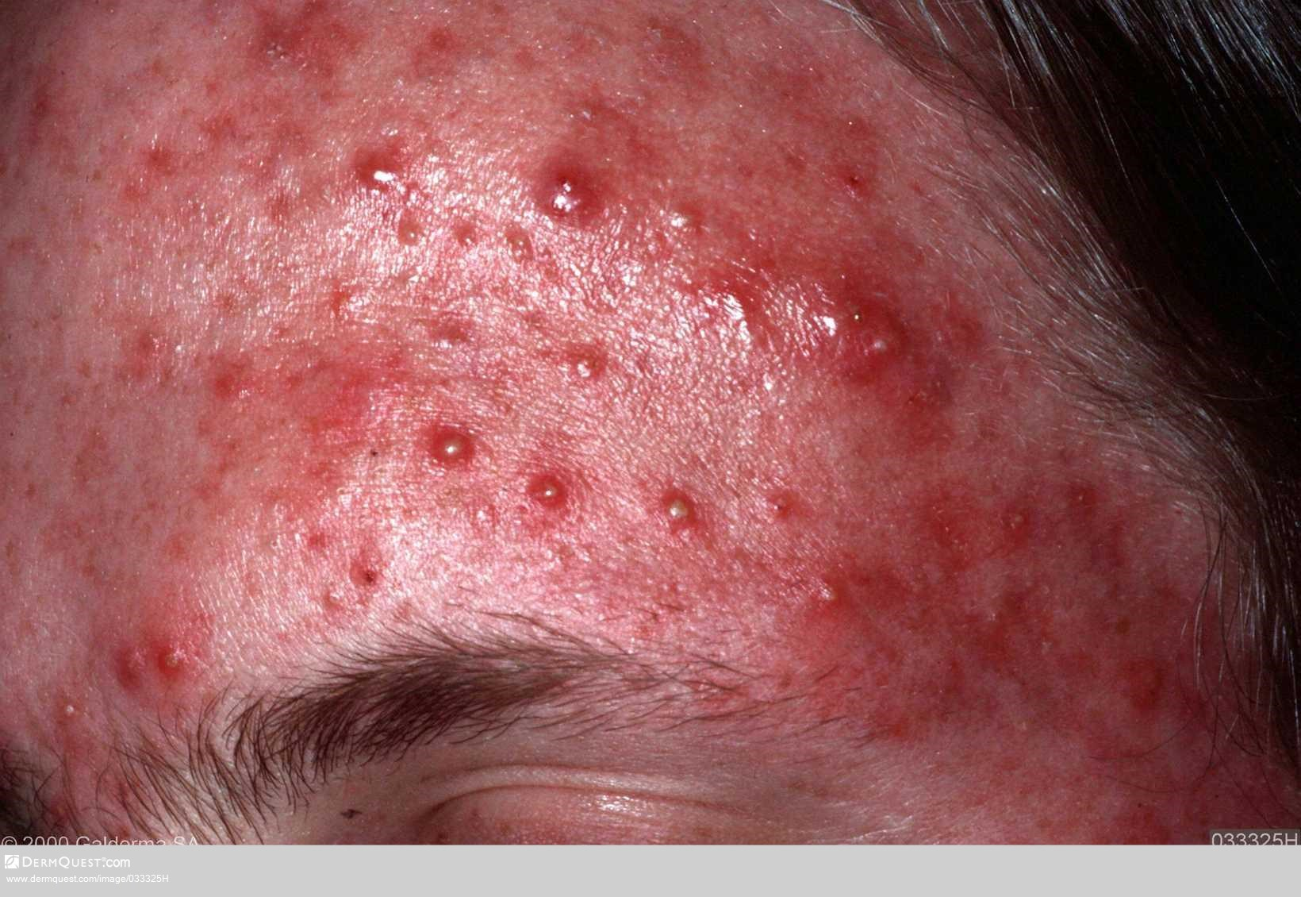
Notes:
www.dermquest.com/imagelibrary/acnevulgaris/033325H

Slide 24
Discussion on treatment
BPO
Topical retinoids
Topical antibiotics
Oral antibiotics
Hormonal anti-androgens
Combination
Refer

Slide 25
Case 3
20 year old man
Had acne since 14
Has been self-conscious about it for 6 months
Has had one short course of antibiotics – worked initially but when discontinued came back
Doesn’t use topicals
How would you treat?

Slide 26
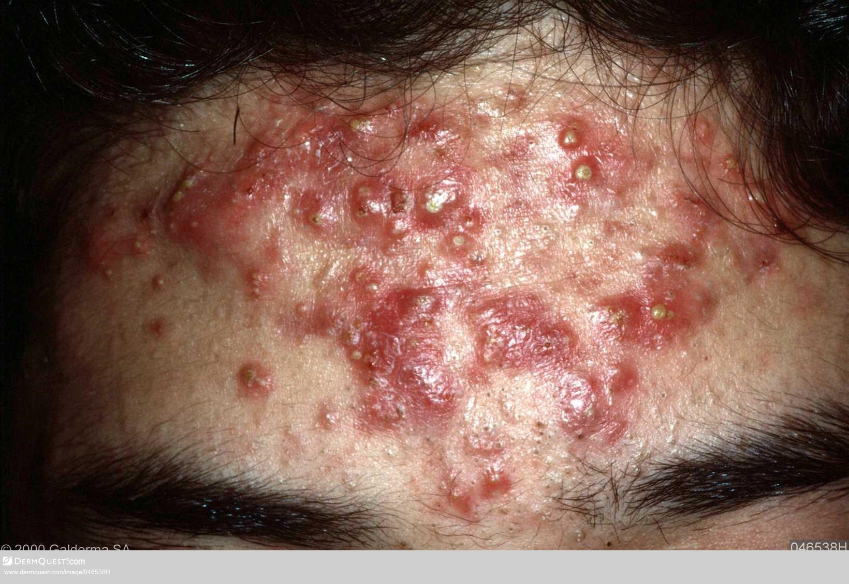
Notes:
www.dermquest.com/imagelibrary/acnevulgaris/046538H

Slide 27
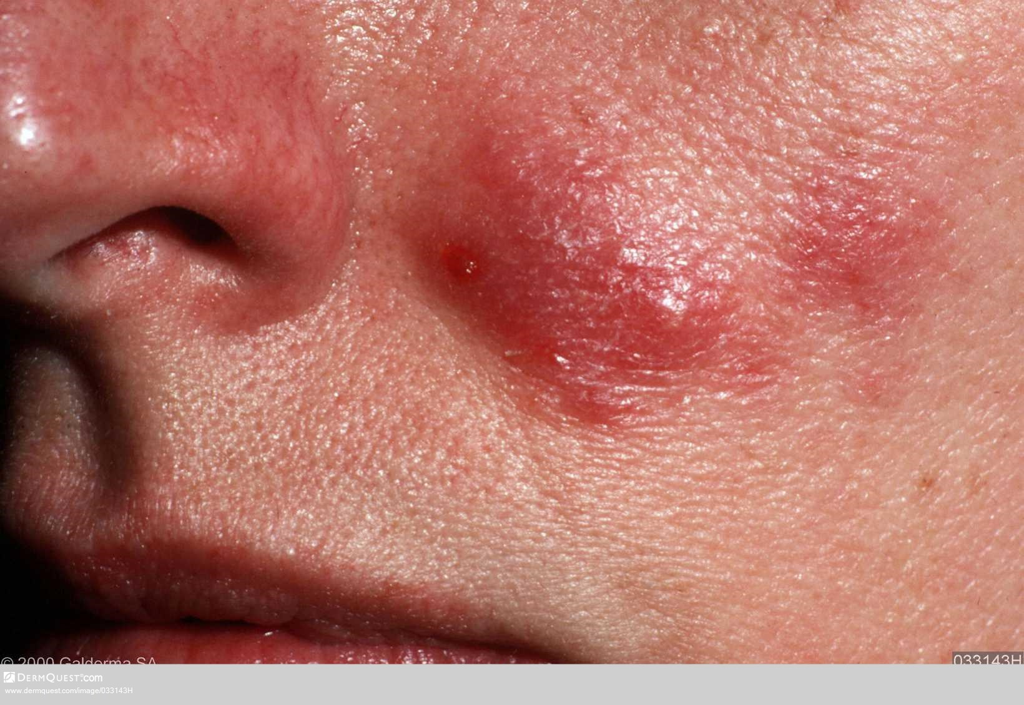
Notes:
www.dermquest.com/imagelibrary/acnevulgaris/033143H

Slide 28
Discussion on treatment
BPO
Topical retinoids
Topical antibiotics
Oral antibiotics
Combination therapy
Refer

Slide 29
Oral isotretinoin
Vitamin A derivative
Mandatory monitoring
Teratogenic
Dose - weight calculated
Counselling
Prescribed only by or under supervision of consultant dermatologist
Effective

Slide 30
Skin care for acne patients
No need to overdose on cleansing!
Soap free cleansing/soap substitute washes
Use non-comedogenic cleansers, make up and moisturisers (oil free)
Avoid greasy/occlusive products
Educate on avoidance of squeezing and associated scarring
Notes:
Frequently asked questions

Slide 31
Scarring
Keloid
Hypertrophic
Atrophic
Ice pick
Treatment limited on the NHS – individual
funding
Notes:
Keloid – overgrowth of fibrous tissue
Atrophic - depressed well defined
Hypertrophic – excessive collagen giving a raised scar
Ice pick – narrow and deep
Funding is a problem and is on IFR (individual funding request) and you have to prove exceptionality over the rest of people with scarring

Slide 32
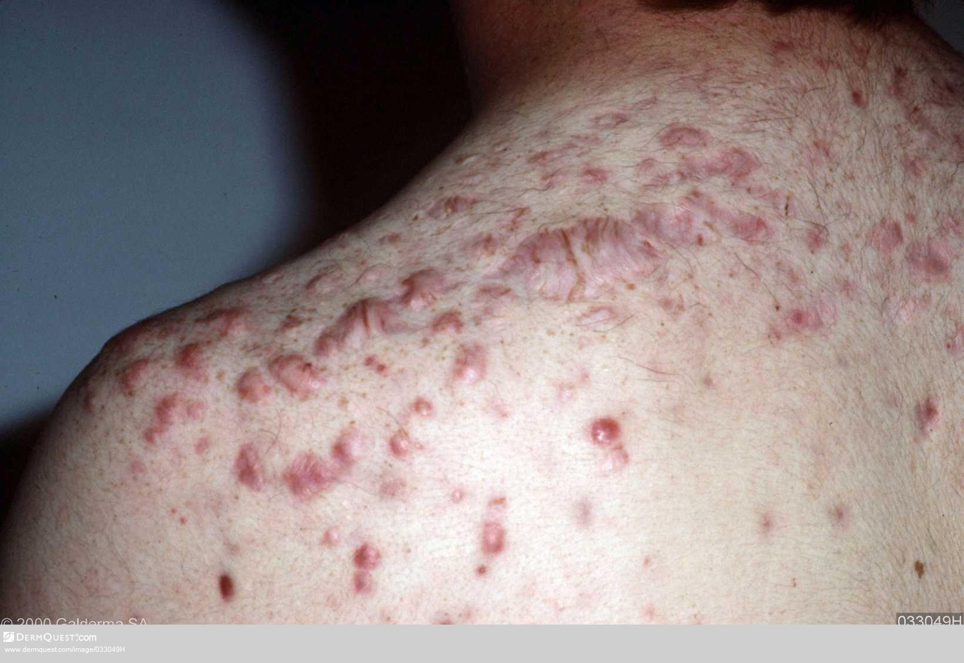
Notes:
www.dermquest.com/imagelibrary/acnevulgaris/033049H
Keloid scarring

Slide 33
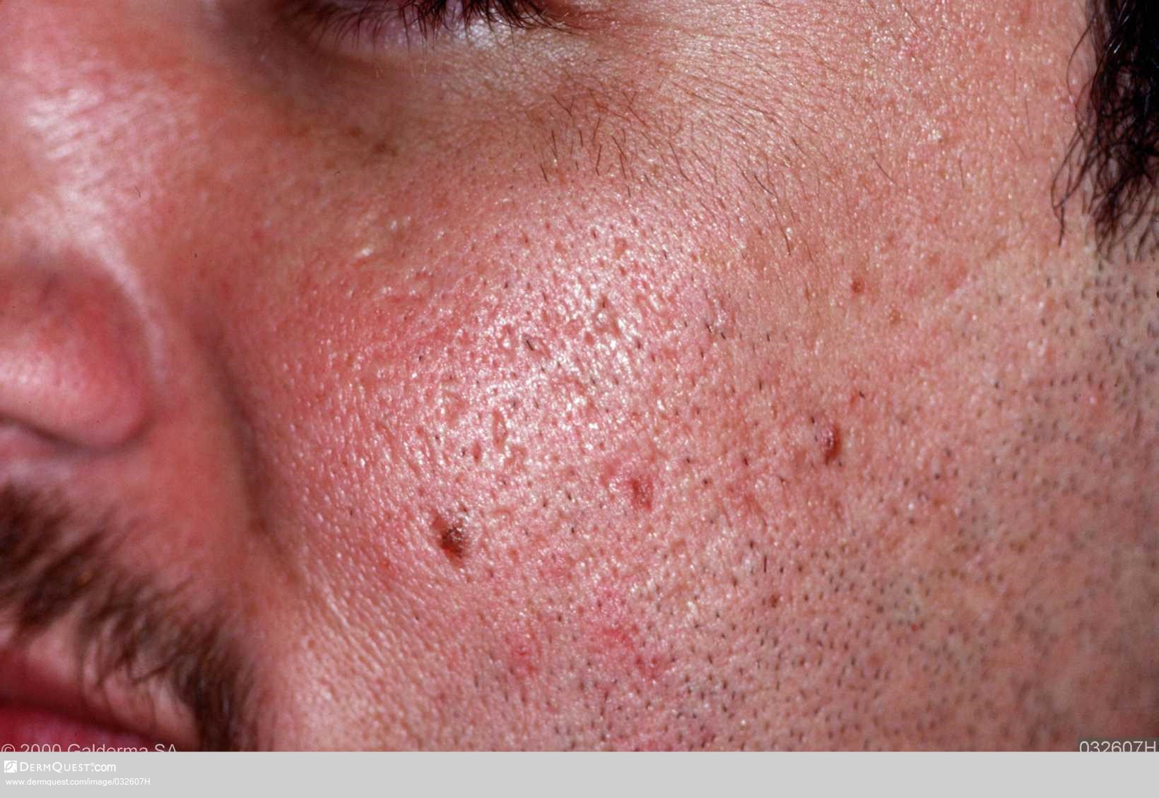
Notes:
www.dermquest.com/imagelibrary/acnevulgaris/032607H

Slide 34
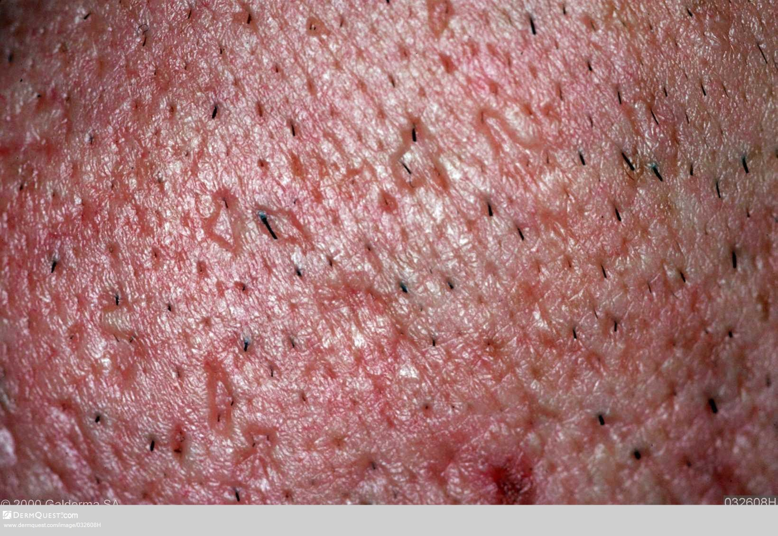
Notes:
www.dermquest.com/imagelibrary/acnevulgaris/032608H
Close up atrophic and ice pick scarring

Slide 35
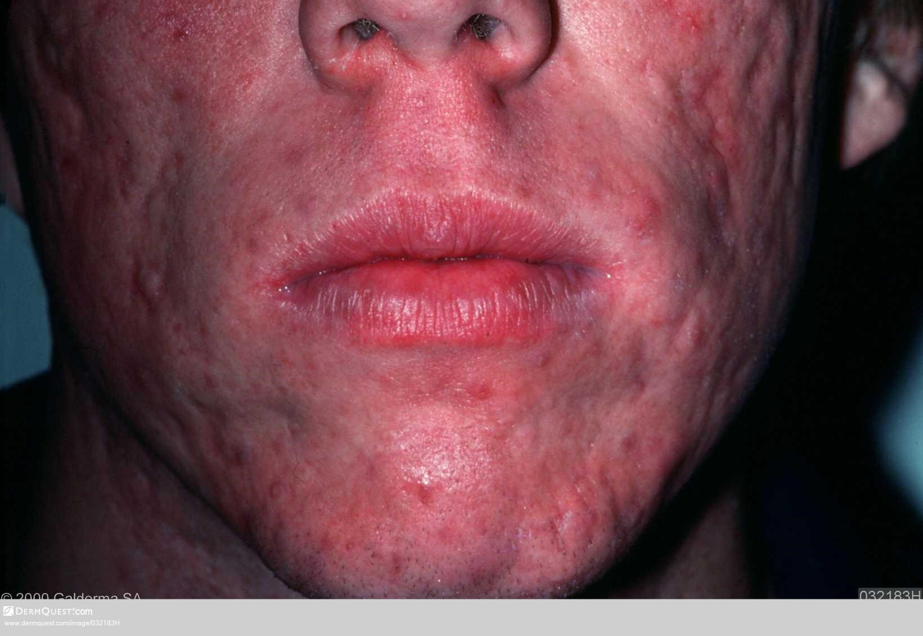
Notes:
www.dermquest.com/imagelibrary/acnevulgaris/032183H

Slide 36
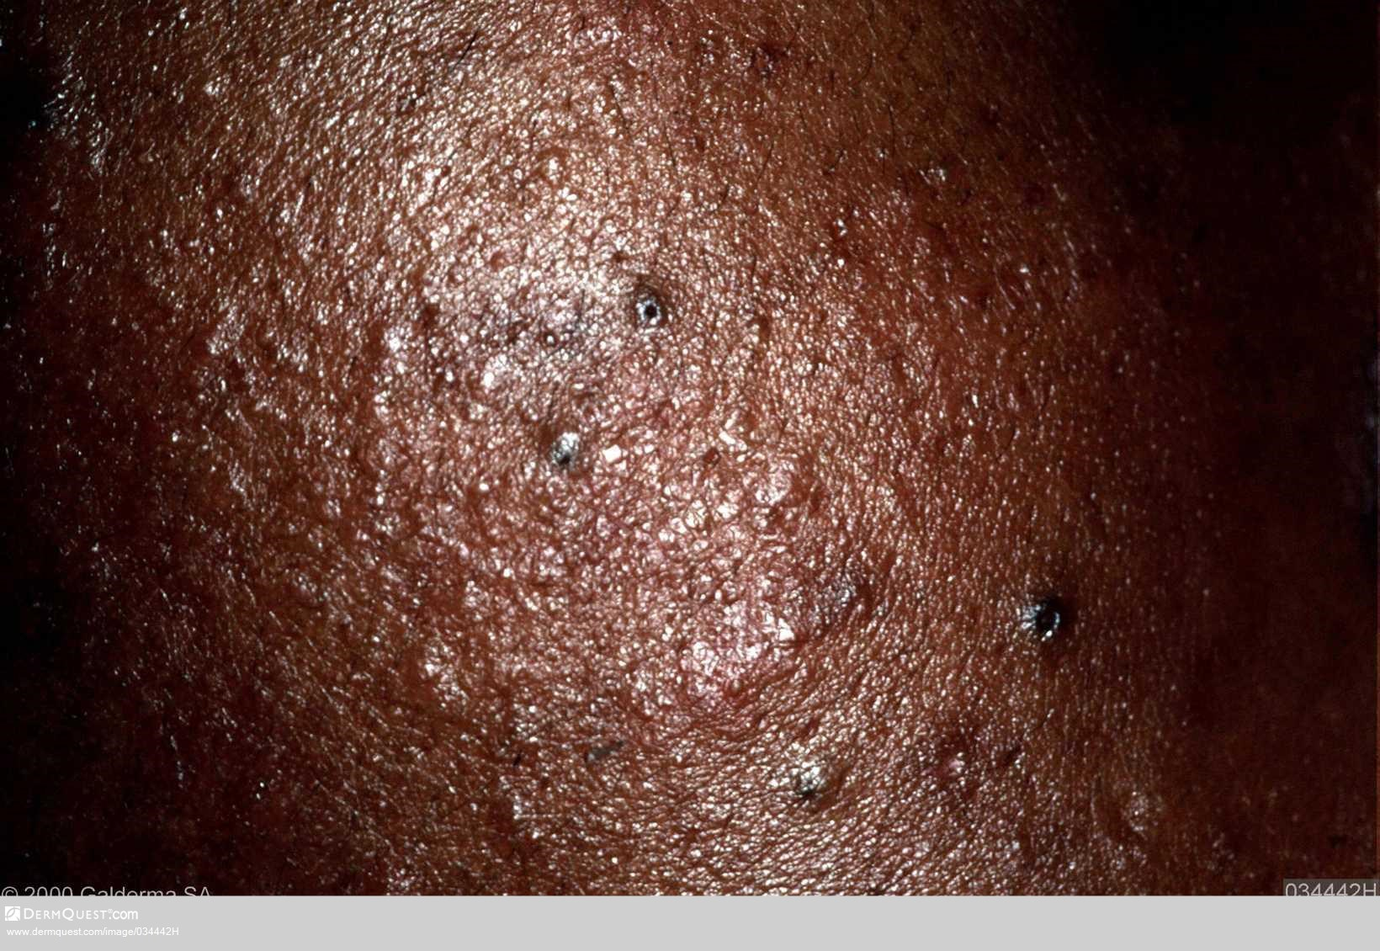
Notes:
www.dermquest.com/imagelibrary/acnevulgaris/034442H
hyperpigmentation

Slide 37
Key to success
Understanding the condition
Understanding the treatments
Build up tolerance to manage side effects
Consider lifestyles when prescribing
Good concordance with treatments
No quick fix
Flexibility in approach
Ongoing psychological support
Notes:
To achieve patient concordance there are some keys to success

Slide 38
Referral
See local pre-referral guidelines

Slide 39
References
Ashton R, Leppard B & Cooper H (2014) Differential Diagnosis in Dermatology 4th Edition, Oxford
Thiboutot D et al (2013) A call to limit antibiotic use in acne, J Drugs in Dermatol 2013; 12 (12): 1331 - 1332
www.PCDS.org.uk/acne
www.euroderm.org/edf/acne 2011
http://cks.nice.org.uk/acne-vulgaris 2014

