Slide 1



Children's allergy in the Northwest
21st May 2016
Dr Stephen Hughes

Slide 2
Outline
Milk
Egg
Peanut
Questions

Slide 3
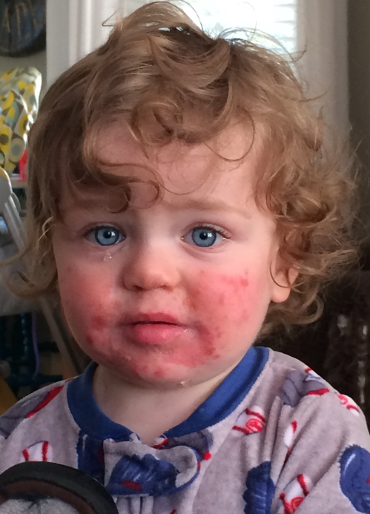
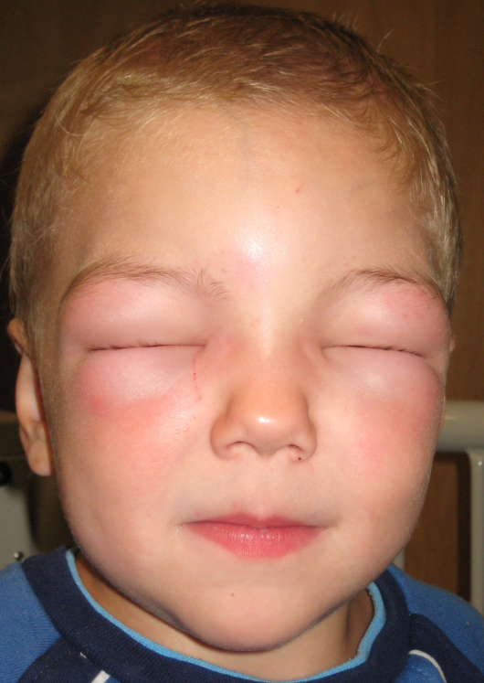
Milk
Immediate
IgE related
Delayed
(non IgE)
Combined
Lactose intolerance

Slide 4
What happens
80-90% of CMA children outgrow their allergy by 3
Some maintain their allergy into adulthood
IgE mediated CMA slower to develop tolerance
More allergic problems may accumulate

Slide 5
What is the trouble?
Costly milk alternatives
Misery from eczema
Sleepless nights – itch, reflux and belly ache
Anaphylaxis with milk
Schemes needed at school and in society
The Atopic March…

Slide 6
Guidelines to follow
Milk Allergy in Primary Care [MAP] guideline
2013
Non IgE mediated CMA -
Exclude milk for 2-4 weeks (+/- extensively hydrolysed formula [EHF])
Reintroduce
Dietician

Slide 7
Guidelines to follow
IgE mediated CMA
Avoid milk protein
EHF or Amino acid formula (AAF)
Dietician
Paediatric allergy management

Slide 8
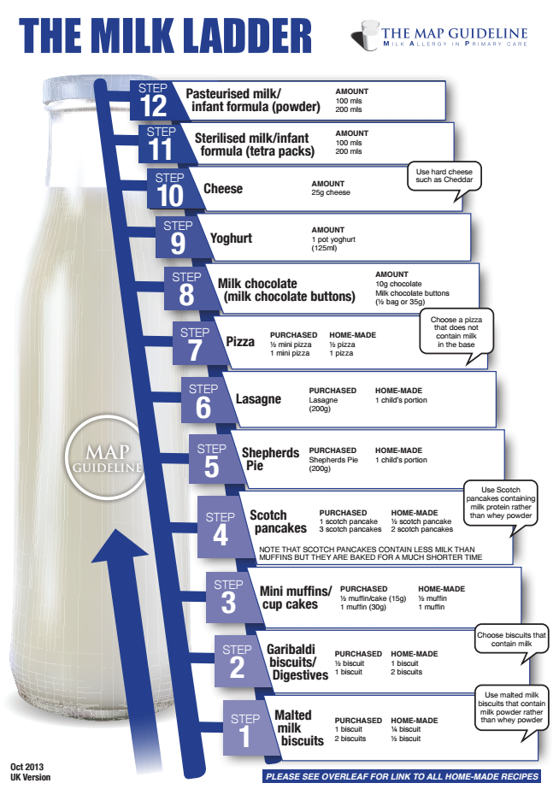
How can we influence this?
For non-IgE CMA, foods containing milk protein can be introduced
This speeds up tolerance significantly
For IgE CMA, we use the same scheme, managing risks in hospital setting

Slide 9
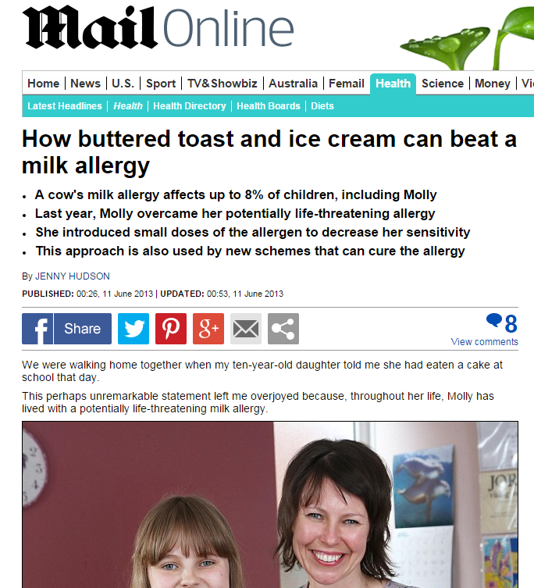

Slide 10
3m with CMA
Troublesome flare of eczema, reflux and diarrhoea when weaned from breast onto standard formula
What would be your initial management?
Would you do any tests?
How would you follow up?
How would you try reintroducing cows' milk?

Slide 11
What if?
Flares of eczema, cramps and diarrhoea occurred with breast feeding.
Would your initial management change?
How would you follow up?
How would you try re-introducing cows' milk?

Slide 12
What if?
Infant had urticaria but no breathing problems when initially tried on milk formula. Symptoms resolved spontaneous after 60 min.
Would your initial management change?
How would you follow up?
How would you try reintroducing cows' milk?

Slide 13
What if?
Infant had anaphylaxis when initially tried on milk formula with respiratory compromise, seen in PED and given IM adrenaline.
Would your initial management change?
How would you follow up?
How would you try reintroducing cows' milk?

Slide 14
Egg
Cake
Trifle sponge fingers
Yorkshire pudding
Pancake
Egg pasta
Egg noodles
Sausages
Flan/quiche
Egg fried rice
Egg in batter (eg fish finger)
French toast
(Hard boiled egg)
Scrambled egg
Meringue
Mayonnaise
Marshmallows
Royal icing
Teacakes
Raw egg in batter

Slide 15
What is the trouble?
Acute allergy
Anaphylaxis
Dietary restriction
Social awkwardness
Yellow fever vaccination (anaphylaxis)
Peanut allergy
All children with egg allergy should receive the MMR vaccination as a routine procedure in primary care.
(Clark et al. 2010)

Slide 16
Influenza vaccination
JCVI has advised that, except for those with severe anaphylaxis to egg which has previously required intensive care, children with an egg allergy can be safely vaccinated with Fluenz Tetra® in any setting (including primary care and schools); those with clinical risk factors that contraindicate Fluenz Tetra® should be offered an inactivated influenza vaccine with a very low ovalbumin content (less than 0.12 μg/ml).
Egg-allergic children with asthma can receive LAIV if their asthma is well controlled.

Slide 17
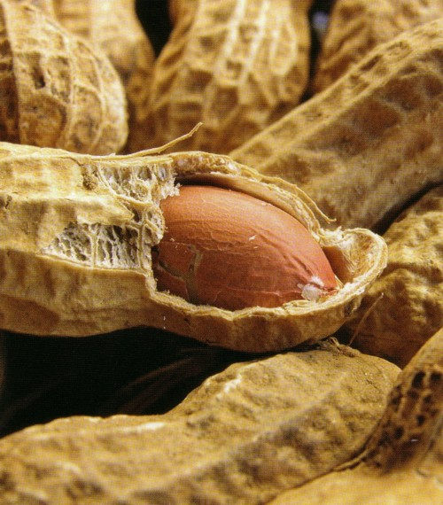
Peanuts
In the UK, as many as 2% of 4 year olds have peanut sensitivity.
Not all have confirmed allergy.
Most common in children with eczema and egg allergy

Slide 18
Case
George cried and itched his throat when he was given a peanut butter sandwich at 18 months old
On helping himself to nuts at age 5, he scratched his throat again
Having been treated for asthma, age 8, Mum raises the issue of possible nut allergy

Slide 19
History
Mum avoided nuts in pregnancy and infancy
Asthma in the past year: cough with exercise and URTIs
Eats marzipan and hazelnut without difficulty
Never had known tolerance of peanut
Never had exposure to Brazil, cashew, walnut
Never had difficulty with egg or other foods

Slide 20
Examination
Mild flexural eczema
No wheeze

Slide 21
Certainty with diagnosis
100%
2%

Slide 22
Certainty with diagnosis
100%
80%
2%

Slide 23
Certainty with diagnosis
100%
95%
2%

Slide 24
Certainty with diagnosis
100%
2%

Slide 25
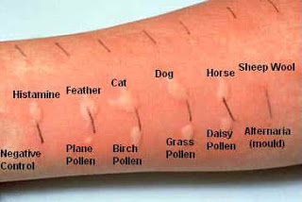
Skin prick tests
Histamine Control Peanut Brazil Cashew Walnut
8mm 0 12mm 0 0 0

Slide 26
Relief or delight
We think George has peanut allergy
In the allergy consultation, life-long strategies are established to preserve well-being
Future risks to be managed
  Accidental exposure and allergy
  Accidental exposure and severe allergy
  Avoidable exposures vs. Prohibitive restrictions

Slide 27

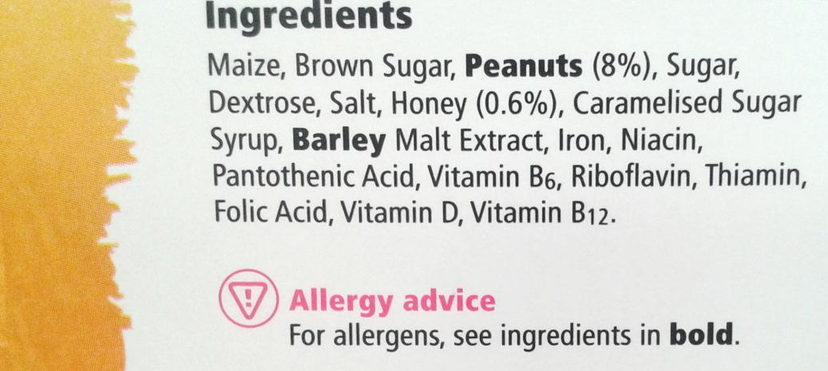
Strategies
Avoidance (peanuts, Crunchy nut cornflakes, Snickers, Celebrations)…
Labelling
Restaurants and Delis
Action plan
Medication

Slide 28
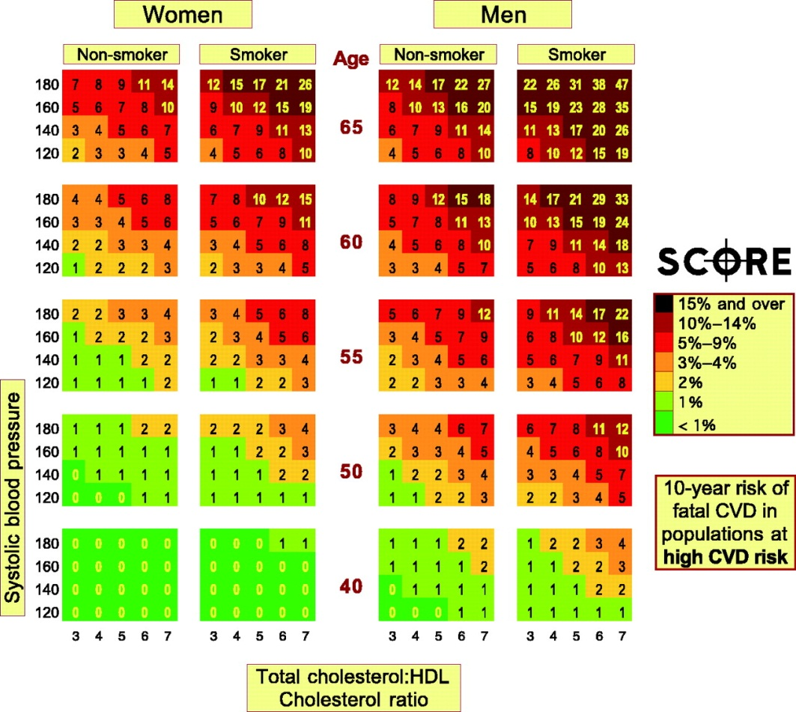
Risk calculator
Age (teenagers)
Gender (M>F)
Asthma (++)
Poor control (+++)
Action plan (+++)
Drugs

Slide 29


Risk calculator
Age (teenagers)
Gender (M>F)
Asthma (++)
Poor control (+++)
Action plan
Drugs
>65
20-64
Doesn’t
12-19
Has a plan
5-12
1-4
Asthma
OOCA

Slide 30

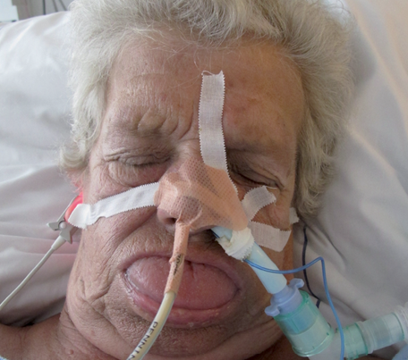
Risk calculator
>65
>65
20-64
20-64
Doesn’t
Plays golf
12-19
12-19
Has a plan
Doesn’t
5-12
5-12
1-4
1-4
Asthma
OOCA
Shelters
Doesn’t

Slide 31
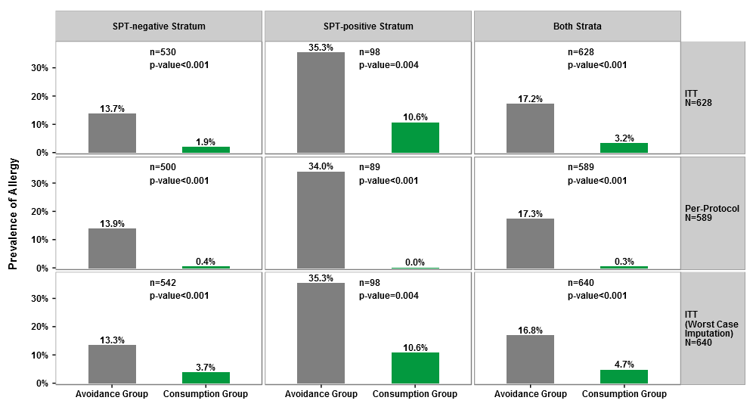
LEAP
Giving peanut tolerises

Slide 32
What can we do?
Giving peanut tolerises
Peanut desensitisation will become standard, after a few more clinical trials…

Slide 33
Take home messages
Peanut vs. Nut allergy
Peanut is a life-long allergy
Exposure predicts reactions
Anaphylaxis is rare
Risk calculation is difficult for families
Desensitisation for those with allergy is still a research procedure
Desensitisation for those before allergy develops is a priority

Slide 34

Strawberry

Slide 36
Protecting the vulnerable
With vaccines, antimicrobials, hygiene and anxiety

Slide 37
Protecting the vulnerable
Vaccination safely primes the immune system to ‘see’ the target germ and generate immunity, thereby protecting the host from subsequent infection.
Immune deficient patients have high risk of infection, potential for benefit, but also vaccine failure.

Slide 38
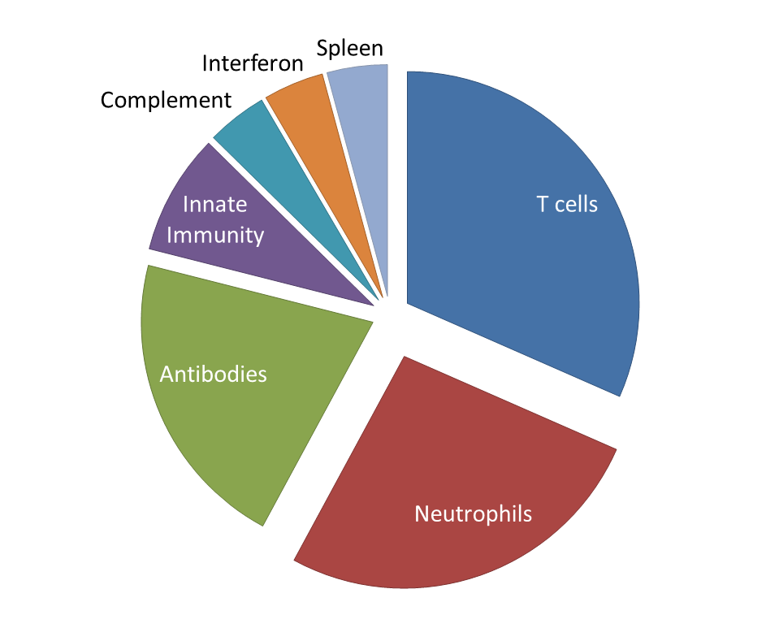
What is suppressed?

Slide 39
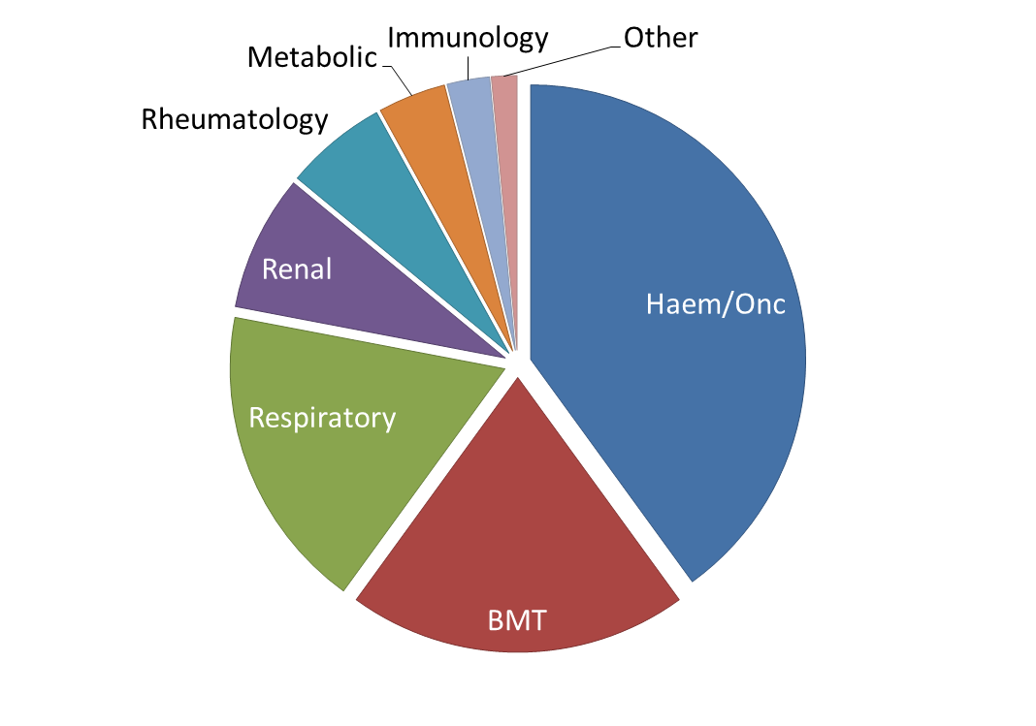
Whose patients?

Slide 40
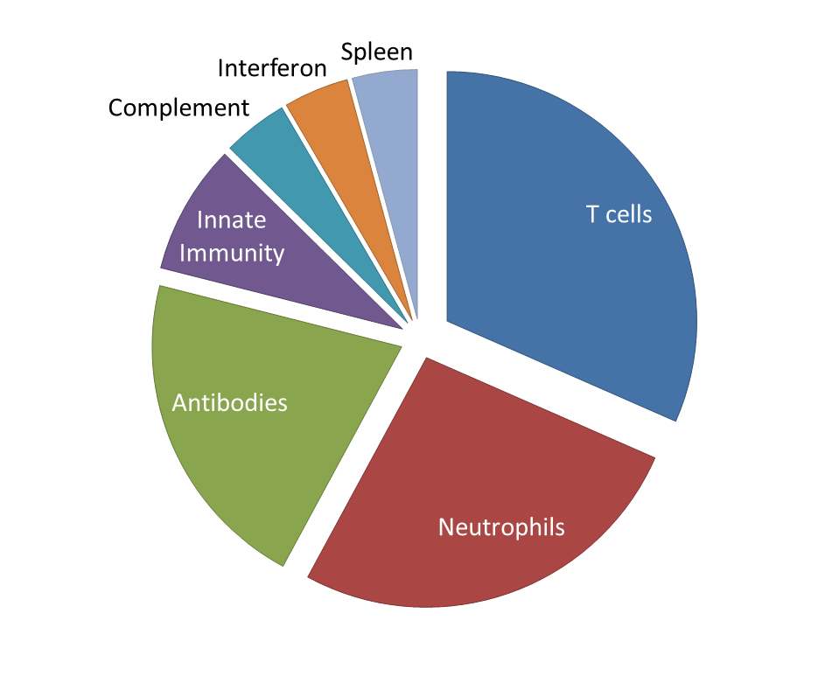
What is suppressed?
Chemotherapy
Chemotherapy
Steroids
Chemotherapy
Constitutional

Slide 41
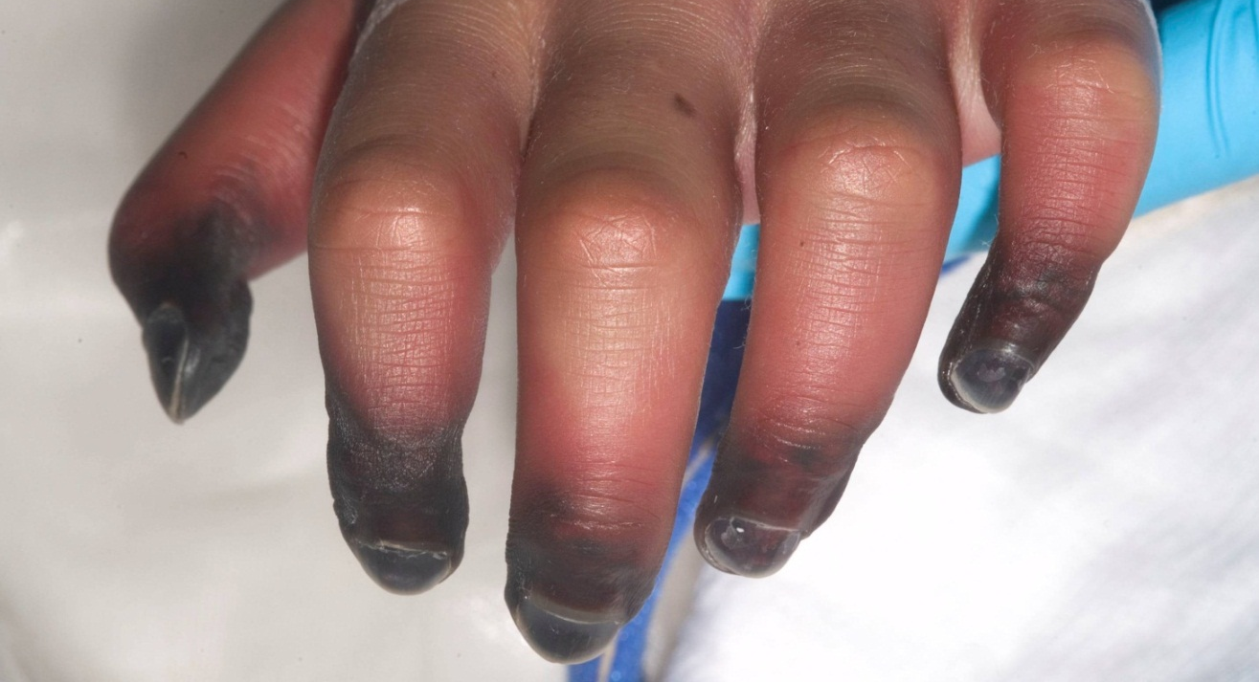
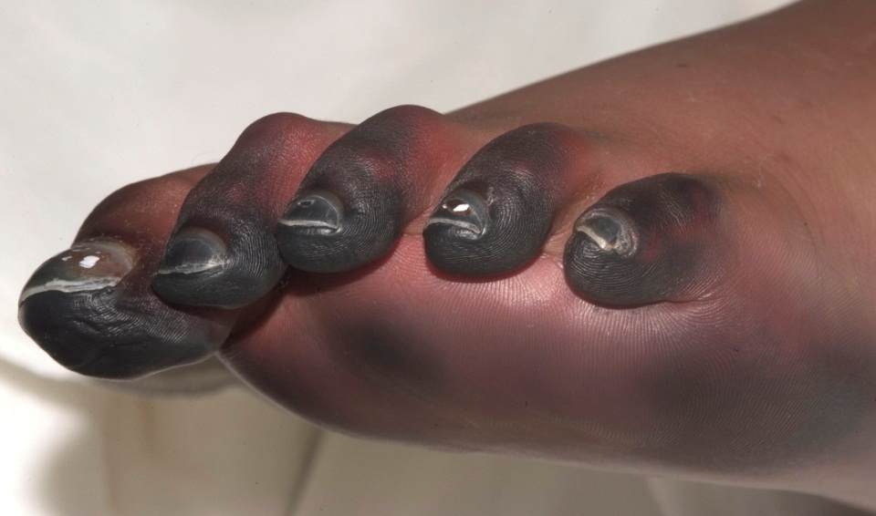
Meningococcal disease
8 year old girl attends with a funny rash

Slide 42
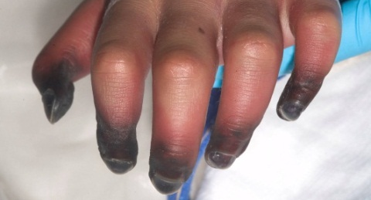

Meningococcal disease
Septicaemic shock
Ischaemia
DIC
Multi-organ failure
Deafness Brain damage Amputations

Slide 43
Meningococcal disease
Who gets Meningococcal infection
1500/yr 3/100,000
Young x 20
Complement deficient x 7000
Asplenic x 1.3
Immune suppressed x 1.5

Slide 44
Meningococcal disease
Who gets Meningococcal infection?
15-19
Complement
deficiency
Other
1-4yr
Immune
deficiency

Slide 45
Meningococcal disease
Who gets which vaccines?
Young
Adolescent
At high risk
Complement deficient
Hyposplenic
Those travelling to high risk locations
15-19
Other
1-4yr

Slide 46
Meningococcal disease
What are the options for vaccination?
What is the current schedule?
Who is allowed additional vaccines?
How do these vaccines work?
How long do they work for?

Slide 47
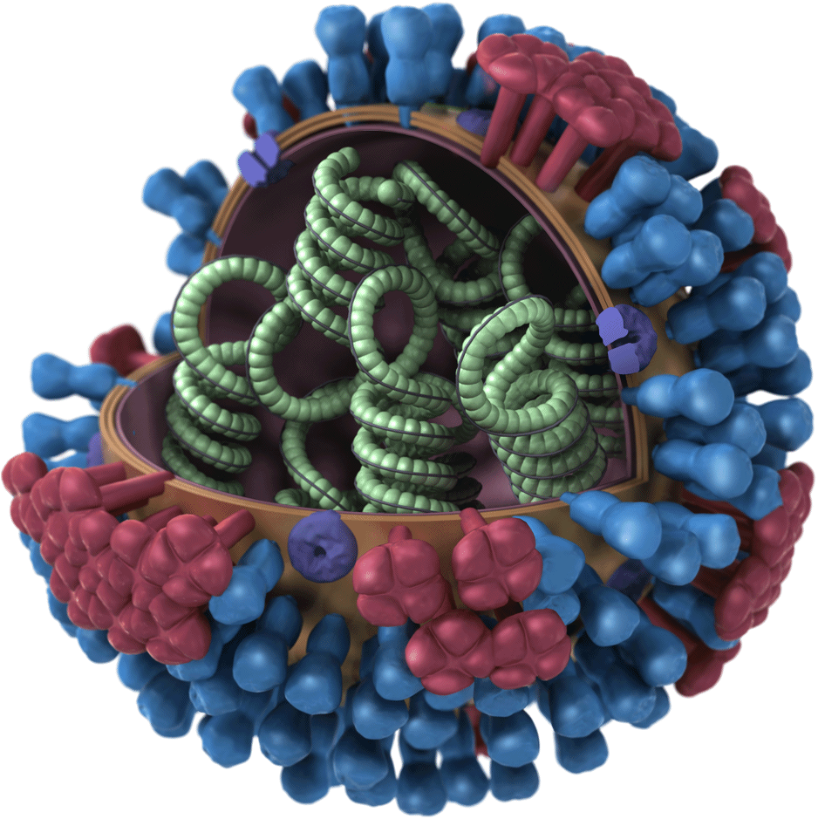
Influenza virus vaccine
Inactivated vaccines
Egg-free
Low egg
Who cares about egg
Live attenuated vaccines
Fluenz

Slide 48
Influenza virus vaccine
Might change every year
Therefore needed yearly
Inactivated (so harmless), until now (Fluenz - live attenuated influenza vaccine)
As flu is a risk factor for sinopulmonary infection, everyone should aim to avoid it

Slide 49
Influenza virus vaccine
Benefits vs. Risks
Might work ‘None’
Costs Accidental LAIV
Alternatives
Eradication / IVIg / Cocooning

Slide 50
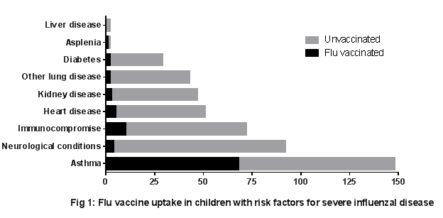
RMCH influenza vaccination

Slide 51
Rotavirus
Live or inactivated?
Schedule?
Who shouldn’t get the Rotavirus vaccine?
Why?

Slide 52
Varicella Zoster
VZV is a definite risk for immune compromised groups
VZIg or aciclovir are protective PEP
Vaccination might be useful
Vaccine is live, so a risk.
There is enthusiasm for using vaccine before immune compromise
‘Severe’ immunosuppression (CD4<15%) remains a contraindication
Steroids > 20mg or 1mg/kg/day for 1/12

Slide 53
Patients on Immunoglobulin
DTP ✓✓✓
Polio ✓
Hib ✓
Pneumococci ✓/✗
MMR ✓✓✓
Rota ?
Flu ✗
Varicella ✓
Hep A ✓
Hep B ?
Typhoid ✗
Yellow Fever ✗
HPV ?
TB ✗
Rabies ✗
Men C ✗

Slide 54
Live vaccines
BCG
Rotavirus
(Oral Polio)
MMR
VZV
LAIV
Typhoid
Yellow Fever
HIV, T cell defects, CGD
SCID
B&T cell defects / alternative
SCID, severe T cell defects
(severe T cell defects)
B&T cell defects / alternative
B&T cell defects / alternative
B&T cell defects

Slide 55
Transmissability
BCG none
OPV yes
Rota very low
MMR none
LAIV low
VZV low

Slide 56
Conclusions
Vaccine use in at-risk groups is on the rise
Understanding the risk profile of the individual patient determines vaccine strategy
Poor responses can be monitored
If unsure, first do no harm
Call me

Slide 57
Questions
stephen.hughes@cmft.nhs.uk

