Slide 1
1st half GP cancer event 3003017 https://www.youtube.com/watch?v=Tgcc5V9Hu3g Heroes 1:14-1:48

Slide 2






WELCOME
Neil Smith 2017

Slide 3
WHO HAS DIED OF CANCER?
Name
Cancer
Age

Slide 4

Notes:
David Bowie, Liver cancer, 69

Slide 5

Notes:
Paul Daniels, brain tumour, 77

Slide 6
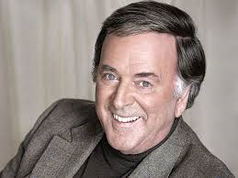
Notes:
Terry Wogan, ?pancreatic cancer, 77

Slide 7
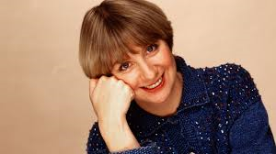
Notes:
Victoria Wood, ?breast cancer, 62

Slide 8

Notes:
Alan Rickman, Pancreatic Cancer, 69

Slide 9
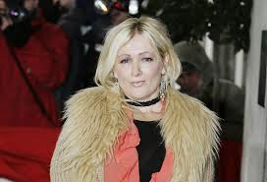
Notes:
Caroline Aherne, Lung cancer (retinoblastoma, bladder cancer) 52

Slide 10




Slide 11
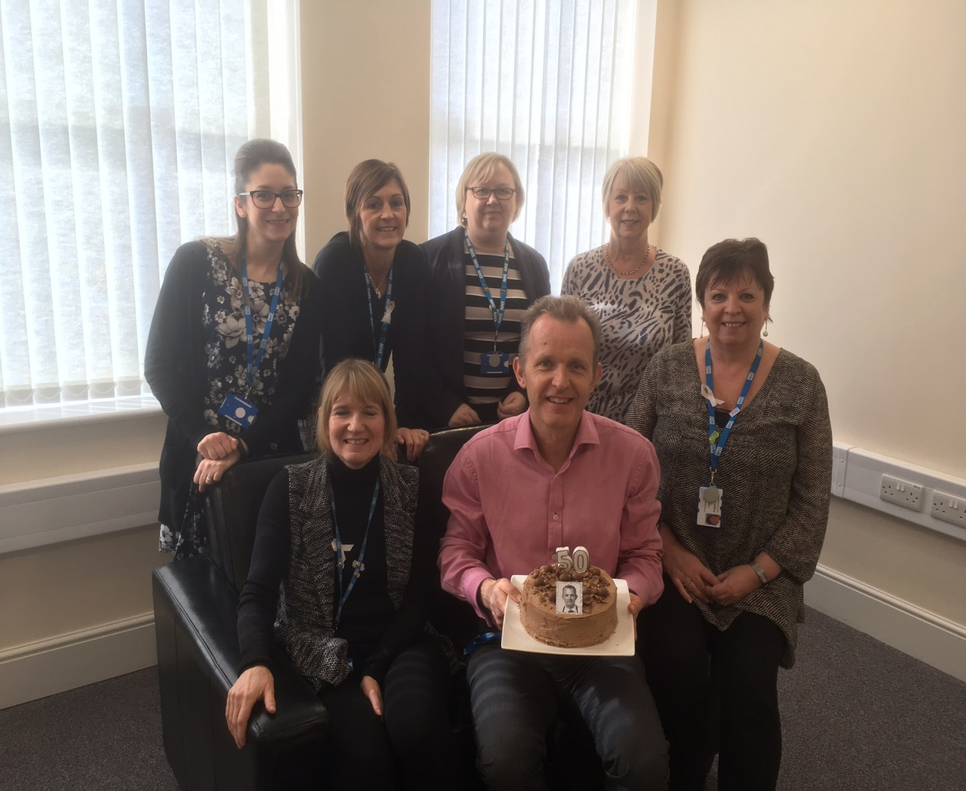
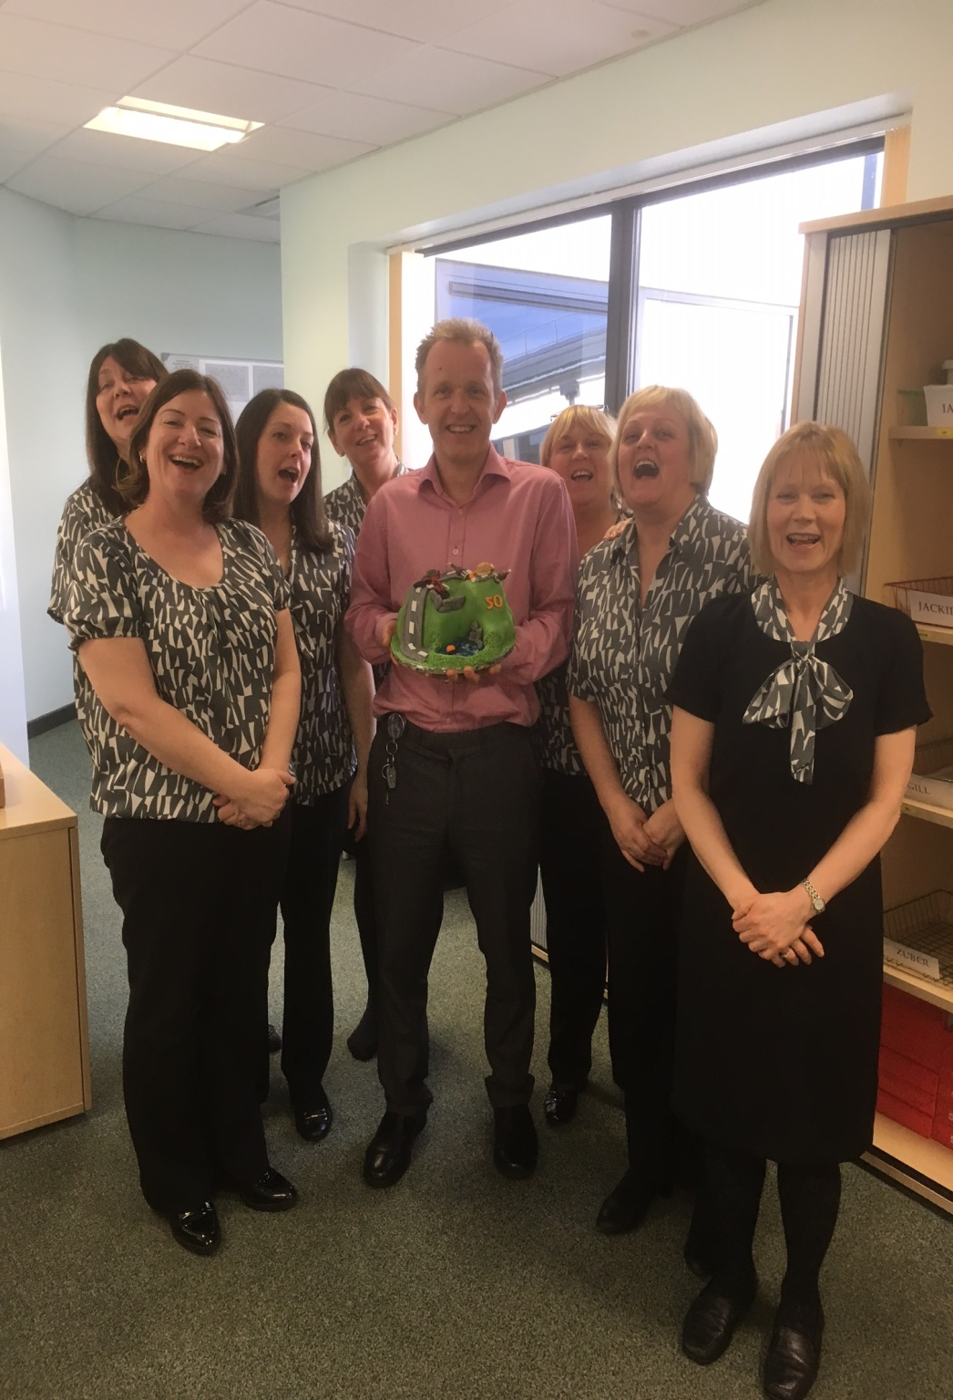

Slide 12

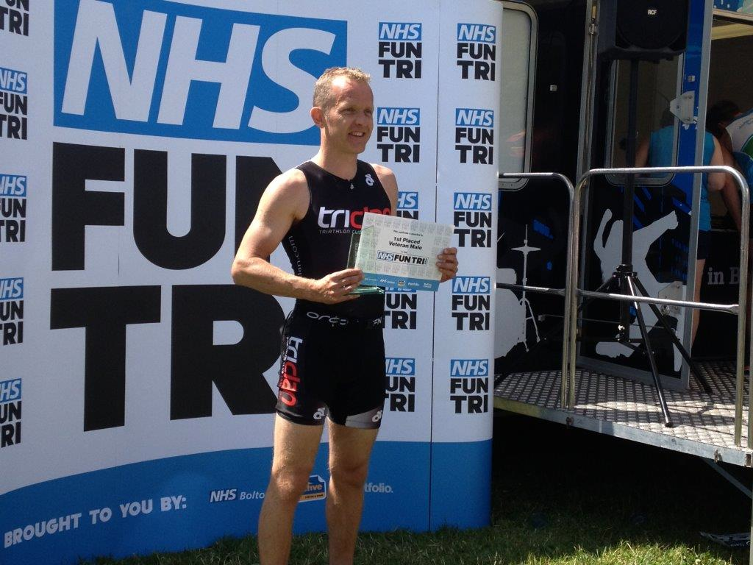
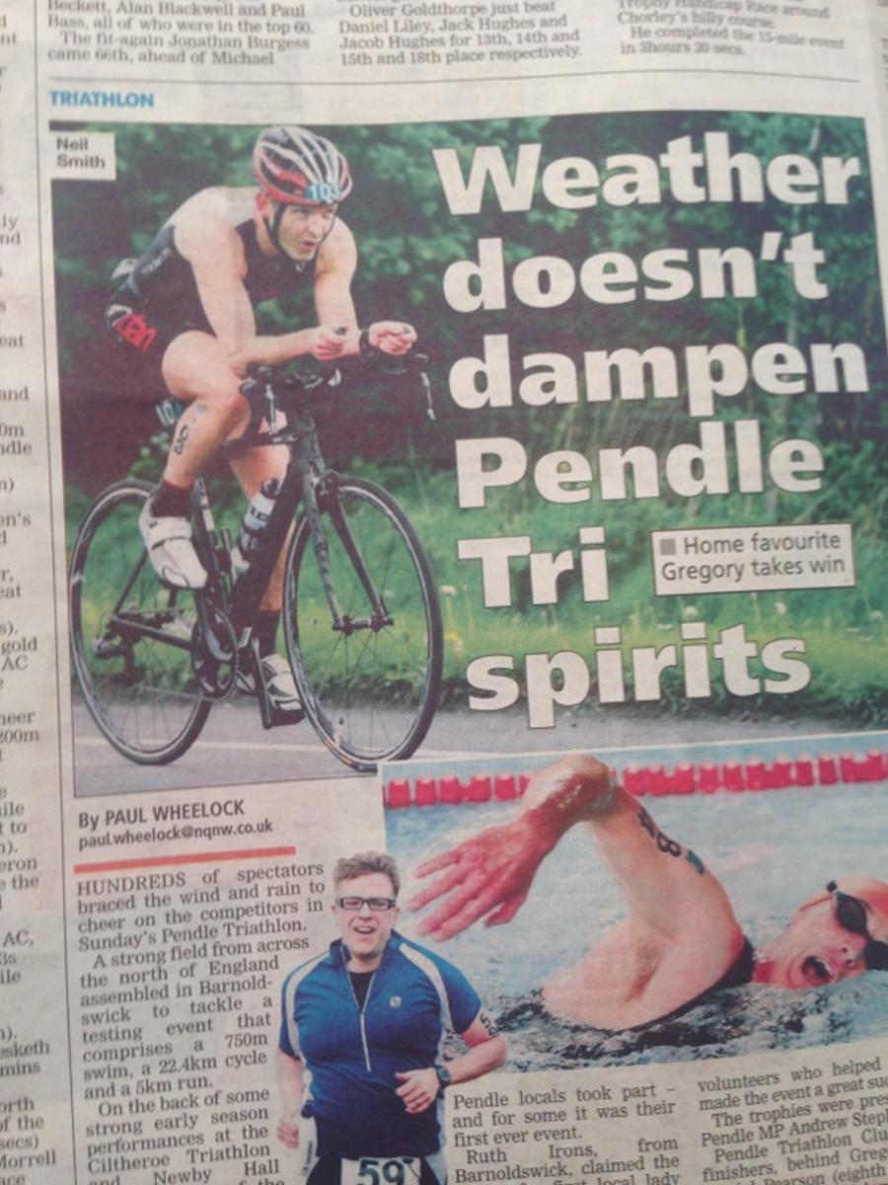

https://www.justgiving.com/fundraising/Neil-Smith27

Slide 13



Notes:
Nick Buckley, Teressa Roberts, Ian Moodie

Slide 14
Cancer Care Action & Implementation Plan
Referral Pathways
Primary Care Responsiveness
Diagnostic Pathways
Integration
Communication
Education
Assessment &
Management
Patient Awareness
Integrated
Cancer
Treatment
Health &
Wellbeing
Living with
& beyond
Cancer
Screening
Recovery & Survivorship
End of Life
Care
Prevention
OUTCOMES: Reduce Health Inequalities - Reduce Premature Mortality - Improve Patient Experience

Slide 15



https://www.youtube.com/watch?v=YoDh_gHDvkk
20-50

Slide 16
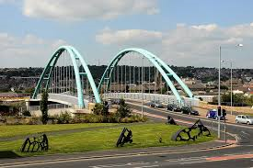
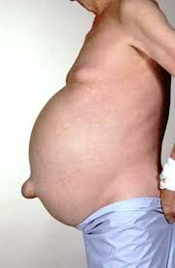
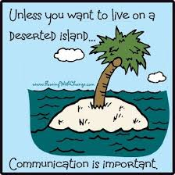

Slide 17


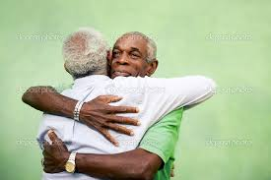

Slide 18
SHOULD WE MAKE 2WW REFERRALS
Neil Smith 2017

Slide 19


Direct correlation between G.P.s propensity to use 2ww and reduced mortality
High referrals rates saves lives!
Reduced emergency presentation
Access to diagnostic test makes a difference

Slide 20
WE REFER LESS THAN AVERAGE

Slide 22
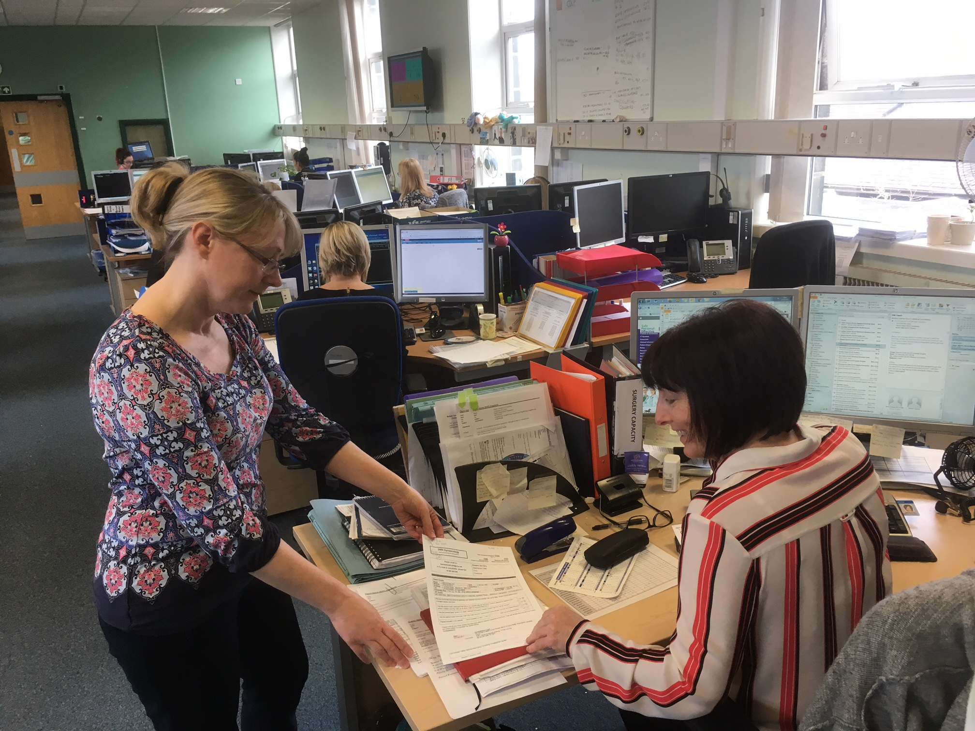


Slide 23
Referrals per tumour group

Slide 24
WE HAVE GOOD CONVERSION RATES

Slide 25
Notes:
If a G.P. does a test first (FBC, CXR, PSA, USS) the conversion rate is higher

Slide 26
WE HAVE GOOD ROUTE TO DIAGNOSIS

Slide 27
WE HAVE LATER STAGE OF DIAGNOSIS

Slide 29
WE HAVE POORER ONE YEAR SURVIVAL RATE

Slide 30
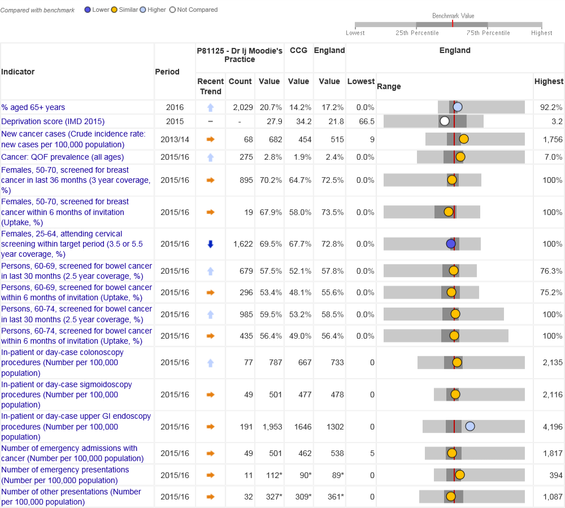
https://fingertips.phe.org.uk/profile/cancerservices/

Slide 31
CONCLUSION- THANK YOU!
We work in a challenging area at a challenging time
We do a very good job
We could refer and investigate more efficiently and effectively
Opportunity to save more lives

Slide 32
BETTER PATIENT PATHWAYS FOR SUSPECTED CANCER
Neil Smith 2017

Slide 33




Slide 34

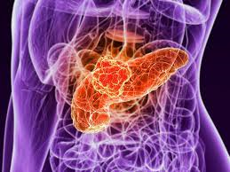
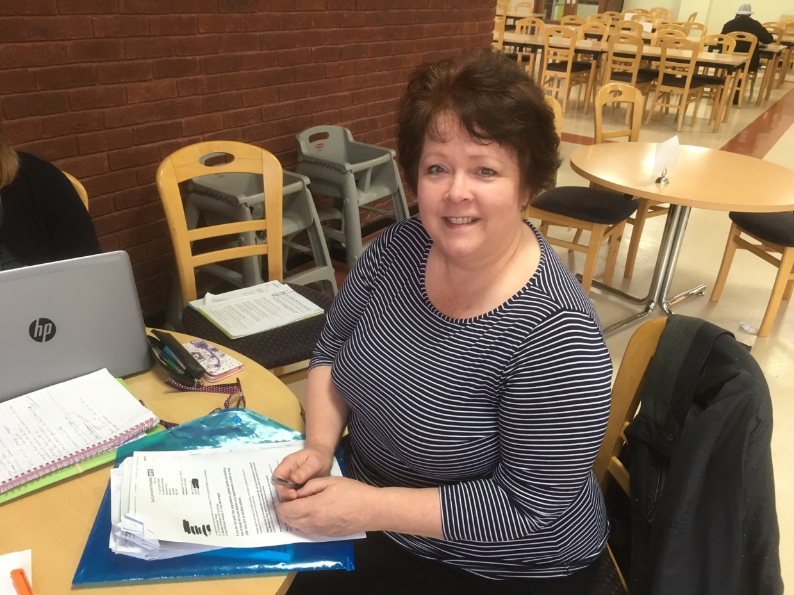
G.P. FEEDBACK CLINICAL CASES

Slide 35
5 COMMON AND CHALLENGING CANCERS
Facts on cancer
Request to the speaker
5 minute presentation
Questions and answer

Slide 36
DERMATOLOGY REFERRAL DATA
Number 2WR 2521 +++
Conversion rate 197 8% =
Numbers of new cancers 342 ++
Percentage diagnosed by 2WR 58% +
Stage diagnosis 1 or 2 67.2% ++

Slide 37
SKIN QUESTIONS -Neil Smith
What should we do about BCCs?
What do we do when a skin lesion does not fit the criteria but we are still worried?

Slide 38
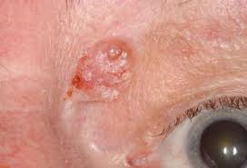
New Intermediate Skin Referral Form Suspected BCC & benign moles of concern
Suspected Basal Cell Carcinoma
Is the lesion on the upper eye lid?
Is the lesion rapidly growing?
Benign moles / pigmented lesions Where 2WR is not indicated but there is concern or uncertainty.
Please send this referral, within 24 hours, to the Intermediate Service (not 2ww)

Slide 39
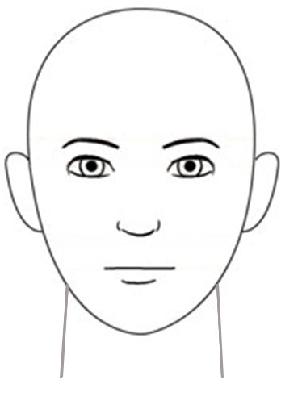
IMPROVED 2WR SKIN 2017
MELANOMA- Refer patients scoring 3 points or more:
Growing in size (2 pts)
Irregular shape(2 pts)
Irregular colour(2 pts)
Largest diameter 7mm or more (1 pt)
Inflammation(1 pt)
Oozing (1 pt)
Change in sensation(1 pt)
Measure the lesion in mm
Show if on head and neck

Slide 40
REMINDER ABOUT INVESTIGATIONS
USS at same time as referral-
ICE change from routine to 2WW CANCER
Gynaecology PMB & suspected ovarian
Urology testicular lump
Jaundice
Bloods before
Jaundice LFT
Gynaecology Ovarian Ca125
Urology Prostate PSA x2
CT U&E, eGFR

Slide 41
LUNG
Number 2WR 610 -
Conversion rate 29% +++
Numbers of cancers 401 +++
Percentage diagnosed by 2ww 44.4%
Stage diagnosis 1 or 2 35% ---

Slide 42
LUNG QUESTION- Fawad Zaman
How can we work together to ensure all patients with lung cancer are diagnosed within 28 days of a G.P. referral?

Slide 43
Malignancy Unknown Origin
MUO- Malignancy unknown origin- scan
CUP- Cancer of Unknown Primary- test +++
10000 cases in UK per year
50 cases in Pennine Lancashire
3% all cancers
6% cancer deaths- 5th most common

Slide 45
MUO QUESTION- Ana Ferreira
What can a G.P. do if they have a high index of suspicion of a malignancy of unknown origin?

Slide 46
MUO/CUP
Malignancy of undefined primary origin (MUO): metastatic malignancy identified on the basis of a limited number of tests, without an obvious primary site, before comprehensive investigation.
Provisional carcinoma of unknown primary origin (provisional CUP): metastatic malignancy identified on the basis of histology or cytology, with no primary site detected despite a selected initial screen of investigations, before specialist review and possible further specialised investigations.
A lower percentage of CUP patients are diagnosed through GP referral (19% compared to 27% for all cancers).
Higher percentage of patients diagnosed with CUP presented as an emergency (57%) compared to all cancers (23%)

Slide 47
SUSPECTED MALIGNANCY OF UNKNOWN ORIGIN -1
Patient presents to their GP with suspicious symptoms
High index of suspicion of MUO
Does not fit site specific 2WW criteria
E.g. Unexplained weight loss, pain, palpable mass,
Severe constitutional symptoms
GP to arrange minimum baseline tests:
FBC, U&E, eGFR, ESR, LFT, TFT, Calcium, CRP, Urinalysis, Chest X-ray
Abnormal or normal test results and obvious primary cancer site
Abnormal or normal test results but no obvious primary cancer site GP still highly suspicious of cancer

Slide 48
SUSPECTED MALIGNANCY OF UNKNOWN ORIGIN - 2
GP to arrange contrast CT chest-abdo-pelvis, 2WW CANCER (essential to have U&E, eGFR)
MRI reported as bone metastases
CT scan reported and results documented by radiologist
GP to review the patient
Communicate with patient
Consider potential primary

Slide 49
SUSPECTED MALIGNANCY OF UNKNOWN ORIGIN - 3
GP Options
Normal CT or benign disease
Primary cancer site identified
Malignancy of unknown origin suspected on basis of CT or MRI scan/Unequivocal findings
Refer according to standard two week suspected cancer referral pathways
Refer as 2WR malignancy unknown origin
Referral triaged by
Oncologist
Appointment made
On going
Management by the patient’s GP

Slide 50
CHALLENGES of MUO PILOT
Overwhelm radiology department- too many CT scans
Only accepted after CT/MRI scan
Only one CUP consultant
Availability (holidays, study, sickness)
Capacity in clinics

Slide 51
PAEDIATRIC 2016
Number 2WR 112
Conversion rate 0%
Numbers of cancers 7
Percentage diagnosed by 2ww 0%

Slide 52
PAEDIATRIC QUESTION- Vanessa Holme
How can you help us
diagnose cancer in children?
assess a child with lymphadenopathy?

Slide 53
Diagnosing Paediatric Cancer
Dr Vanessa Holme
Consultant Paediatrician
Lead for Haematology and Oncology

Slide 54
Children’s Cancer
V Rare 1:500 Children/year in UK
Everyone worries about missing it
Very Different from adult cancer
Very Variable Presentation
Very low pick up from 2 week wait referrals

Slide 55
Types of Childhood Cancer
Leukaemia (ALL & AML)
CNS Tumours
Lymphomas
Soft Tissue Sarcomas
Neuroblastoma
Renal Tumours
Bone Tumours
Germ Cell Tumours
Retinoblastoma
Hepatic Tumours
Others

Slide 56
Important Features
Tend to be fast growing
Child often well except Leukaemia
Parental concern is relevant
Isolated lymphadenopathy rarely a presentation in young children

Slide 57
Lymphadenopathy
Red Flags:
Supraclavicular nodes
Size greater than 2 cms.
Fixed to underlying structures
Weight loss of more than 10%
Abnormal Chest X-ray
Drenching night sweats(although this is rare)
Progressive enlargement
Persistent fever.

Slide 58
Take Home Messages
Paediatric Cancer Rare
Many Different Presentations
If Concerned – Pick up the Phone
Clic Sargent e-learning module
http://elearning.rcgp.org.uk/cancercyp

Slide 59

SCOTTISH CHILDREN
3 strike rule- unresolving physical symptom
Neurology- behaviour change, deterioration in normal activity or school performance

Slide 60
LOWER GI 2016
Number 2WR 2,201 +++
Conversion rate 5% --
Numbers of cancers 252 +
Percentage diagnosed by 2WR 44% --
Stage diagnosis 1 or 2 67.2% ++

Slide 61
LOWER GI QUESTION- Adnan Sheikh
How can we improve the service we offer for patients when we suspect they may have colorectal cancer?

Slide 62


Slide 63
IMPROVING COMMUNICATION BETWEEN PRIMARY AND SECONDARY CARE
Neil Smith 2017

Slide 64

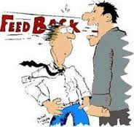
“Inappropriate”
“Not acceptable”
“Unprofessional”
“I’m not your house officer”

Slide 65
Consultant want
To see the right person/ time/ place
To add local advice to NICE guidelines
To have enough information to be able to make a decision
Patients to be aware of suspected cancer
To sort patients out efficiently
To be able to communicate with G.P.s

Slide 66
BEST ADVICE FOR INVESTIGATIONS AND REFERALS FOR CANCER
Referral forms
Patient engagement
Clinical communication
Responsibility to patients
Cancer pathways

Slide 67
G.P. feedback
Independent review of SEA emergency cancer diagnoses (2014/15)
Recommendations for secondary care best practice (2016)
Analysis of >150 SEA cancer diagnoses (2016/17)

Slide 68
G.P. want- Better clinical communication CANCER
Provide direct access for G.P.s to tumour consultants and CNSs.
Consultants offer constructive clinical feedback to G.P.s.
Consultant- consultant cancer referral rather than return to G.P.
Offer prompt communication from ELHT to G.P.s about what is happening to the patient (especially at MDT).

Slide 69
“I was wondering whether the cancer team could do anything about an issue we have had in our practice about hospital results??
We are finding more and more patients are being told by the hospital to contact their GP for their results for tests done at the hospital for example biopsy or scan results - this then involves us looking on the ICE system and interpreting the result, but sometimes we do not feel we are the best people to be doing this, and that it should be the hospital specialist, but patients are struggling to get through to anyone at the hospital to get their results so are left worrying.
Is this something you could help with?”

Slide 70
G.P. want- Better clinical communication HOSPITAL CONSULTANTS TO:
Take responsibility for acting on the results their own investigations (Hospital initiated test results should not be passed to G.P.s to either communicate or act on)
Take responsibility for communicating with patients they are dealing with.
Take responsibility for sorting patients out.

Slide 71
Improving Communication between Primary and Secondary Care
Preeti Shukla

Slide 72




Slide 73
NHS Contractual Changes
In response to ‘Making Time in General Practice’ research which revealed 4.5 % of GP appointments are taken up in re arranging hospital appointments, chasing up discharge letters and details of changes in medication.
It amounts to 13.5 million appointments a year, freeing this time would enable GP's to see patients quickly thus reducing the likelihood of A/E attendances and Emergency admissions.

Slide 74
Local Access
Informing patients of cost of treatment /investigations
Patients discharged to GP on missing appointment only if clinically appropriate
Text Service being rolled out

Slide 75
Discharge Summaries
A/E discharge letter recommendations :
a. change from 'GP for further management' to 'Contact GP if any concerns'
b. GP action section
c. Refrain from advising patients for referrals/investigations

Slide 76
Clinic Letters
All letters to be sent electronically ASAP.
Standardised identification of
a. When a letter is for information only
b. When it requires action.

Slide 77
Onward Referral of Patients
For a non –urgent condition directly related to original complaint, please refer on to another professional and there is no need to refer back to GP.
Re-referral for GP approval is only required for onward referral of non –urgent unrelated conditions

Slide 78
Medication on Discharge
Minimum 7 day supply.
Consider amending pink prescription asking patients NOT to attend GP for the medication and colleagues to reiterate this to patients.

Slide 79
Results and Treatment
Clinician requesting investigation responsible for informing patients in a timely manner- Major concern with Cancer/gynaecology/endoscopy
Pre-op clinic

Slide 80
Sick notes
Following surgery/procedure please give sick note for entire duration considering the job of the patient

Slide 81
1. Poster in OPDs, junior doctor induction packs & wards reminding them of their contractual obligations
2. Roll out of ‘Connect’ from 1st April and a governance system to monitor issues.
3. Memo again to all consultants
​4. New discharge letters with 'GP action’ at bottom in 2 weeks

Slide 82
Thank you
Preeti Shukla

Slide 85
CONSTRUCTIVE SUGGESTIONS FOR PRIMARY CARE
Ask for clinical advice from consultants.
Receive feedback and support on the quality of the referral.
Reflect on feedback and support from consultant on clinical issues following a 2ww referral.
Let us train a practice cancer champion to help administer the process for you.

Slide 86
CONSTRUCTIVE SUGGESTIONS FOR SECONDARY CARE
Be contactable by G.P.s for clinical advice. "LeadCancerClinician@elht"
Offer feedback and support to G.P.s on clinical issues following a 2ww referral.
Utilise consultant- consultant referral
Be responsible for results and patient communication.

Slide 87
https://www.youtube.com/watch?v=sI66hcu9fIs

